Slide 1
What you can expect at the #DPS2020 Virtual Meeting

Slide 2
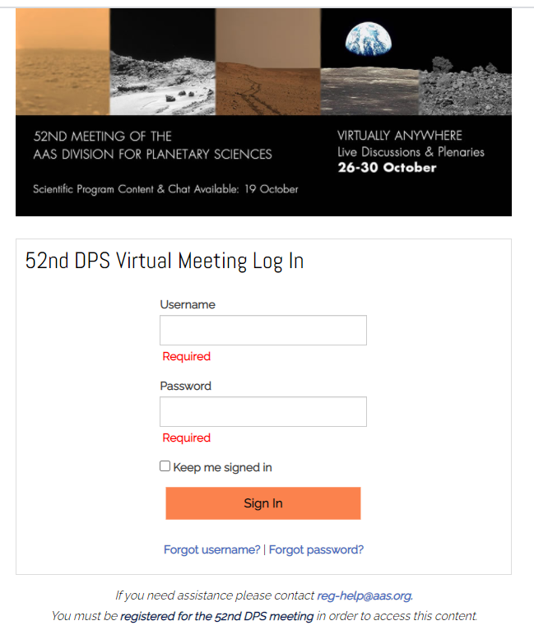
On October 19, we will send you an invitation to join the meeting platform. Start by logging in with the same username and password you used to register.
If you need assistance logging in, please contact reg-help@aas.org

Slide 3
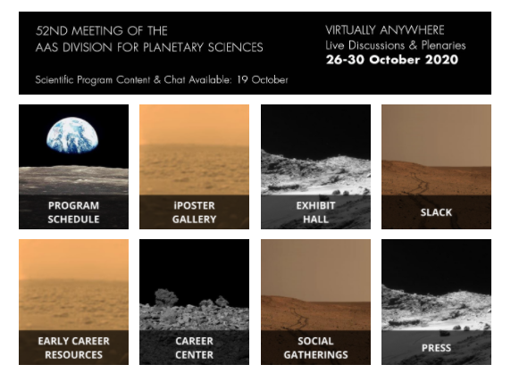
Starting October 19, you will be able to view the science sessions, including oral presentations and iPosters, under Program Schedule.

Slide 4
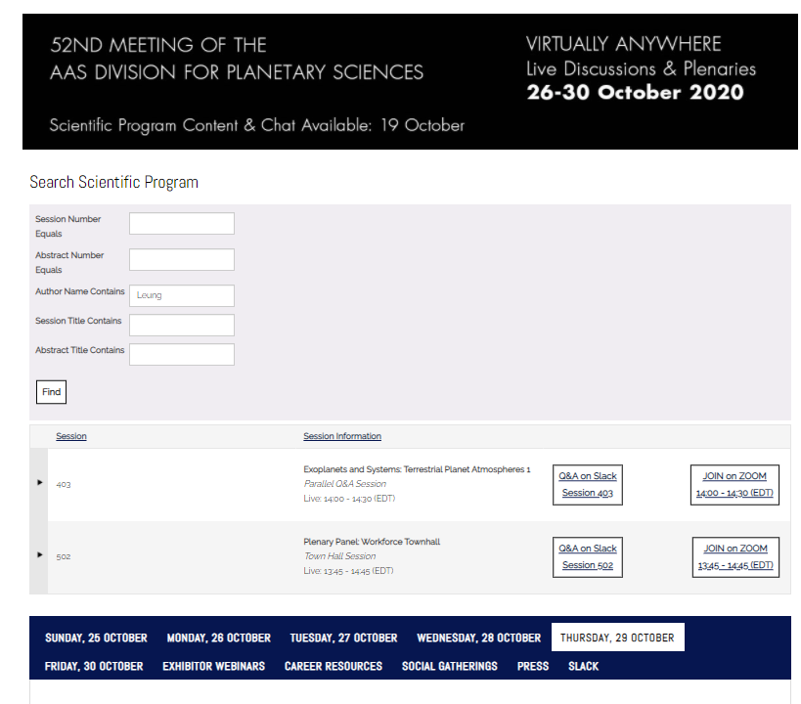
Under Program Schedule, you can:
Search for a session by day
Search for a specific abstract
Search by author
Search by title
Search by words within a title

Slide 5
Expand the session information by selecting the right arrow.

Slide 6
To view oral presentations or iPosters, select recordings under each session.
Have a question for the presenter? Select Q & A on Slack. This is available starting October 19.
To participate in the live sessions the week of October 26, select Join on Zoom at the designated time. Chairs and presenters should use the separate link emailed to them October 19.

Slide 7
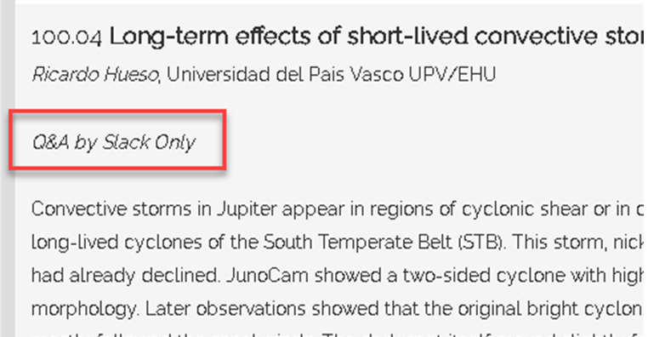
Presenters will either answer questions in the live Zoom session and Slack, or in Slack Only.

Slide 8
Summary of how the zoom sessions will run:
1. Five minutes before the session: chairs and presenters should log on to the zoom webinar with the “panelist” link provided in email by the AAS contractor, “Warp Speed”
2. Opening: Session chairs will introduce themselves and welcome everyone to the session
“Warp Speed” will prepare a summary slide with the session name, presenters’ names, and presentation titles
3. Lightning summaries from each presenter: < 5 minutes
Each of these should be under 60 seconds each; aim to wrap up the set in the first five minutes of the session
Prompts from the session chairs should be something like “what’s the most important take-away / most exciting result from your presentation?”
Presenters should deliver these orally. Do not try to share presenter screens
4. Questions and Answers: ~20 minutes
Audience questions will be submitted via the session slack channel
The zoom chat will redirect participants to the session slack channel, so session chairs can monitor just the slack
Presenters will be encouraged to reserve their answers until the zoom Q&A
Session chairs will select questions from the slack channel and present them out loud and presenters will respond in kind. Again, do not try to share screens.
Chairs will rotate questions among the presenters in order to make sure each presenter gets a chance to address at least one question before the session ends
5. After the session, the Q&A will continue on the session slack channel, where there will be plenty of time for follow-up!

Slide 9
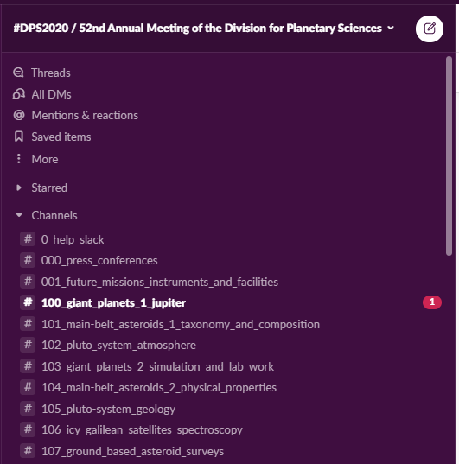
Asynchronous topical discussions will be conducted via Slack, a free and secure messaging service that can be used in a Web browser, in a standalone application on your computer, or via a mobile app available for iOS and Android smartphones and tablets. #DPS2020 discussions are organized by session into Slack “channels” and will be accessible only to registered meeting participants.
Invitations to join the DPS Slack workspace were emailed to all who were registered by October 12. Those who register after October 12 will receive the invitation email within 24 hours after registering.
If you did not receive an invitation to Slack, please contact reg-help@aas.org.

Slide 10
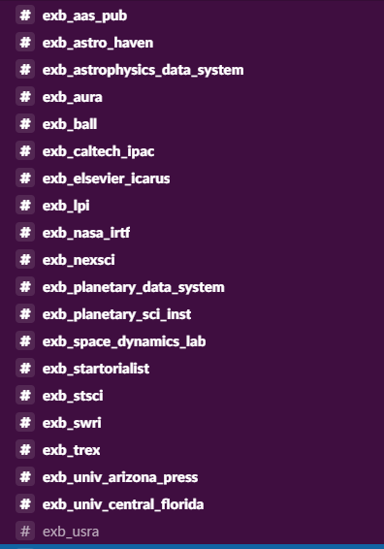
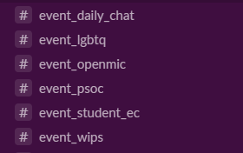
In Slack, in addition to the science sessions, there are channels for exhibitors (prefix #exb), peripheral events (prefix #event) and social events (prefix #).

Slide 11
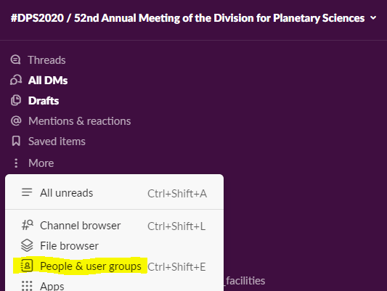
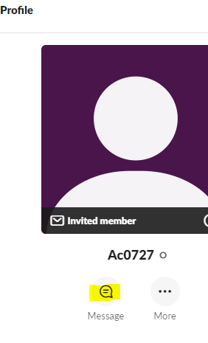
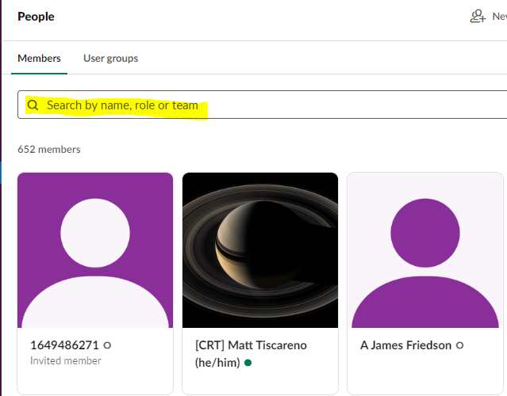
Want to send a direct message to an attendee?
Select more and then People & user groups
Search by name, role or team
Send message

Slide 12
Need help once in Slack? Visit the 0_help_slack channel.

Slide 13
iPosters may be viewed in both the science sessions and iPoster gallery.

Slide 14
Starting October 26, you may visit the Exhibit Hall
Visit the Virtual Exhibit Hall with over 20 institutions and companies represented. The exhibitors have produced interactive virtual exhibits where you can engage with booth staff in their open Zoom Room, schedule an appointment with a member of their team, download and view documents and videos, browse job openings, meet with hiring staff, chat in designated Slack channels and much more!
Exhibits are open and staffed daily, however each day has a designated ‘Interactive Exhibit Hall’ hour when the booths will be fully staffed.
Attend exhibitor webinars right from the exhibit hall!

Slide 15
DPS Career Center
Are you graduating soon? Are you seeking a new position? Perhaps you are considering a change. The DPS has created a Virtual Career Center filled with resources to help you on your career journey. Stop by to view open planetary science positions, view career webinars, download resources and more.
If you are an employer and would like to advertise a position, please submit it for no charge at https://dps.aas.org/node/add/job

Slide 16
Career Resources

Slide 17
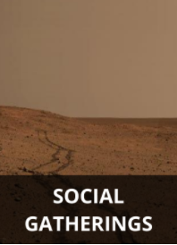
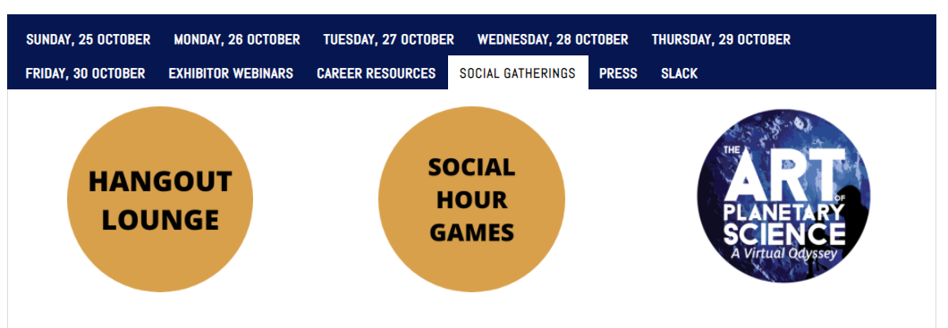
Social Gatherings
Meet up with colleagues in the gather.town Hangout Lounge (anytime)
Play trivia (with prizes!) during Social Hour (Mon-Wed)
Check out Open Mic Night on Thursday
Participate in informal science discussions during Daily Science Chats
Nurture your artful side at the Art of Planetary Science show

Slide 18
Hangout Lounge in Gather.town will be open October 19 to 30.

Slide 19
Daily press conferences via Zoom will be held on Monday-Thursday, 26-29 October, to showcase some of the most exciting discoveries being presented at the meeting.
They’ll also be live-streamed on the AAS Press Office YouTube channel (where you will not be able to ask questions; to do that, you will need to participate via Zoom) and archived there afterward.

Slide 20
Gold Sponsors & Gold Partners

Slide 21
Silver Sponsors & Silver Partners

Slide 22
Bronze Sponsors & Bronze Partners

Slide 23
#DPS2020 Trainings Sponsored by

