Slide 1
Simulating the Brightness of Satellites with Bidirectional Reflectance Distribution Functions (BRDFs)
A Resident Space Object Characterization Capability
Moriba Kemessia Jah, Ph.D.
Associate Professor
Aerospace Engineering and Engineering Mechanics Department
Director
Computational Astronautical Sciences and Technologies
Oden Institute for Computational Engineering and Sciences
The University of Texas at Austin
Daniel Kucharski, Ph.D.
Research Associate
Computational Astronautical Sciences and Technologies
Oden Institute for Computational Engineering and Sciences
The University of Texas at Austin
Notes:
1

Slide 2
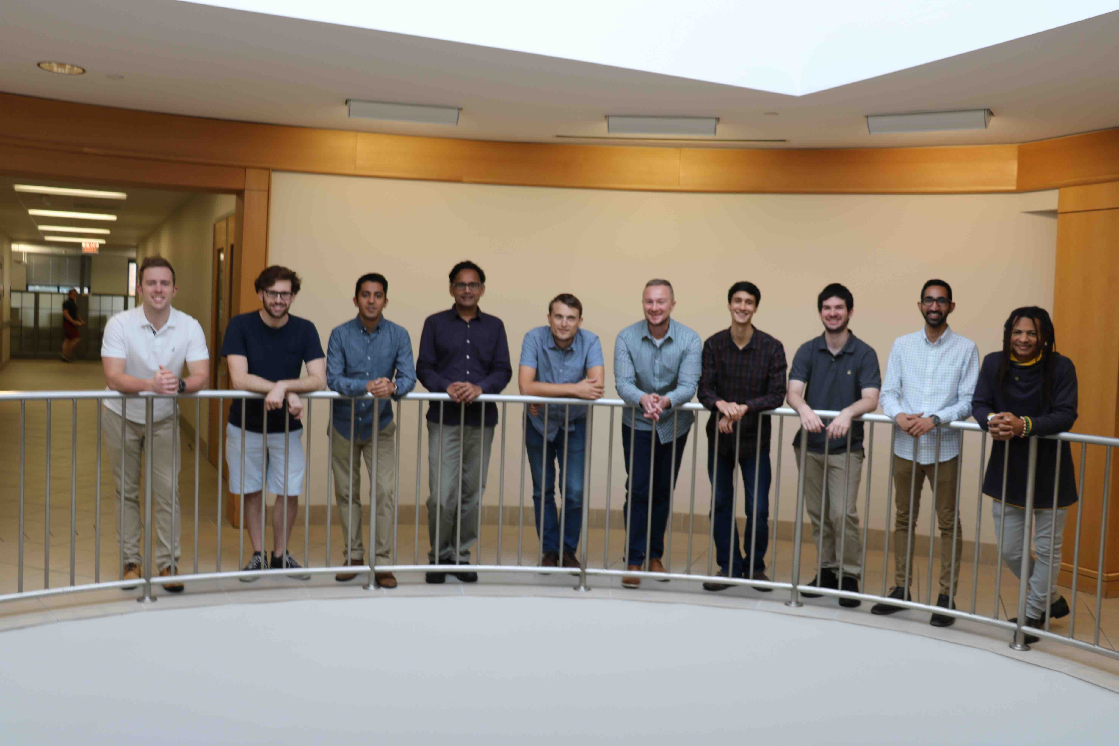

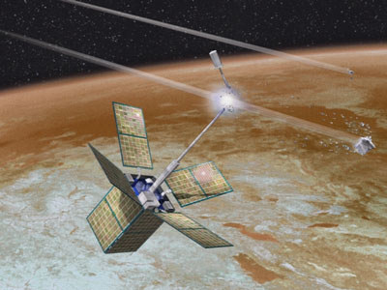
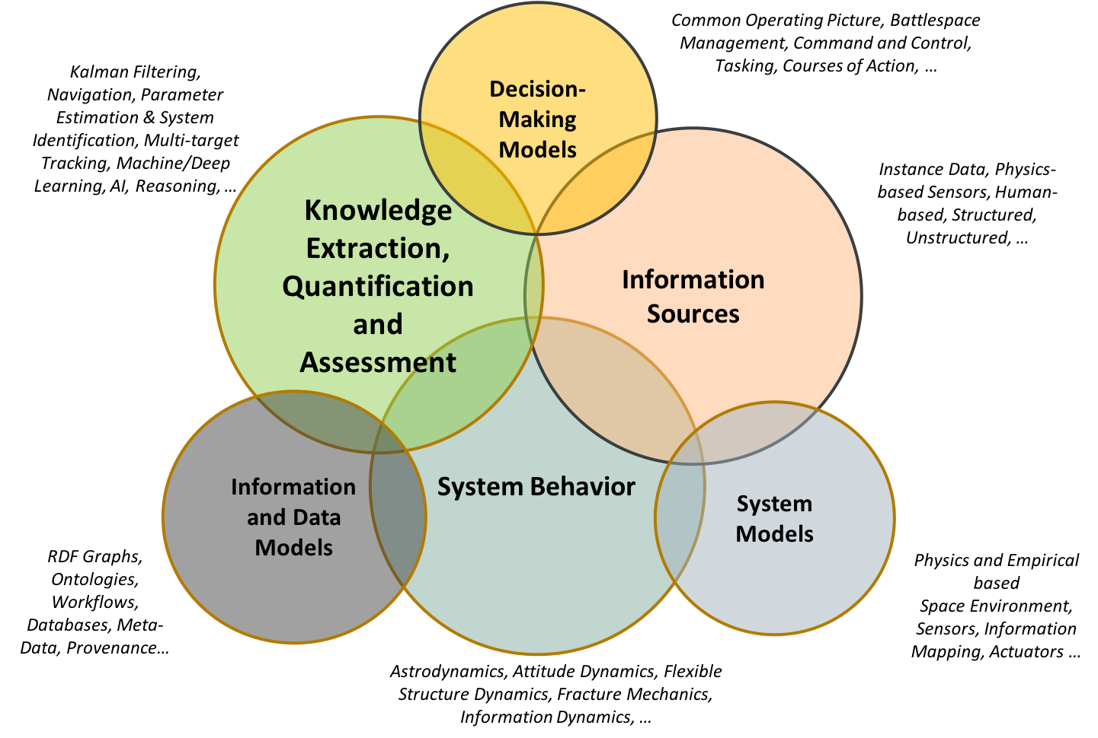
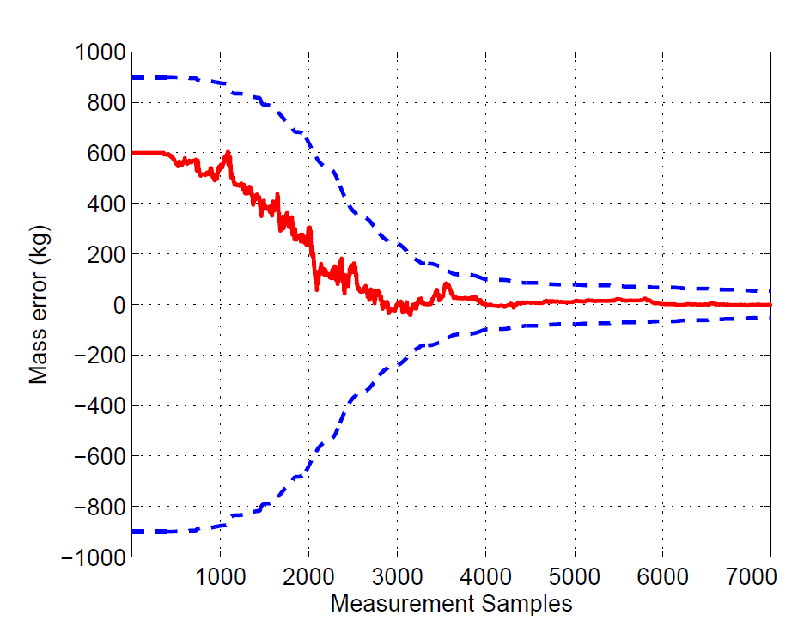
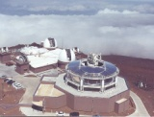


Slide 3
Understanding a Population
“Tag and Track”
Identify individuals of a certain species in the population
Tag those individuals
Formulate initial hypotheses
Track the behavior of those individuals over time, space, and frequency and their interactions with their environment to include individuals of other species
Test hypotheses
Identify correlations
Infer or determine causal relationships

Slide 4
Detecting Vs Tracking

Slide 5
Unique Space Object Identification

Slide 6
Biometrically-Inspired Space Object Recognition (BISOR)

Slide 7



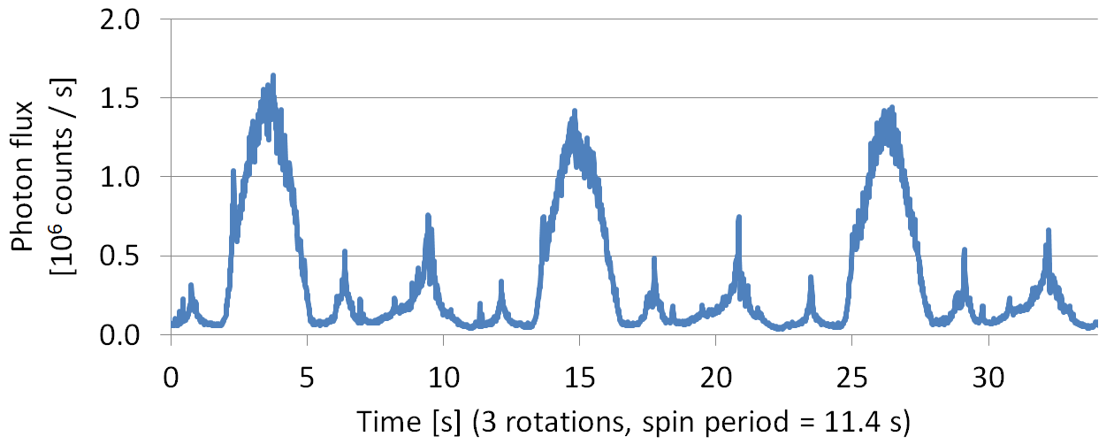

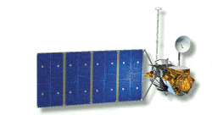
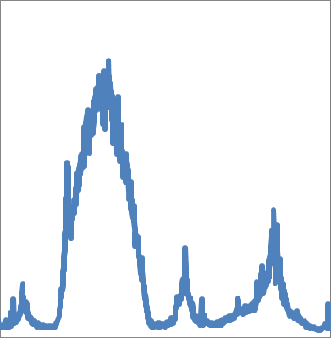
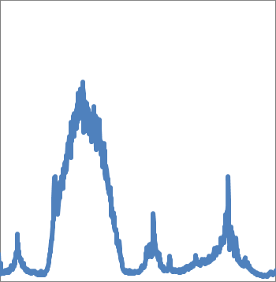
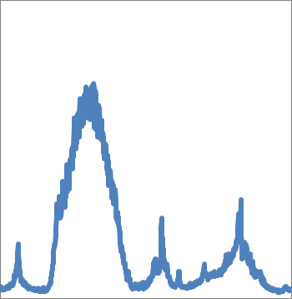

Satellite spin measurement
High rate photometric detectors allow for an accurate spin measurement of the passive, sunlit satellites
a)
b)
c)
Spinning TOPEX/Poseidon light curve
a)
b)
Phase Dispersion Minimization
c)
Spin angle
0°..360°
Time of pass

Slide 8
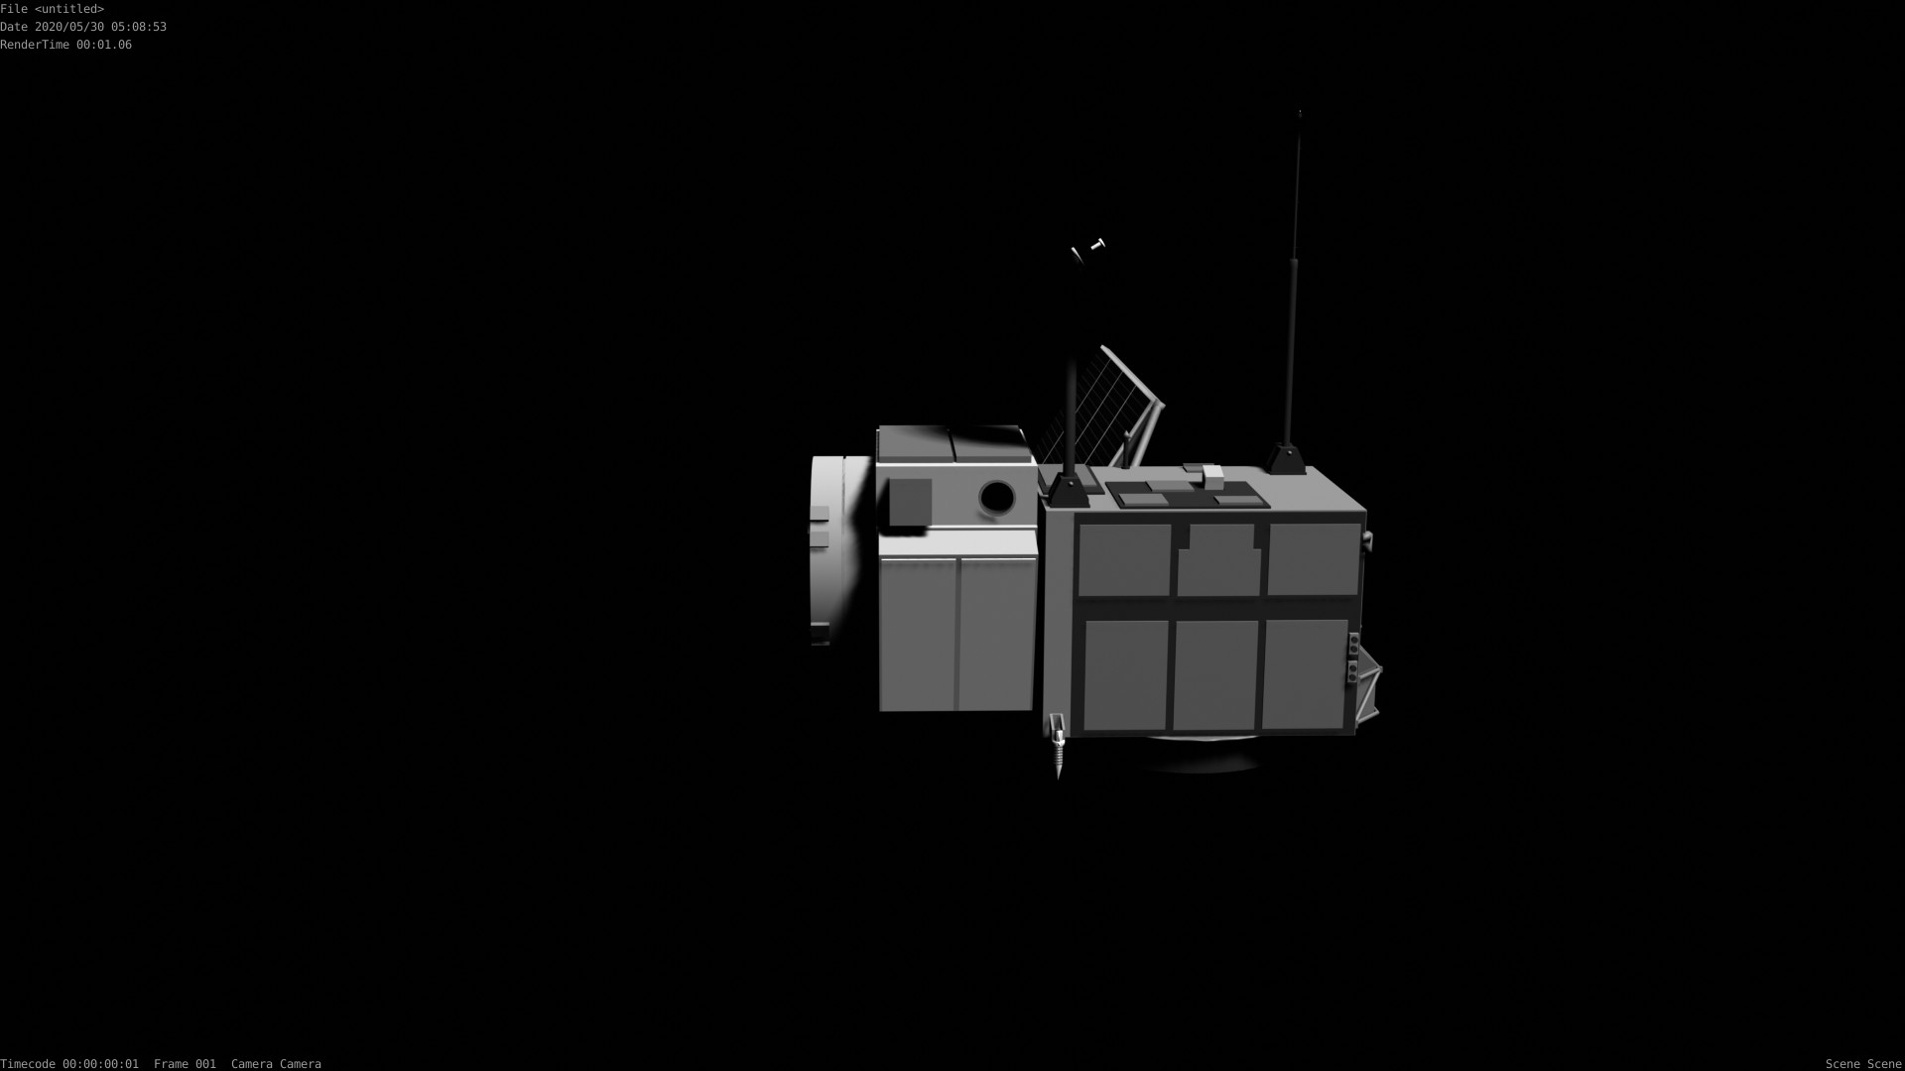

Slide 9
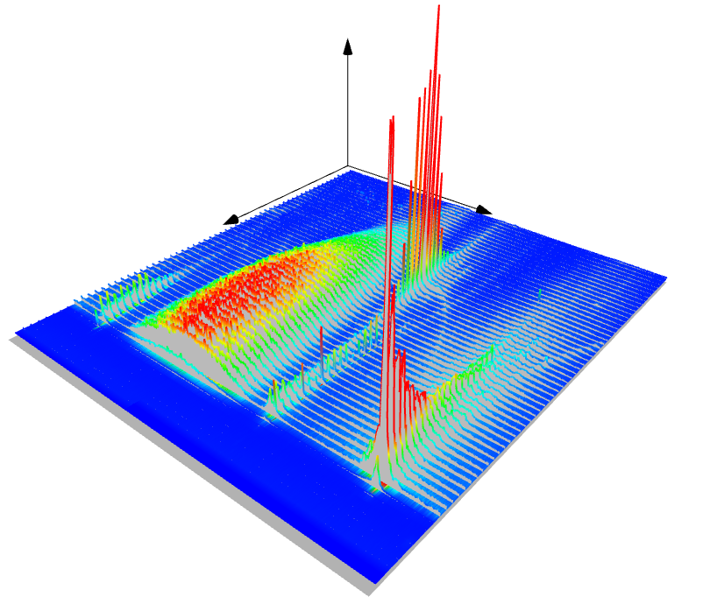
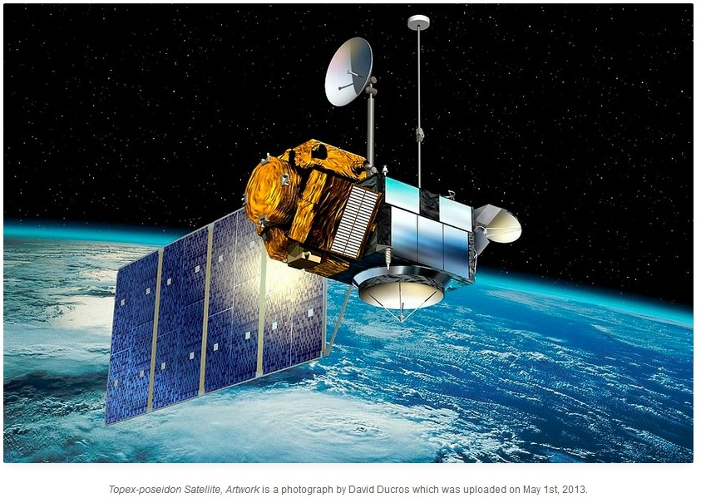
Satellite spin measurement
High rate light curve analysis
TOPEX/Poseidon light curve
- Phase folded pass, 57 rotations (11 minutes)
- mix of specular and diffuse reflections from different sides / surface elements of the spinning body
Brightness
Phase folded light curve
Spin angle (0°..360°)
Time of pass (11 minutes)
TOPEX/Poseidon. Author: D. Ducros
Kucharski et al., Photon pressure force on space debris TOPEX/Poseidon measured by Satellite Laser Ranging, AGU Earth and Space Science, 2017
Notes:
The phase-folded light curve of defunct TOPEX/Poseidon satellite measured with the photon counter at Graz.

Slide 10
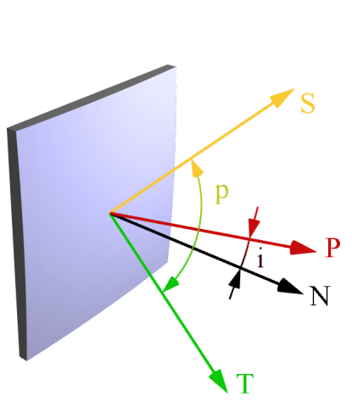
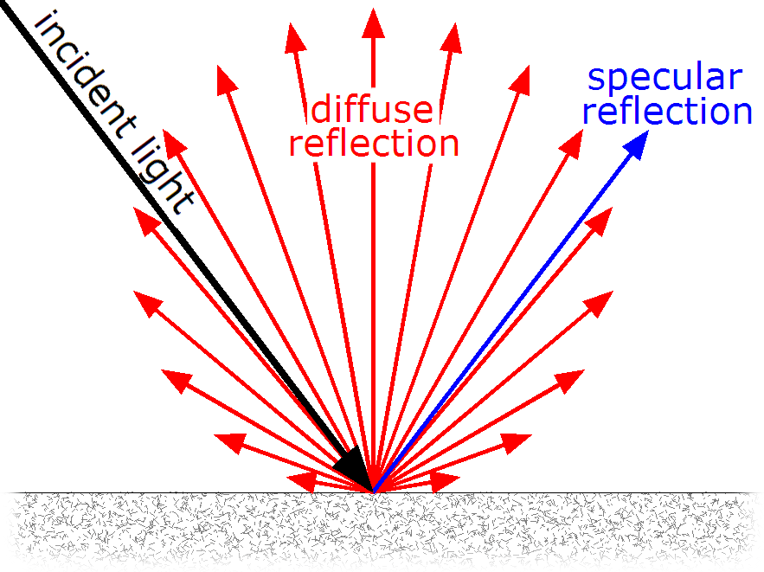
Satellite spin measurement
Specular and diffuse reflections form geometrical patterns
Phase folded light curve
Specular reflection
Diffuse reflection
Brightness
N
Spin angle (0°..360°)
Time of pass (11 minutes)
T
S: sun
T: telescope
P: phase vector = S + T
p: phase angle
i: inclination angle (<0.25°)
BRDF Lambertian model
The intensity of diffuse reflection depends on the angles between Sun, Telescope and the Normal vectors.
BRDF: bidirectional reflectance distribution function; Lambertian model is the most common one.
Kucharski et al., Photon pressure force on space debris TOPEX/Poseidon measured by Satellite Laser Ranging, AGU Earth and Space Science, 2017

Slide 11
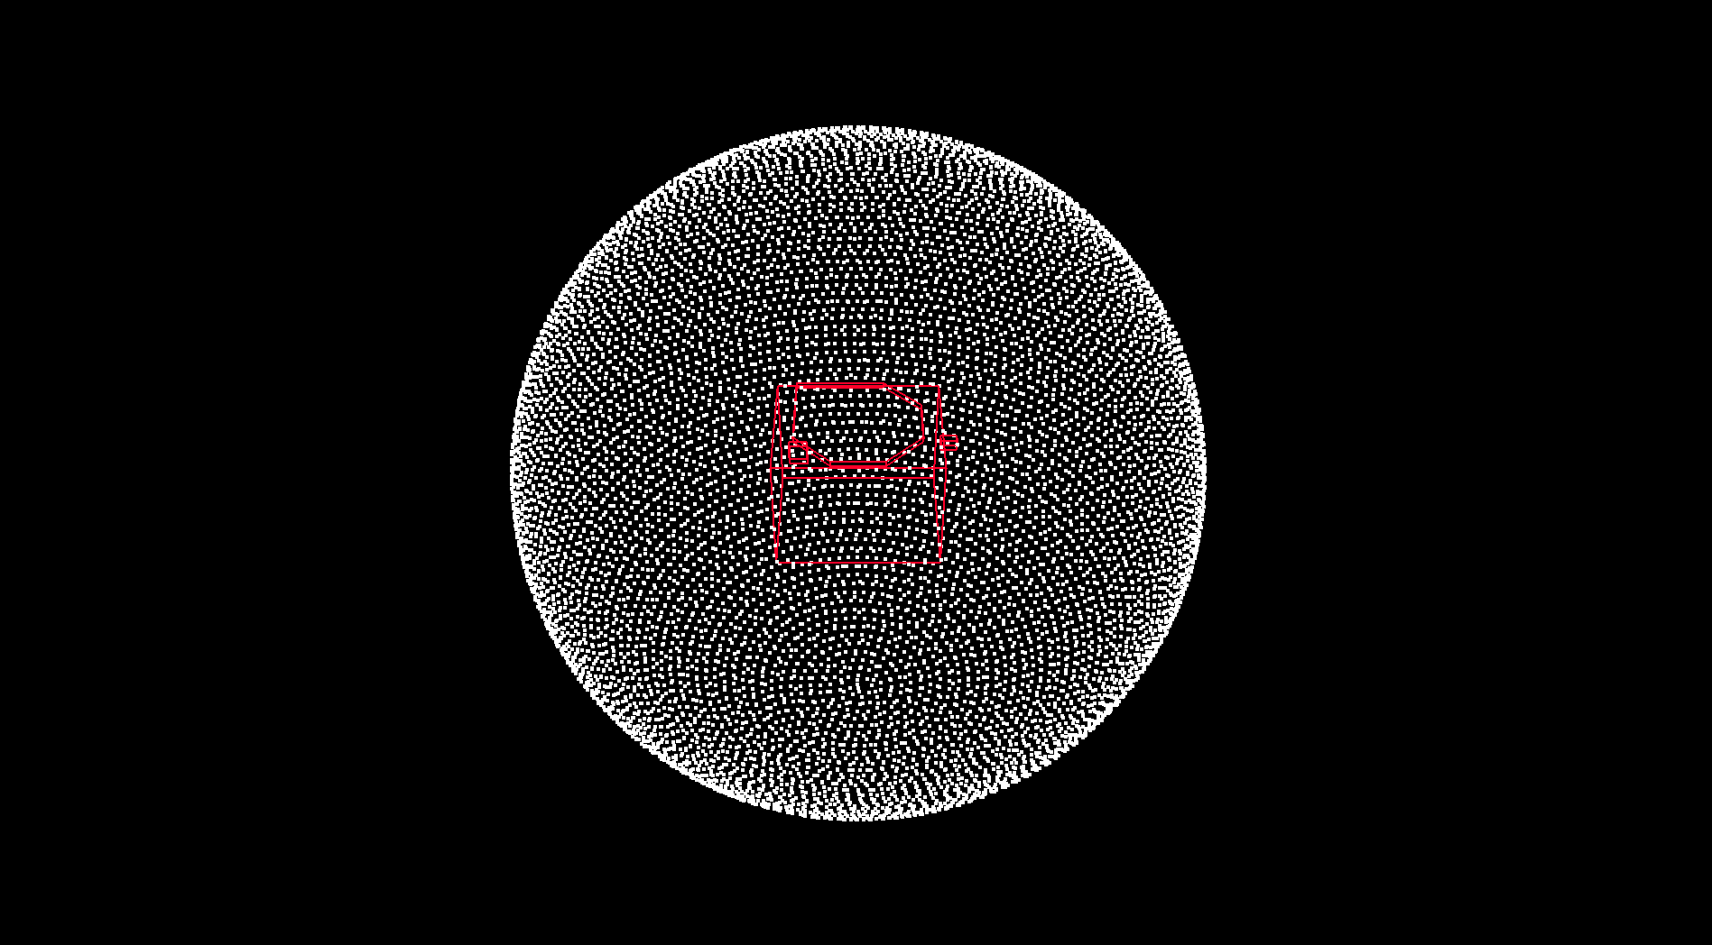
Space Object Centered Celestial Sphere and Mollweide Projection

Slide 12
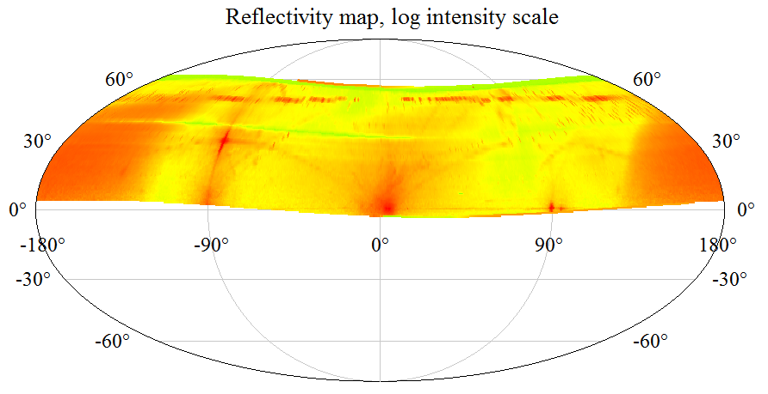

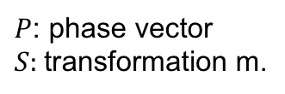
Quanta Photogrammetry (QPM)
HTP generates detailed reflectivity maps by projecting satellite brightness measurements onto a phase vector expressed in the body fixed coordinate system.
Time dependent pattern
(depends on the view angle)
Time independent pattern
(fixed with the satellite body)
$$P_{Body}=S P_{Inertial}$$
Brightness
$P$: phase vector
$S:$transformation m.
Time of pass
Spin angle (0°..360°)
The specular reflection occurs when the phase vector and surface normal coincide, thus the location of the specular reflections in the Body frame is fixed (assuming rigid body).
Kucharski et al., Photon pressure force on space debris TOPEX/Poseidon measured by Satellite Laser Ranging, AGU Earth and Space Science, 2017
Notes:
Projecting single photon light curves on the satellite body –centered and –fixed coordinate system requires the attitude parameters of the satellite to be properly modeled.
This projection produces a heat map of solar reflection intensity wrt the satellite body with the pattern geometry strictly depended on the satellite shape and optical properties.

Slide 13
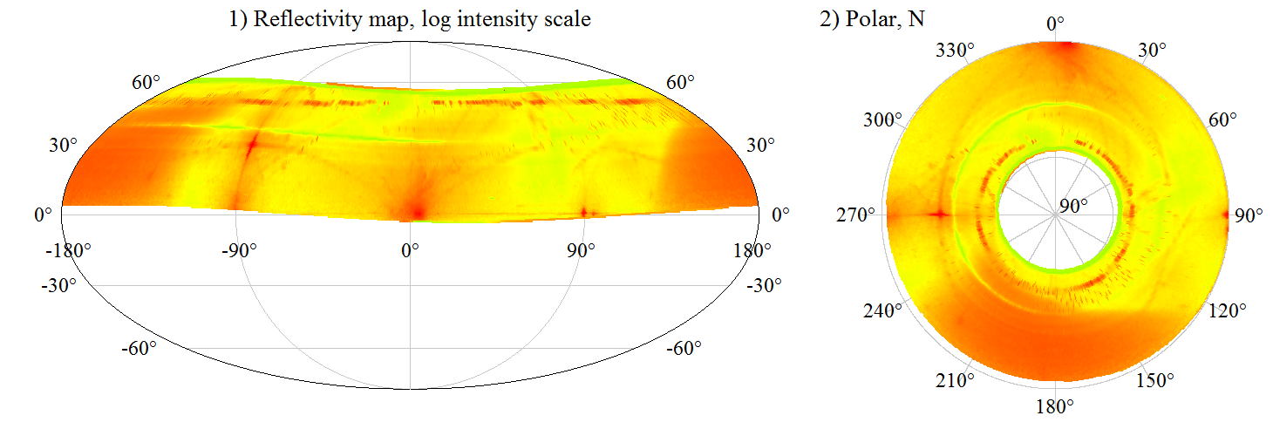

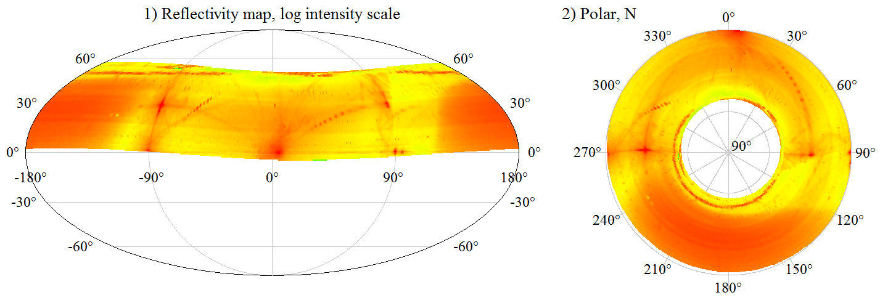
Quanta Photogrammetry (QPM)
2015-July-9
2015-July-10
TOPEX/Poseidon. Author: D. Ducros
Kucharski et al., Photon pressure force on space debris TOPEX/Poseidon measured by Satellite Laser Ranging, AGU Earth and Space Science, 2017
Notes:
The measured heat maps of two different passes.

Slide 14

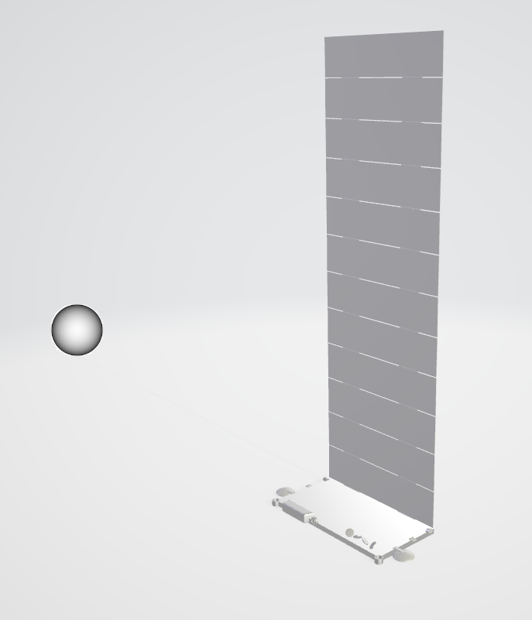
Space Object Light Pollution simulation
In order to estimate the number of solar photons reflected off of a space object and arriving at the ground telescope, a one-way (free-space) optical link budget is modelled.
Lambertian BRDF model is used to predict the reflection intensity of a sunlit satellite surface.
For now, 1-m diffuse sphere approximation is used in the simulations, but this condition will be relaxed as we implement more realistic satellite shapes. We assume a reflectivity of 0.8
The intensity of solar reflection depends on the angles between Sun, satellite surface normal vectors, and the ground observer.
The proper satellite shape model will improve brightness simulations.
N
BRDF Lambertian model
D. Kucharski et al., Hypertemporal photometric measurement of spaceborne mirrors specular reflectivity for Laser Time Transfer link model. Adv. Space Res. 64 (2019) 957-963.

Slide 15
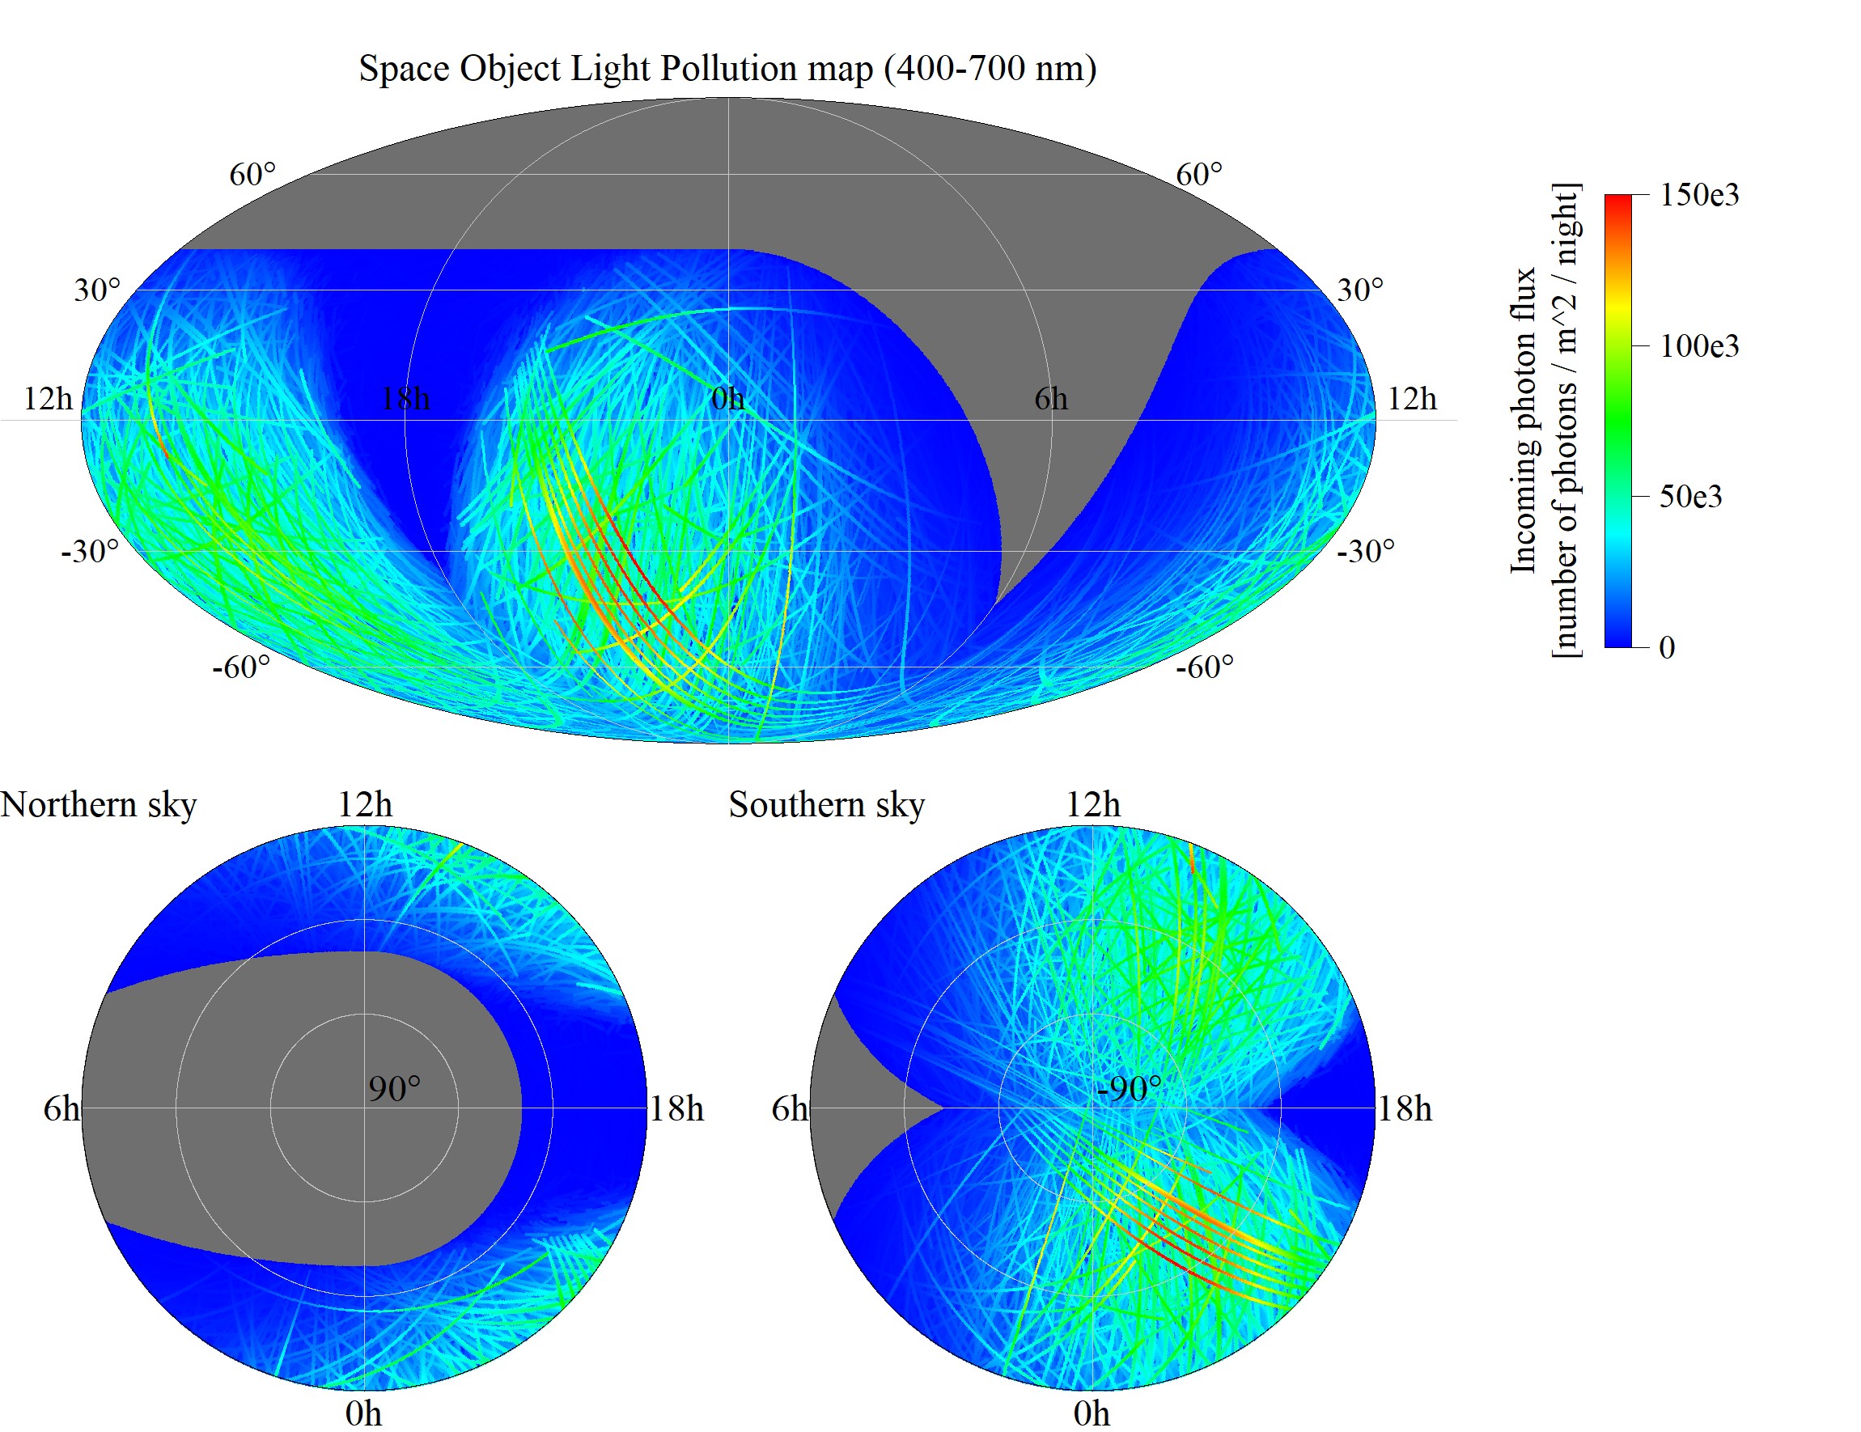
Space Object Light Pollution – all objects
Prediction of the satellites’ passes within the theoretical line-of-sight of a specific ground location allows estimating their brightness and the number of reflected solar photons that “contaminate” the dark-sky.
An example map of a “light pollution” caused by reflective sunlit space objects for Rubin Observatory (nautical night of June 20, 2020) is presented on the graphs.
All satellites from the public catalog are included in this simulation (6568 objects visible above 20° of the local horizon).
The simulated reflection flux is expressed as a number of photons (400-700 nm) arriving at the telescope.
The J2000 geocentric inertial reference frame is used to represent the simulated data, where RA/Dec coordinates indicate the pointing direction of the ground telescope.

Slide 16
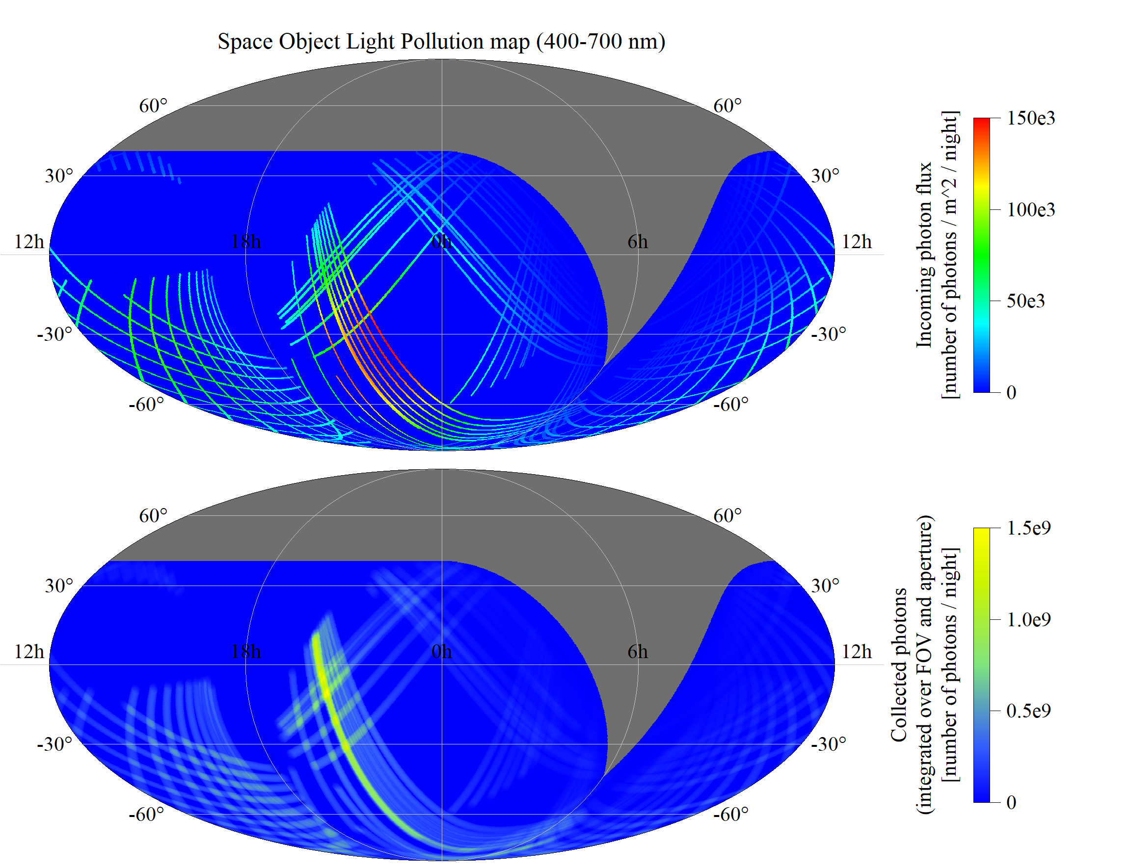
Space Object Light Pollution – Starlink
A simulated “light pollution” caused by the existing Starlink satellites can reach the high intensity levels (Rubin Observatory, June 20, 2020).
Using the Two-Line Element (TLE) data from the public catalog allowed predicting 109 Starlink passes visible from Rubin Observatory on June 20, 2020.
The map indicates that the “light pollution” is not uniformly distributed across the celestial sphere and there are regions of darker sky that could be selected for long exposure imaging during the particular night.
The bottom plot shows the satellite reflection flux integrated over the telescope Field-of-View and the collection surface area (primary mirror) of the ground telescope. The graph indicates that the most polluted parts of the sky are located where the passes cross or overlap.

Slide 17


