Slide 1
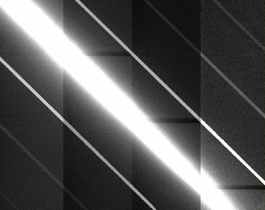
Metrics for Impact on Diverse Astronomical Programs and Recommended Simulation Studies James Lowenthal Smith College SATCON1 SOC and Metrics WG AAS Committee on Light Pollution, Radio Interference, and Space Debris
How bad is it?
How often does it happen?
What is cost to science?
Notes:
We've heard from world experts on how LEOSat constellations will appear in the sky, and what the quantitative effects will be on various kinds of observations, telescopes, and detectors.
What will that mean for science? What kinds of science will be most impacted? Least impacted? What kinds may simply no longer be achievable given the new reality of LEOSat constellations?
Our goal here is to paint a realistic picture of the diversity of astronomical science programs underway and planned and how they might or will be affected by LEOsats, so we can convey that to the NSF, to decision makers, and to satellite operators.

Slide 2
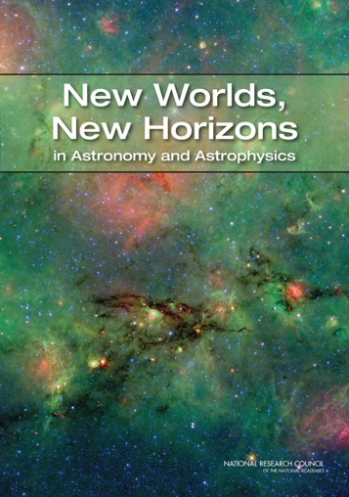
2010 Decadal Survey
Science Frontiers panels:
Cosmology and Fundamental Physics
Galactic Neighborhood
Galaxies Across Cosmic Time
Planetary Systems and Star Formation
Stars and Stellar Evolution
Program Prioritization Panels:
Electromagnetic Observations from Space
Optical and Infrared Astronomy from the Ground
Particle Astrophysics and Gravitation
Radio, Millimeter, and Submillimeter Astronomy from the Ground
NO MENTION OF LEO SATELLITE CONSTELLATIONS

Slide 3
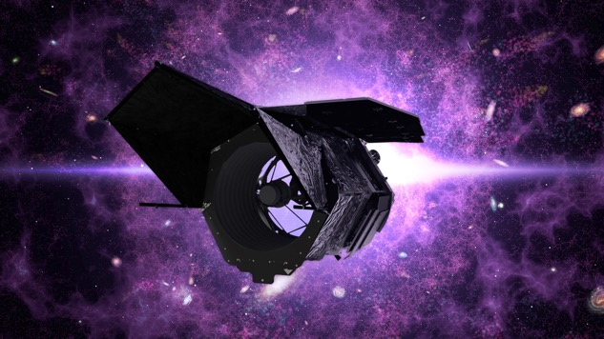
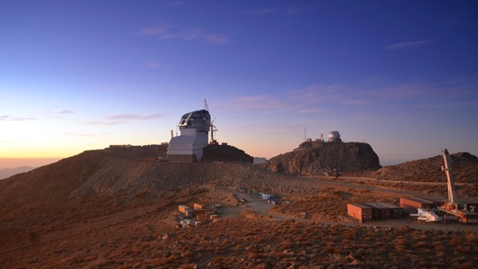
2010 Decadal Survey
2010 recommendations
Space-based, large: WFIRST (, Explorer, LISA, IXO...)
Ground-based, large: LSST (mid-scale, GSMT, ACTA)
WFIRST / Roman Space Telescope
LSST / Vera Rubin Observatory

Slide 4
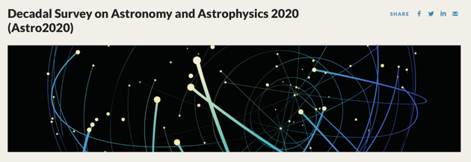
2020 Decadal Survey
Science Panels:
Compact Objects and Energetic Phenomena
Cosmology
Galaxies
Exoplanets, Astrobiology, and the Solar System
the Interstellar Medium and Star and Planet Formation
Stars, the Sun, and Stellar Populations
Program Panels
An Enabling Foundation for Research
Electromagnetic Observations from Space 1
Electromagnetic Observations from Space 2
Optical and Infrared Observations from the Ground
Particle Astrophysics and Gravitation
Radio, Millimeter and Submillimeter Observations from the Ground
April 2020:3-hour panel on Satellite Megaconstellations and OIR Astronomy

Slide 5
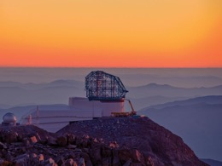
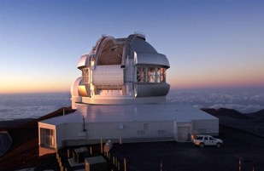
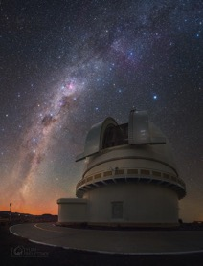
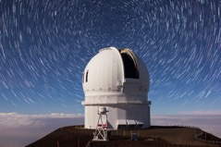
AAS Survey on Satellite Constellations
VRO
Gemini
7 questions, sent Dec. 2019 to major observatories world-wide
23 responses from all continents
Rubin, Gemini, VLT, ZTF, CFHT, Pan-STARRS, APO, HATNet, ATLAS, Steward Obs. UKIRT, Las Campanas, Jodrell Bank, Mt. Stromlo, SOAR…
Large range of impacts, from 0-100% of science lost.
Majority: significant concern; grave challenges to science; significant costs due to 1584 Starlink v0.9 satellites (e.g. Rubin: 15% loss = $210M). Much worse if 10x more sats.
Las Campanas
CFHT

Slide 6
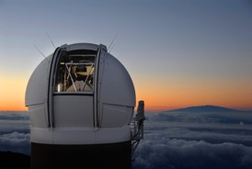
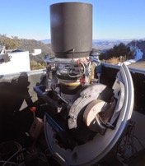
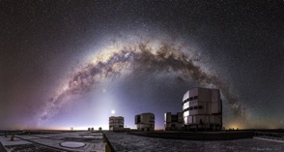
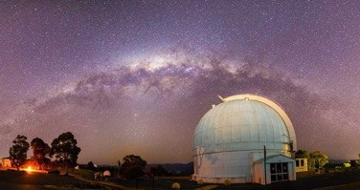
AAS Survey on Satellite Constellations
Pan STARRS
HATNet
https://aas.org/sites/default/files/2020-06/survey_summary.pptx
Science losses predicted in many fields:
Fast transients (GRBs, FRBs…)
High-z supernovae
Wide-field / all-sky surveys
Large statistical surveys e.g. weak lensing, Dark Energy
OIR followup of gravitational wave triggers from LIGO, VIRGO
Near-Earth asteroids and comets
Distant solar system objects
If 20,000 more bright satellites in LEO (vs. 1,584):
17/23: virtually all science impacted
12/23: critical failure of facility
VLT
Mt. Stromlo

Slide 7
Transient phenomena
“Time-critical observations of transient phenomena will be irretrievably lost, and long exposure spatial observations of the most distant galaxies (imaging or IFU) will also be irretrievably lost. Exploratory imaging searching for high-z galaxy candidates may also be impacted. This is critical science for 8-10m class telescopes, but is also key science for the ELTs. The financial impact of satellite constellations will be even more significant for ELTs in these science areas.” (Lisa Kewley, Australia National University)
“It's unlikely that the albedo could be reduced enough from magnitude 5 to reduce the loss enough. The surface brightness of the trail (assume 1 arc second width) would need to be reduced to > 22 mag /arcsec2 or fainter.” (Richard Wainscoat, PanSTARRS)
Pan STARRS

Slide 8
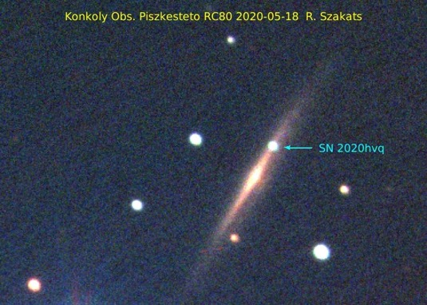
Transient phenomena
“Starlink will seriously affect the operations of our Fly's Eye
telescope system.…The system can go as deep as 17 magnitude with stacking multiple images. The goal is to perform time-domain astronomy (stellar activity, transients, pulsating and eclipsing variable stars, exoplanets) and Solar System investigations complementing TESS, GAIA, and even LSST on the northern hemisphere in cadence and magnitude range.” (Robert Szabo, Konkoly Obs.)

Slide 9
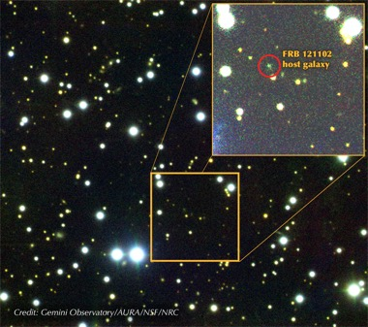
Fast transients (e.g., gamma ray bursts, fast radio bursts, gravitational wave transients)
“This is a burgeoning research area with many unknown events and physical phenomena. We coordinate over 60 major facilities to work simultaneously and in rapid-response mode to detect and follow up fast transients (millisecond-to-hours duration). Satellites can ruin detections of these events and, as the events fade very rapidly, the ability to acquire the rare data is lost forever. Moreover, hundreds of thousands of dollars of telescope time is proposed for, awarded, and coordinated, thus the impact on cost is very large.” (Jeff Cooke, Swinburne U.)
Danielle Futselaar

Slide 10
High-redshift supernovae
“High redshift supernovae … events are very faint and are acquired during classically scheduled telescope time on the largest optical telescopes in the world (Keck, Subaru, VLT, Gemini, SALT, LBT, etc.). They require hours of exposure time to achieve a signal-to-noise ratio of a few.... The time on these large telescopes is very competitive and satellites can ruin long exposures and the data is lost forever, as well as the telescope time, which is purchased at ~$100,000 per night, or about $4 a second.” (Jeff Cooke, Swinburne U.)
Supernova Cosmology Project
Riess+ 2007

Slide 11
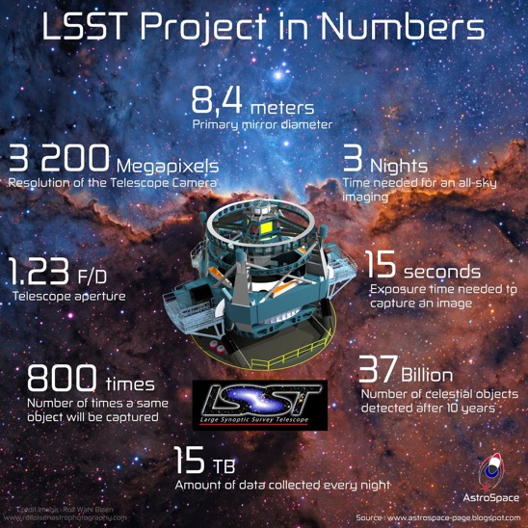
Wide-field / All-sky surveys
“[B]y the time (2027 in mid LSST survey) the full Starlink constellation of 42,000 is in place at orbits from 320-550 km. Initial scheduler simulations of dodging for that density of satellites show that at astronomical twilight only half of the number of available observations would be completed.” (Tony Tyson, Rubin Observatory)
Notes:
Add quote from Gaspar, HATNet…

Slide 12
Deep long-exposure spectroscopy
“In the coming years, we anticipate an increasing fraction of our night-time observations to be spectroscopic follow-up of LSST transients. The brightness of these satellites, were one to cross our aperture, would be sufficient to outshine any likely LSST follow-up target even in spite of the motion; the chance of a satellite crossing a slit is of course minimal, but many high-priority targets (GW170817 being a prime example) are observed far to the west after twilight, and the effect of a satellite crossing the aperture would be devastating to that particular exposure. Overall, the impact on our followup of LSST will be proportional to the impact on LSST. “
(John Blakeslee, Gemini Obs.)
Notes:
See mitigations report for more sp.?
Olivier Hainaut: subtle effects on sp. Surveys
Smaller FOV but much longer exp. -> 2x higher rate of trails e.g. FORS 2% of spectra trailed

Slide 13
Large statistical surveys (e.g., weak lensing, Dark Energy)
“[M]ost of LSST science derives from the statistical analysis of trillions of photometric measurements of 20 billion objects. The science discoveries will thus be more affected by systematics than sample size. This is a new paradigm. Residual image artifacts can create systematics which affect the science discovery space to varying degrees. Virtually the entire astronomical community will rely on the released LSST data products (transient alerts and static deep sky catalogs) rather than processing the hundreds of PB of images. Thus they will rely on the LSST data management to do the required pixel processing and artifact removal. The issue is systematics that may print through to the catalogs and alerts. The science collaborations would need to characterize them. For those programs most affected, the sheer task of tackling these new systematics in the released data products is likely beyond the capability of many in the astronomical community.” (Tony Tyson, Vera Rubin Observatory)

Slide 14
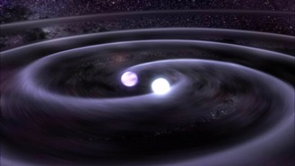
OIR followup of gravitational wave triggers from LIGO, VIRGO
“The Gravitational wave Optical Transient Observer (GOTO) is a project that performs a high-cadence survey of the optical sky down to ~20 mag, by making use of an extensive array of wide-field telescopes (up to 32). Satellites can't be avoided in projects like this that survey the visible sky all the time, and survey observations are scheduled during the whole night, including twilight. With an instantaneous sky coverage of 80 square degrees, it is not feasible to schedule the observation around an increasing number of contaminating satellites. Some fraction of the data is compromised, depending on the brightness of the object. With typical exposures of 60s, the satellites would fully trail across CCD images, which span several square degrees across. Since the main science goal involves fast evolving transients, many observations are time critical and cannot simply be rescheduled at a later time.” (Danny Steeghs, Gravitational wave Optical Transient Observer)

Slide 15
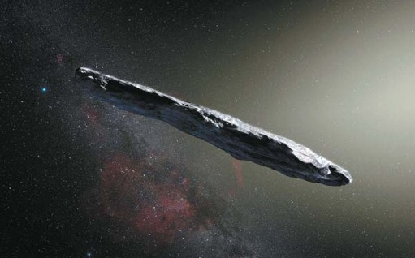
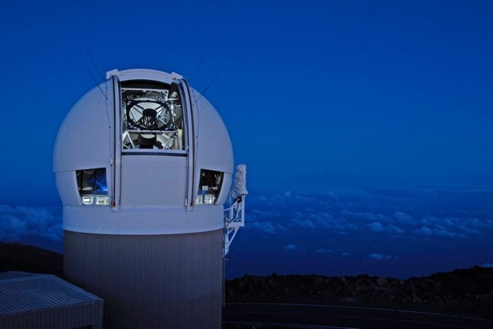
Near-Earth asteroids and comets
ESO
“LEO satellites already cause loss of data to Pan-STARRS, effectively wiping out a 3 degree long streak in the focal plane. More satellites will only make it worse. The part of the night right after evening twilight and right before morning twilight is the only part of the night that we can search for Near-Earth Objects at low solar elongation. This is a particularly rich area for the NEO search because we are looking along the orbit of Earth.” (Richard Wainscoat, PanSTARRS)
Notes:
See Mitigations: PanSTARRS

Slide 16
Distant solar system objects
“[W]e are in the process of dedicating our smaller telescopes to transient discovery and monitoring. We also have an active imaging survey to look for distant solar system objects. Bright moving satellites could impact the real-time analysis of these surveys, although we might be able to mitigate this by avoiding certain areas on the sky around sunset/sunrise… It may be possible to write code to use these positions in the searches for transient or solar system objects, but that would likely require us bringing in computer scientists that we currently do not employ. Such a position would cost us about $150,000 per year. (John Mulcahey, Carnegie Obs.)

Slide 17
Discovering the unexpected
"Astronomy is still driven by discovery.”
-- New Worlds, New Horizons

Slide 18
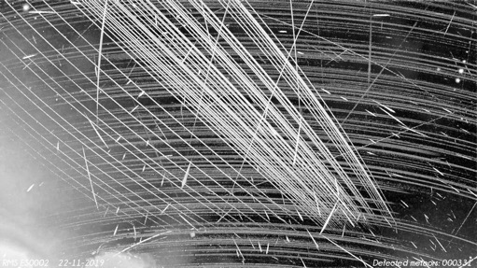
Parameters of Observing Programs
Easy:
Latitude of observatory
Etendue = AΩ = collecting area ⨉ field of view
Exposure time and cadence
Spectral dispersion
Science goals and program design
Not so easy:
Sensitivity of science project to:
Trails
Saturation of trails
Ghosts from trails
Undetected trails
Time constraints (FRBs, GWs, SNe, NEOs)
Uncertainty in satellite position
Unique / rare opportunities
Faint surface brightness effects (e.g. at edges of sat trails)
Systematic errors (e.g. orientation of galaxy images for weak lensing measurements)
Global Meteor Network

Slide 19
Possible metrics: science programs
Probability of exposure loss vs. rarity of the event.
% of pixels /frames / time / objects lost as f(t)
Number of sat trails per exposure or per unit time as f(t)
Brightness / surface brightness of streak
S/N of sat trails vs. S/N of science target
S/N or precision compromised in science result
Number, brightness of glints, flares
Introduced systematic errors
$ investment lost, or $ required to overcome problem (observing strategy, streak removal, additional time and equipment and personnel)
Thresholds for above losses:
negligible: science goals will be realized with original plan essentially unchanged
significant but tolerable: science goals will be somewhat compromised, additional time or resources required to offset losses
fatal: science goals cannot be realized
How to define metrics for unanticipated discoveries not made?
Notes:
If all of these were ZERO, then astronomical discoveries could continue unimpeded (and Elon Musk’s promise would be fulfilled).

Slide 20
Possible metrics: satellites
Primary observables:
Brightness: [7.0] V mag +2.5*log(r_orbit / 550 km), equivalent to [44]*(550 km / r_orbit) Watts/steradian. (brighter = worse)
Number (more = worse)
Spatial density (more = worse)
Angular velocity (faster = better?)
Positional + temporal accuracy and precision [1 arcsec, 1 second]

Slide 21
Possible metrics: satellites
Primary observables:
Brightness: [7.0] V mag +2.5*log(r_orbit / 550 km), equivalent to [44]*(550 km / r_orbit) Watts/steradian. (brighter = worse)
Number (more = worse)
Spatial density (more = worse)
Angular velocity (faster = better?)
Positional + temporal accuracy and precision [1 arcsec, 1 second]
Secondary / input parameters:
Orbital altitude <[600 km] (higher = worse)
Orbital inclination
Number of orbital planes (more = worse)
Spacing within orbital planes
Albedo (higher = worse) – including with or without sunshade
Chassis shape and control of specular reflections
Attitude control – chassis + solar panel(s)
Physical size (larger = worse)
Angular size (larger = worse)

Slide 22
Possible metrics: satellites
Primary observables:
Brightness: [8.0] V mag +2.5*log(r_orbit / 550 km), equivalent to [44]*(550 km / r_orbit) Watts/steradian. (brighter = worse)
Number (more = worse)
Spatial density (more = worse)
Angular velocity (faster = better?)
Positional + temporal accuracy and precision [1 arcsec, 1 second]
Secondary / input parameters:
Orbital altitude <[600 km] (higher = worse)
Orbital inclination
Number of orbital planes (more = worse)
Spacing within orbital planes
Albedo (higher = worse) – including with or without sunshade
Chassis shape and control of specular reflections
Attitude control – chassis + solar panel(s)
Physical size (larger = worse)
Angular size (larger = worse)
Many of these are interdependent, i.e. lower altitude means more LEOsats; higher altitude means fainter but slower angular speed and more illuminated, long-lived

Slide 23
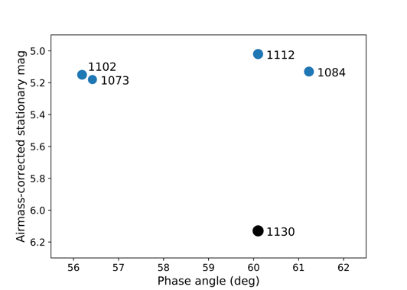
SpaceX changes to reduce Starlink visibility
1. DarkSat: black coating
~3x fainter
2. VisorSat: Sun-shield
3. Attitude control during orbit raise
Significant resources devoted to these technical solutions.

Slide 24
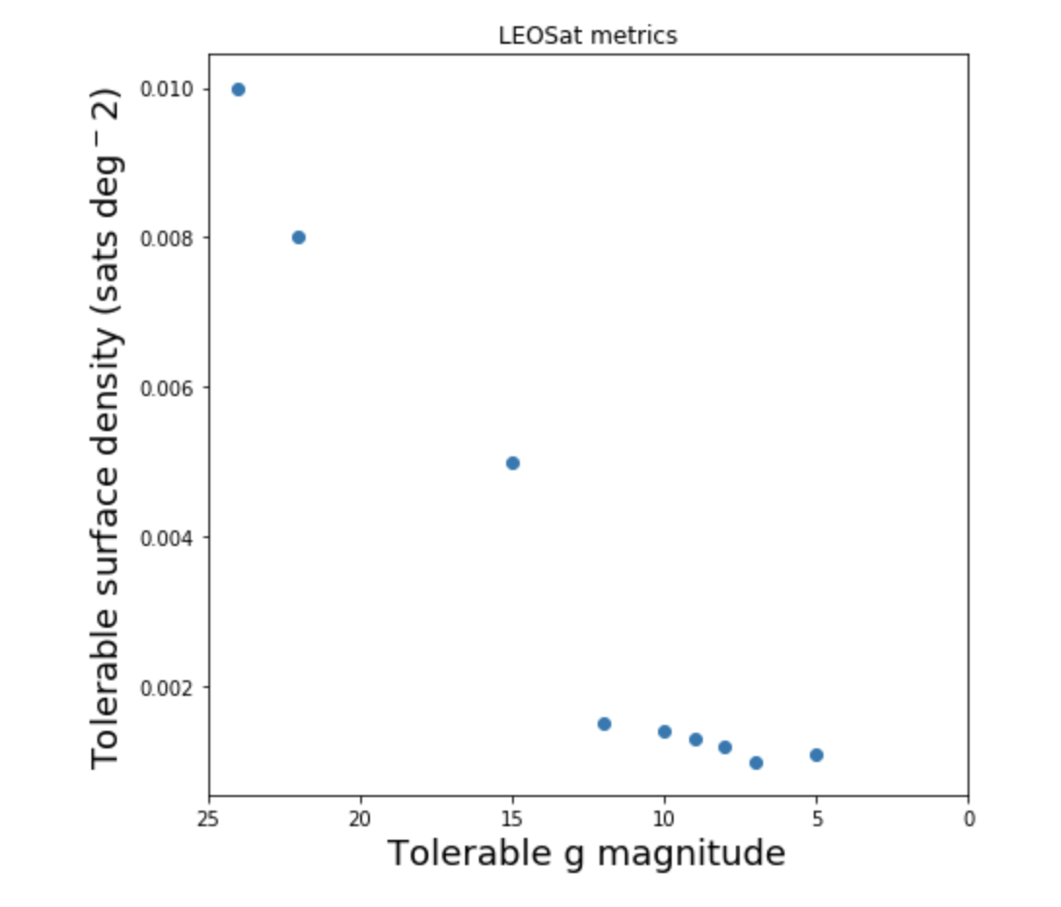
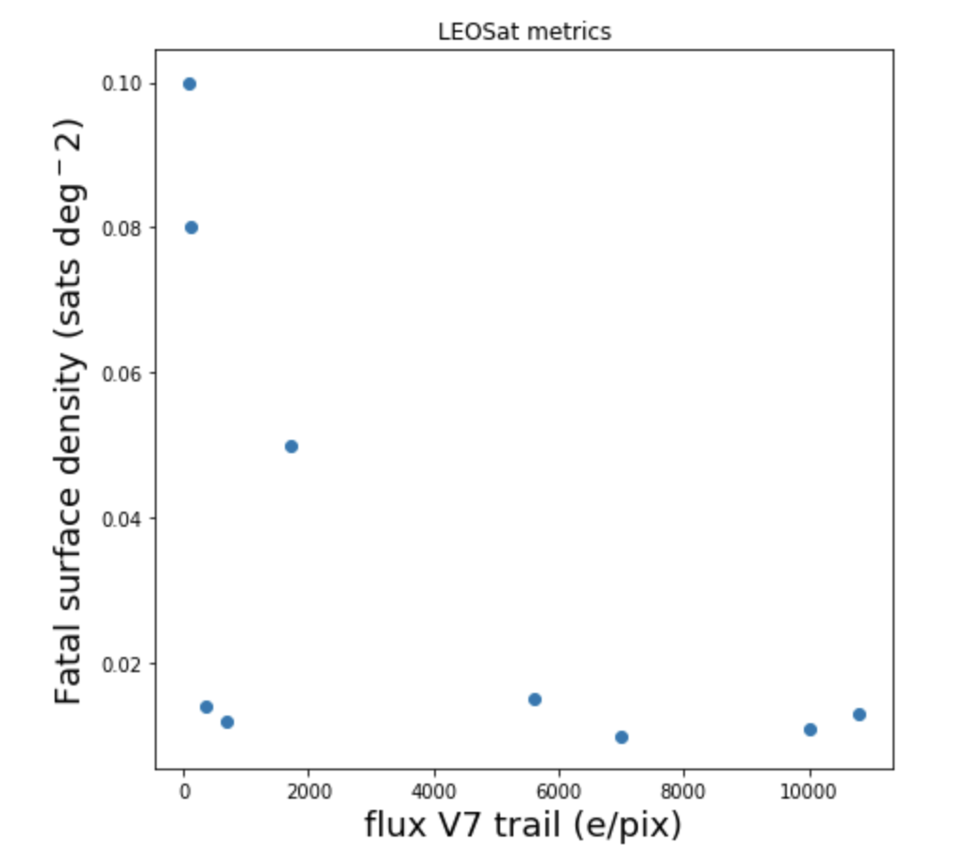
Define + explore parameter space
fictional
fictional

Slide 25
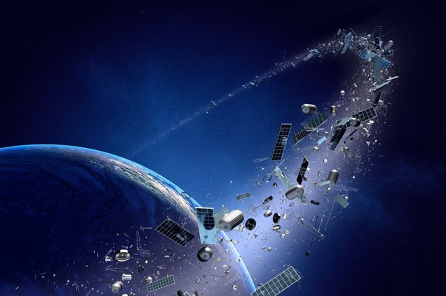
Further Simulations Needed
End-to-end simulations of broad science impact for all sectors of astronomy community.
Systematics imposed by streaks on wide-field deep images (e.g. shear, WL)
Realistic satellite shapes, reflectivities (BRDF), orbital parameters
Schedulability / Ability to dodge LEOSats (cf. Rubin/LSST)
Streak removal algorithms
Glints, including from moonlight and city lights
Kessler syndrome -- debris cascade

Slide 26
Satellite photo-bombs now common
experience both pro + am
Messier 10 with 6” f/8 amateur telescope + DSLR
FOV ~ 1°
6/13/20 22:08 EDT (sun: -14° altitude)
3-min exposures
3 in a row with satellite trails
Notes:
The sky has already changed. Here are some images of the globular cluster M10 taken this month through an amateur backyard telescope – mine – with a field of view of about 1 degree. Integration time is 3 minutes.
There are 3 pictures in a row.
All three have bright satellite streaks.
I’ve never seen this happen before, and I think this is the new normal.

Slide 27
Impacts on Human Experience
What are the stars and the sky worth?
Who decides? Whose sky is it?
What is the value of exploring the cosmos?
Where will we find a naturally dark, starry sky?
Metric 1: Keep all satellites fainter than [8th] mag
Notes:
This brings us to broader impacts that, together with industry and decisionmakers, astronomers need to consider and discuss carefully.

Slide 28
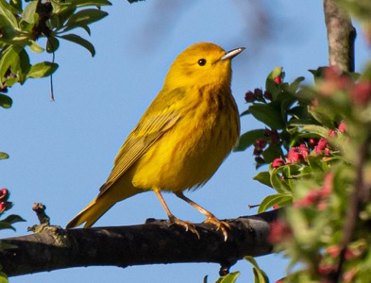
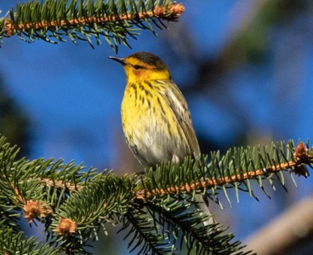
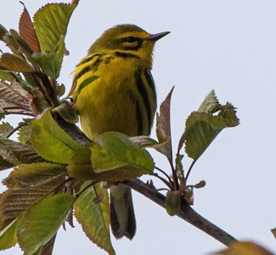
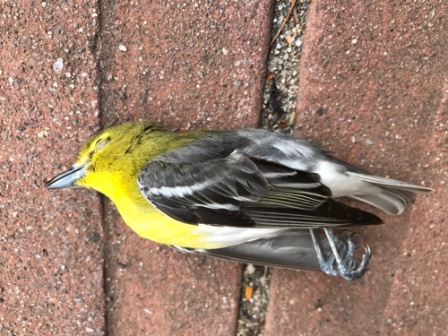
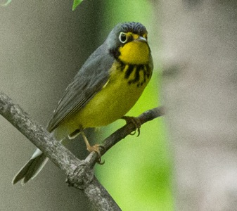
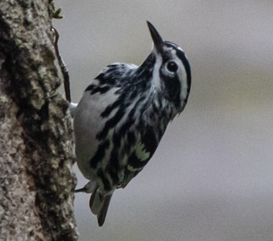
Impacts on ecosystems
80% of migrating birds migrate at night; many or most use stars to navigate
10⁹ deaths/year
What happens if all the “stars” are suddenly moving quickly?

Slide 29
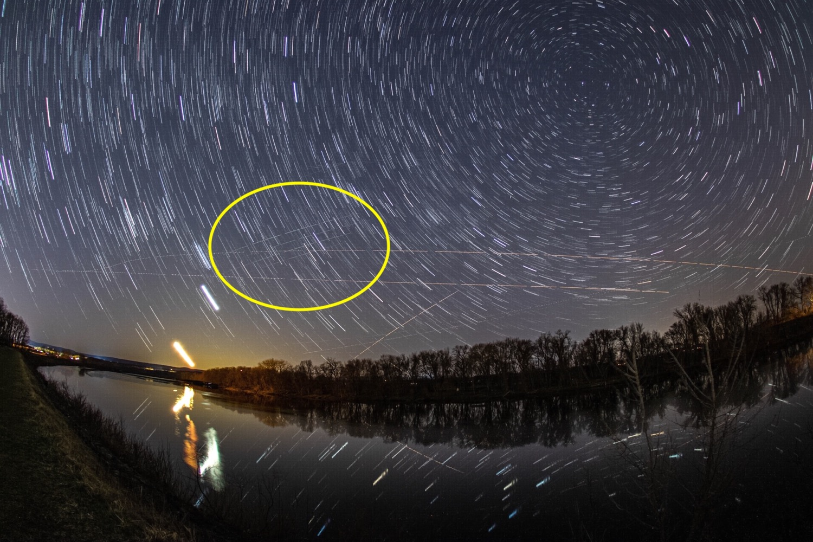
Thank you!
Starlink, >1 hr past twilight

Slide 31
Kessler Syndrome (debris cascade)?
10⁻⁶ = 1 per 100km box →
300,000 objects larger than 1 cm in orbit
~18,000 objects, mostly D > 10cm in LEO, actively tracked by US Space Command
2017: 4,000,000 conjunction warnings
> 100 collision avoidance manoeuvres / year
LEO orbits could become unusable
Okapiorbits.space 2018
Notes:
https://okapiorbits.space/knowledge-base/the-low-earth-orbit-environment/
Total: >300,000 objects larger than 1 cm in orbit
4,500 satellites (< 2000 still active)
~18,000 objects, mostly D > 10cm in LEO, actively tracked by US Space Command
2017: 4,000,000 conjunction warnings sent to sat operators, leading to
> 100 collision avoidance manoeuvres / year

Slide 32
Starlink Satellites
Launched March 18, 2020
Observed April 11, 2020
Northampton, MA
Apparent brightness: ~2nd mag

Slide 33
Michael Vlasov

Slide 34
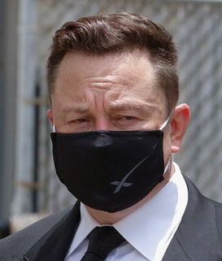
SpaceX promises not to break astronomy
"I'm confident that we will not cause any impact whatsoever in astronomical discoveries, zero. That's my prediction. We'll take corrective action if it's above zero.” – Elon Musk, CEO, SpaceX, quoted 3/10/20 BusinessInsider.com
“No impediment to science.” Starlink satellites will be “invisible to the naked eye within one week of launch.” – Elon Musk, addressing National Academy of Sciences Astro2020 decadal survey hearing 4/27/20

