Slide 1
Impact of constellations of low Earth orbiting satellites on Rubin Observatory
Tony Tyson
University of California, Davis
Chief Scientist, Vera C. Rubin Observatory
AAS – SIA Webinar May 26, 2020

Slide 2
Most Impacted
by satellites
Rubin Observatory will execute the Legacy Survey of Space and Time, producing the deepest, widest, view of our dynamic Universe:
Notes:
Ranked as the nation’s highest priority in ground-based astronomy by the 2010 Decadal Survey, Rubin Observatory’s Legacy Survey of Space and Time (LSST) will produce something unprecedented: A digital color motion picture of the Universe..

Slide 3
Rubin Observatory will execute the Legacy Survey of Space and Time, producing the deepest, widest, view of our dynamic Universe:
8.4-m mirror
3200 megapixel camera
Each image the size of 40 full moons
Scans the sky with 2000 images per night
10 year survey of the sky 2022-2032
37 billion stars and galaxies
10 million alerts, 20 Terabytes of data .. every night!
Significantly impacted by bright satellite trails
Notes:
Other observatories worldwide will use the alerts produced by Rubin Observatory to drive their science programs. Unfortunately such a wide and deep survey of the sky is is most impacted by bright low-Earth orbiting satellites! Undarkened, the current generation of Starlink satellites are 600 million times brighter than the faint galaxies in the deep LSST survey.

Slide 4
2018
Notes:
The Rubin Observatory in northern Chile nearing completion in 2018.

Slide 5
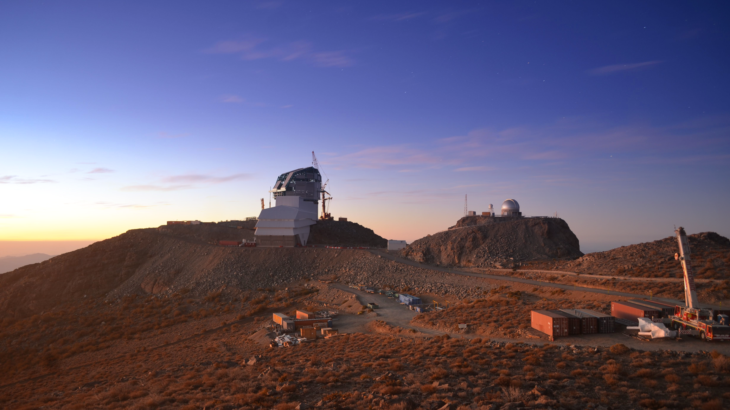
Rubin Observatory LSST survey 2022-2032
February 11, 2020
Notes:
The observatory is now nearing completion, in preparation for the ten year LSST survey. Unfortunately 2022-2032 is the era of planned mega constellations of LEO satellites.

Slide 6
Starlink v0.9

Slide 7
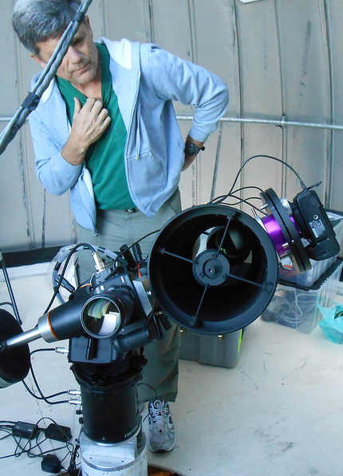
Two Starlink satellites
in a 30 sec exposure
2019-08-27
Very small telescope with wide field of view.
John Tonry
U Hawaii
Notes:
A 30 sec ATLAS very small telescope exposure showing two Starlink satellites. The field of view is 5.4x5.4 degrees. This was done when only 60 Starlinks were in orbit. Consider 40,000! We measured the brightness of these Starlink satellites, and translated that to how they would appear in the Rubin Observatory camera.

Slide 8
12K, 48K LEO sats in normal LSST cadence
Peter Yoachim
Notes:
In normal LSST observing cadence, some fraction of 30 sec visits will encounter a LEO Sat trail. This is a function of the number of LEO Sats (here 12K and 48K), the season, and whether observing is done in astronomical twilight or at midnight.

Slide 9
Dodging satellites: a losing battle
Peter Yoachim
Notes:
We simulate running our regular scheduler, but check each observation directly prior to execution to see if it will collide with a sun-illuminated satellite. If there will be a collision, the simulation advances 10 seconds and requests a new target from the scheduler. While the satellites are most prevalent in twilight, we continue to lose observations well into traditional dark time. For 48,000 satellites, twilight time will have multiple streaks, so we need to dodge those fields – decreasing LSST efficiency.

Slide 10
Rubin Observatory: a limiting case
All optical astronomy observatories will be affected to some degree by the light pollution generated by LEO Sats. The issue is frequency of LEOsat trails in their data and their brightness.
Rubin Observatory is the limiting case because of its unprecedented throughput: the product of its light collection and the wide field of view per exposure.

Slide 11
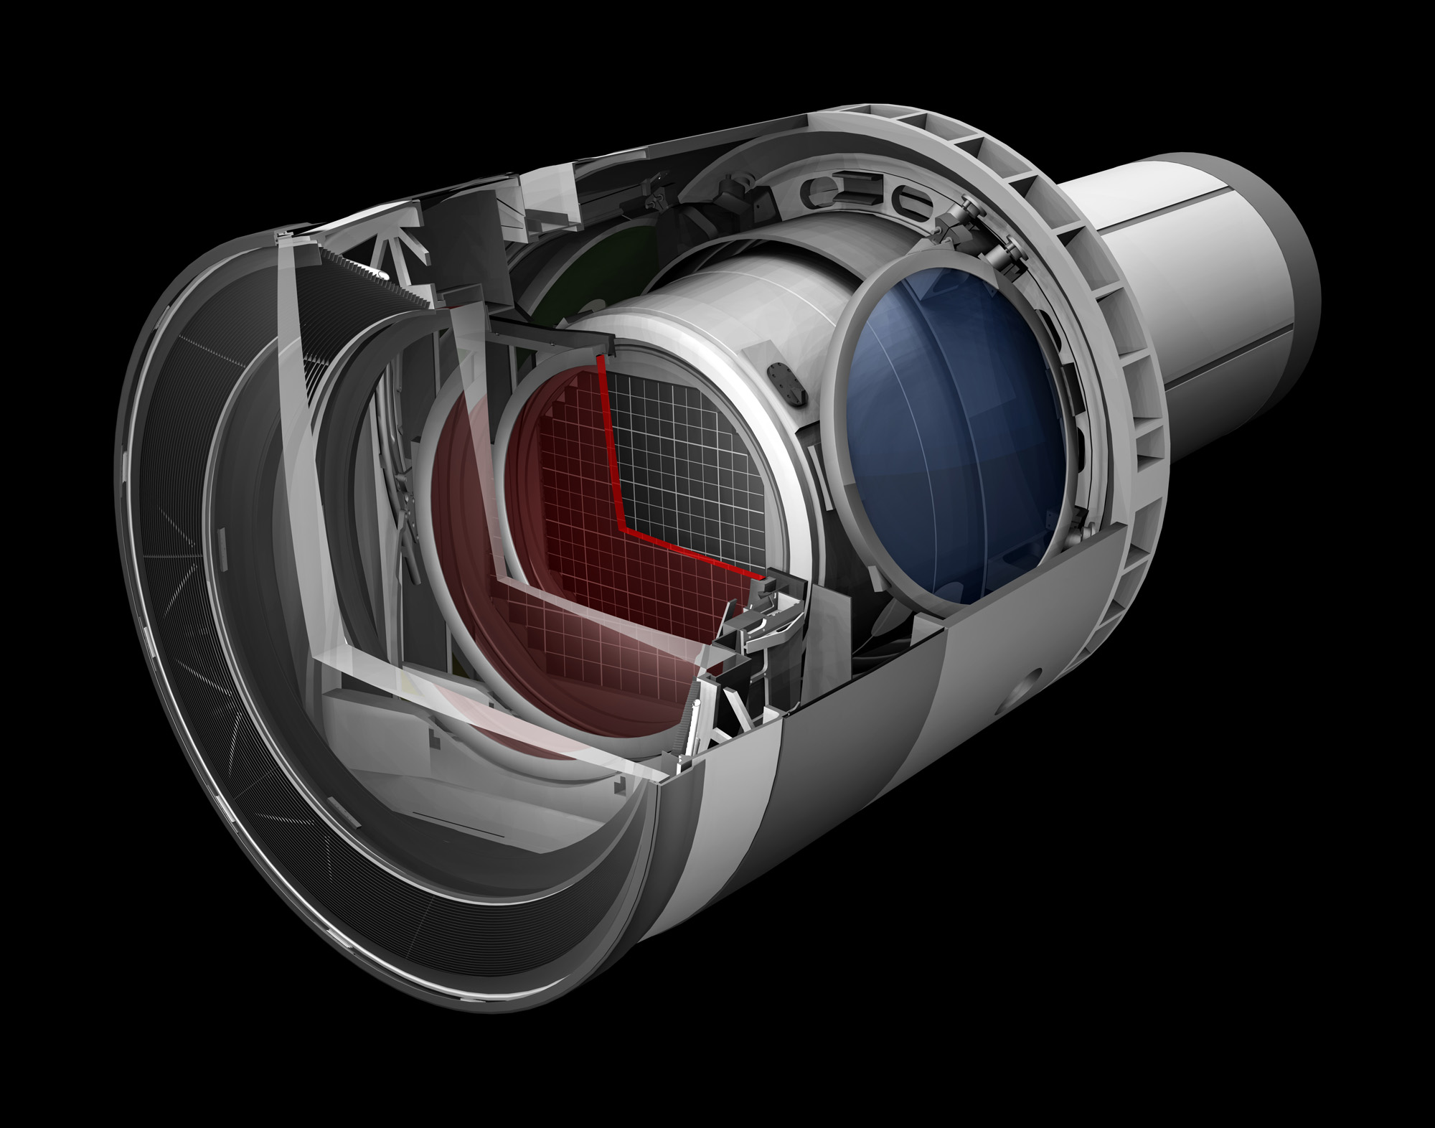
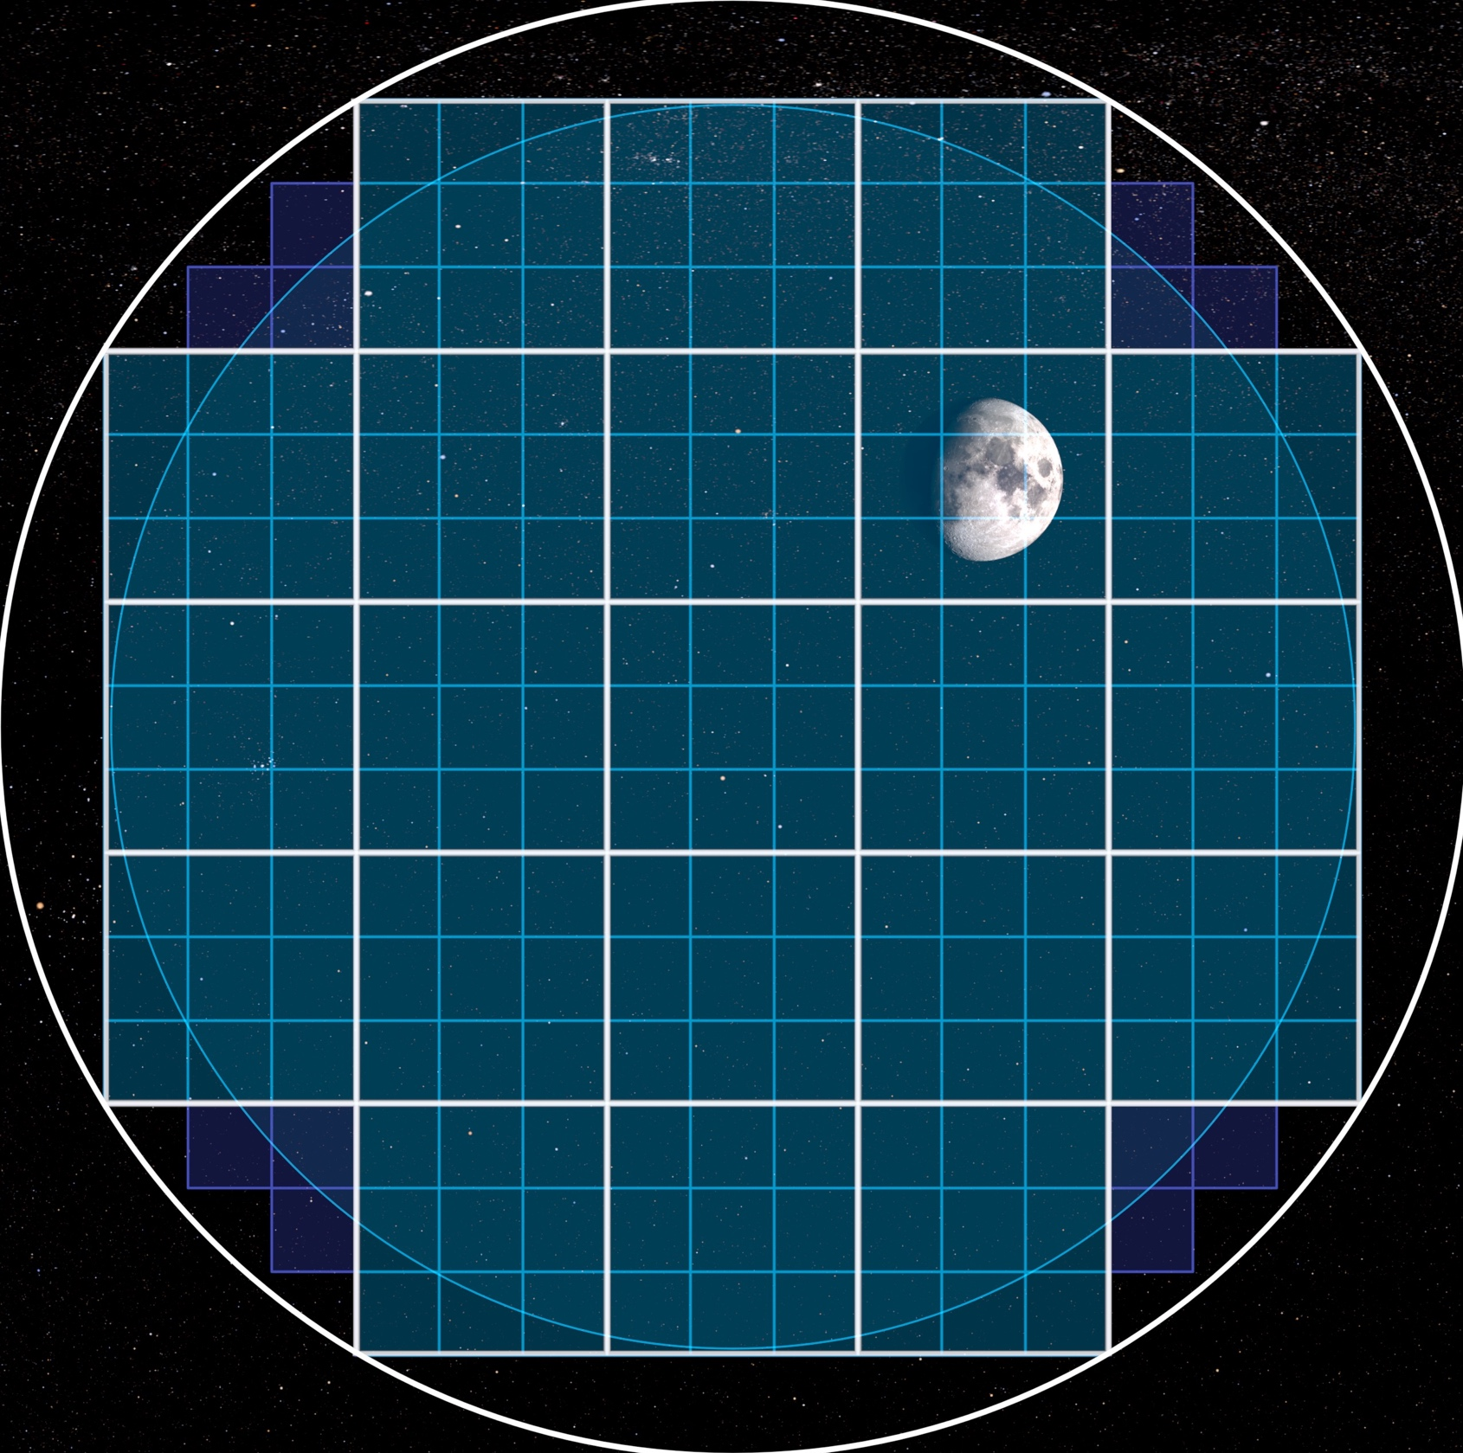

Slide 12
Notes:
The field of the LSST camera is 9.6 square degrees. A typical LEOsat trail may cross 4-5 rafts, and 12-15 CCDs in the LSST camera as shown. Each CCD is segmented into 16 regions, each 512x2000 pixels with its own output amplifier. There is crosstalk between amplifiers on each CCD, but very little crosstalk between CCDs.

Slide 13
Bright satellite trail in the Rubin Observatory camera induces image artifacts.
If LEOsat darkened to 7th magnitude, special pixel processing can remove the “ghost”
trails.
Notes:
The resulting bright trail of the LEO satellites is near saturation and causes many image artifacts in the camera. The only viable mitigation is darkening the satellites to 7th magnitude – so that artifacts may be removed in pixel processing..

Slide 14
Blanco imaging of
5 recent Starlinks
STARLINK-1130
“DarkSat” is 3
times fainter
Meredith Rawls
Notes:
Four of these 5 satellites are 20% fainter than the original Starlink v0.9, and DarkSat is a factor of 2.5 fainter. Goal: 7th magnitude.

Slide 15
SpaceX is working with the astronomy community to reduce the light pollution effects on optical astronomy
Making the Starlink 7th magnitude can remove some satellite trail artifacts in the Rubin Observatory camera
We are working with SpaceX to measure the effect of darkening test satellites in future launches
However, even if that works, the satellite trails will clearly be in the data – complicating data analysis and limiting discoveries
tt

Slide 16
Analysis of Blanco telescope imaging of 5 recent Starlinks demonstrates progress to darkening goal
Darksat: 6.1 magnitude
Visorsat may reach the goal of 7th magnitude for LEOsats at 550 km.
SpaceX brightness mitigation efforts set an example for others to follow
tt

Slide 17
Looking to the next decade, industry together with the astronomy community must address these issues
Work jontly to develop operations solutions to minimize science impact. Tools for efficient scheduling.
LEOsats at 1200 km are incompatible with optical astronomy
Operate surveys longer if needed to compensate. But science opportunity cost.
tt

