Slide 1
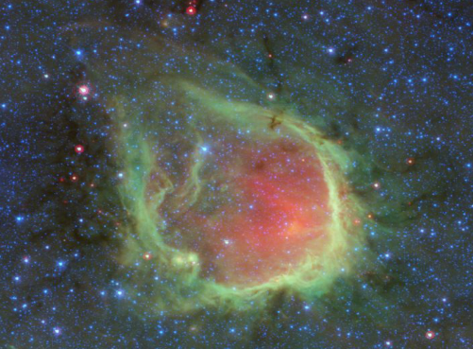
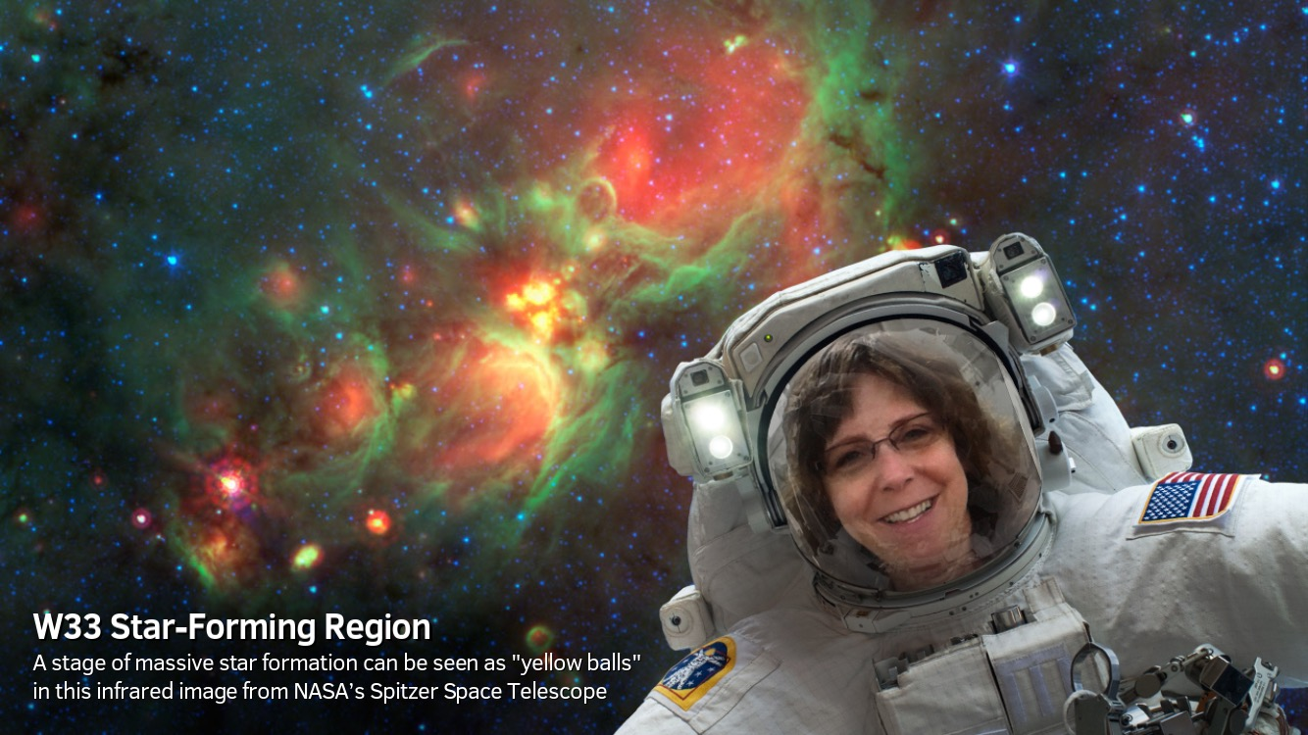
Why Do Massive (and Not-So-Massive) Stars Form in the Milky Way?
G. Wolf-Chase, Adler Planetarium; C. Kerton, ISU; K. Devine, C of I
#yellowballs discovered serendipitously by citizen scientists.
MWP re-designed to build a catalog of YBs.
2016-2017: More than 6,000 YBs identified and measured.
Zooniverse (Adler Planetarium, Oxford); MWP (M. Povich)
Finding sites of recent massive star formation (“bubbles”).
Spitzer images of ~305 sq deg of the inner & outer Galaxy.
Grace Wolf-Chase: gwolfchase @ adlerplanetarium.org, (630) 414-2128
Notes:
Reporting on some research made possible by citizen scientists.
Zooniverse: World’s largest, most popular platform for online citizen science. Led by Adler and University of Oxford. Currently engages >1.7 million people, over 200 academic research publications.
Milky Way Project (M. Povich, Cal Poly University): One of ~100 research projects in Zooniverse. Uses representative color infrared images from the Spitzer Space Telescope to identify “bubbles” created as massive stars ionize and sculpt their birth clouds (≥ 8 solar masses.) Massive stars produce and distribute heavy elements critical for life. Good evidence our Solar System formed with massive stars.
Blue: stars; green: complex organic molecules (“PAHs”); and red: dust.
Discovery of Yellowballs: Citizen scientists began tagging circular “yellow” objects (YBs). We wondered whether these might be “infant bubbles”. Image of W33 at right used for Spitzer 15th anniversary selfies.

Slide 2
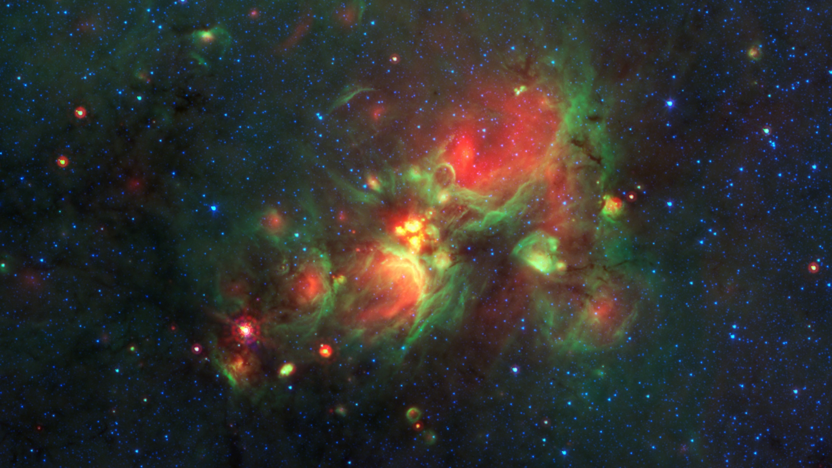
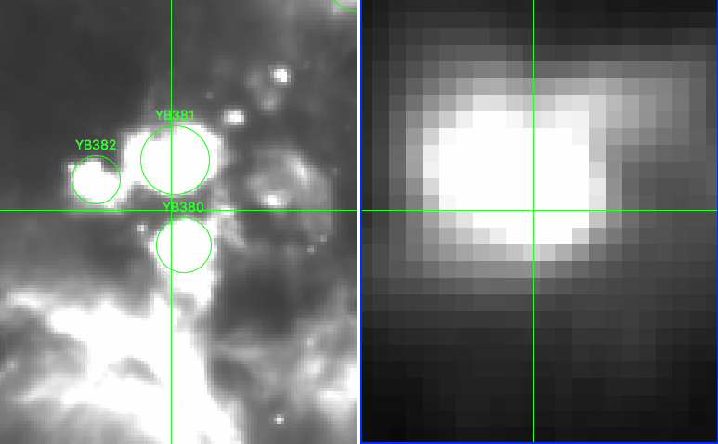
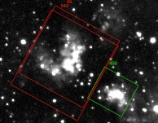
YBs Reveal Young Stars AND Birth Clouds
Infant stars (UKIDSS 2 μm)
ATLASGAL 870 𝛍m
YBs located in dense “clumps.”
Notes:
Great example of how what you see depends upon the wavelength of light you use.
near-IR: We can peer into some of YBs to examine young clusters of stars.
submm/mm: We can study the birth clouds associated with the YBs.
UKIDDS: Lucas et al. 2008, The UKIDDS Galactic Plane Survey, MNRAS, 391, 136
ATLASGAL: Schuller et al. 2009, ATLASGAL – The APEX telescope large area survey of the galaxy at 870 microns, A&A, 504, 415

Slide 3
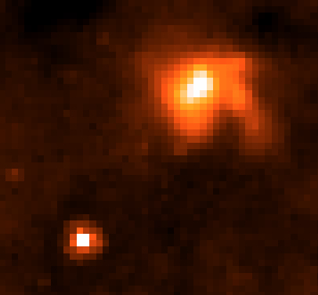
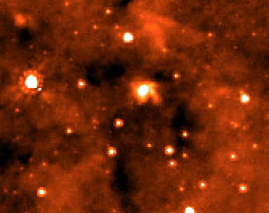
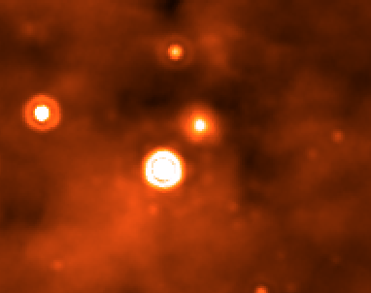
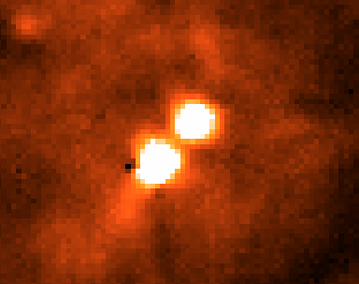
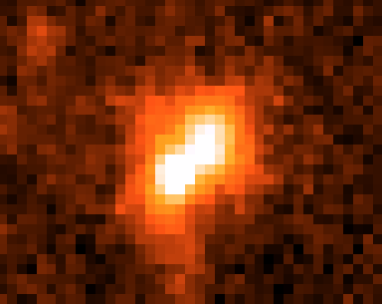
An Example Yellowball: YB 1153
YB 1153
8 μm GLIMPSE
24 μm MIPSGAL
>70% of YBs are associated with dense “clumps”.
70 μm Hi-GAL
870 μm ATLASGAL
Notes:
Pilot study: 20 sq deg region of a well-studied portion of the inner Galaxy that contains 518 YBs. Able to match most YBs with catalogs containing different indicators of star formation such as young massive stellar objects and dense molecular gas. YB 1153: WISE candidate HII region.
BU-GRS: Jackson et al. 2006, The Boston University-Five College Radio Astronomy Observatory Galactic Ring Survey, ApJS, 163, 145
Hi-GAL: Elia et al. 2017, The Hi-GAL compact source catalogues – I. The physical properties of clumps in the inner Galaxy, MNRAS 471, 100
WISE HII: Anderson et al. 2014, The WISE Catalog of Galactic HII Regions, ApJS, 212,1
CORNISH: Purcell et al. 2013, The Coordinated Radio and Infrared Survey for High-Mass Star Formation. II. Source Catalog, ApJS, 205, 1
ATLASGAL: Schuller et al. 2009, ATLASGAL – The APEX telescope large area survey of the galaxy at 870 microns, A&A, 504, 415

Slide 4
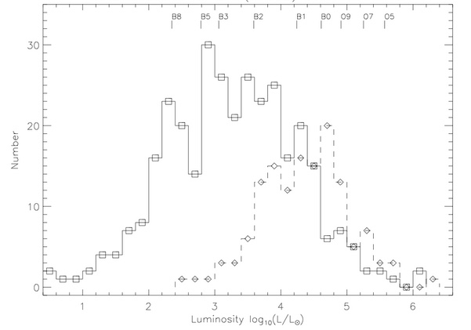
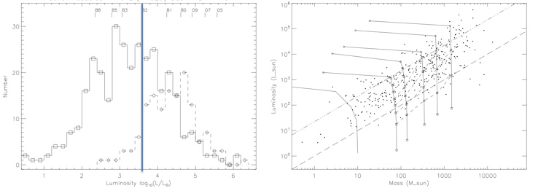
Do all YBs Produce/Harbor Massive Stars?
More YBs than bubbles but YB stage should be shorter.
YBs present a “snapshot” of diverse star-forming regions.
Cutoff for supernovae
KWA15 ---
This study ⎯
Notes:
Initially, we thought all YBs might be very young bubbles associate with massive stars. KWA15 refers to a paper we wrote a few years ago based on some very early identifications of these objects.
Dashed histogram indicates the luminosity of YBs that appear in a catalog of massive YSOs:
RMS: Lumsden et al. 2013, The Red MSX Source Survey: The Massive Young Stellar Population of Our Galaxy, ApJS, 208, 11
Solid histogram indicates a sample from our pilot region that have matches in the Herschel Hi-GAL clump catalog. Tick marks indicate different spectral classes of stars. Most YBs expected to contain multiple stars -> upper limit to the luminosity of the brightest star.
[NOTE: We have a much larger sample with known distances.]
Massive stars that form form bubbles and eventually SNe lie to the right of B2 (about 8 Msun). We’ve uncovered many lower-luminosity objects.

Slide 5
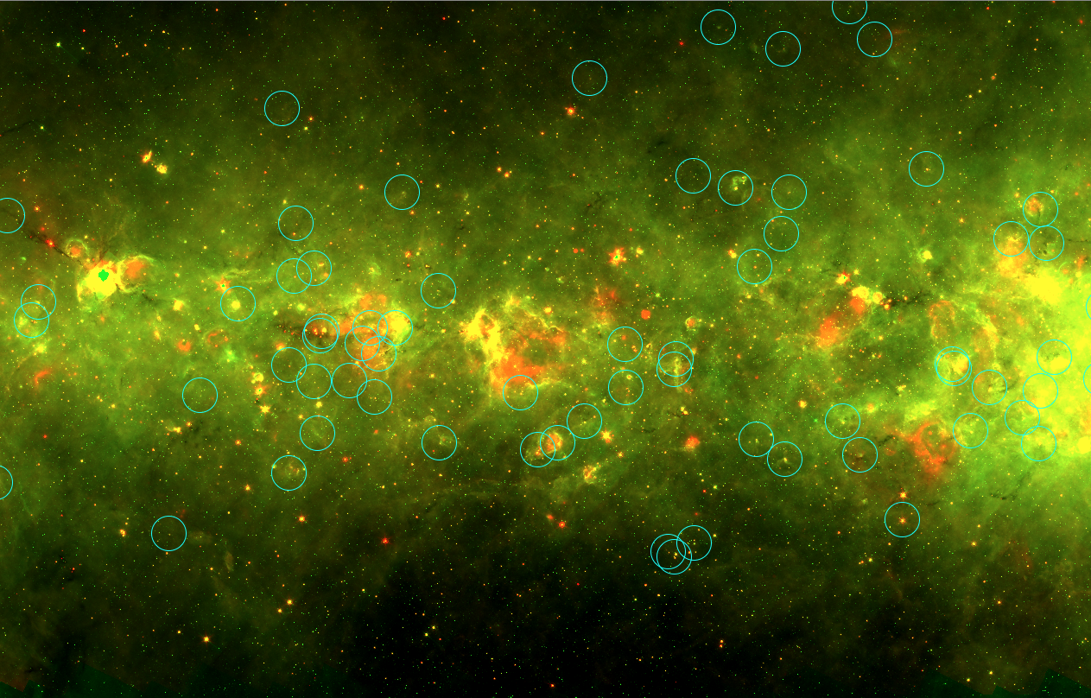
New Star-Forming Regions
Circled YBs:
Associated with dense gas (Hi-GAL).
Not associated with catalogued massive star formation.
$$ℓ=31.°5 −34.°5, 𝒷= ±1°$$
Notes:
Roughly 1/3 of the YBs in our survey region associated with dense gas, but no other catalogued star-formation tracers.
Two-color image of part of our survey that highlights just the gas and dust, not stars.
These YBs have the characteristics of “protostars,” which are still in the process of accumulating mass, and intermediate-mass SFRs.
Hi-GAL: Elia et al. 2017, The Hi-GAL compact source catalogues – I. The physical properties of clumps in the inner Galaxy, MNRAS 471, 100

Slide 6
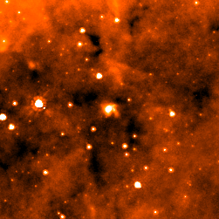
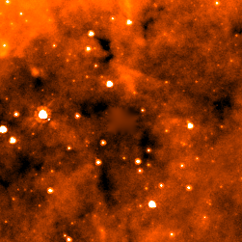
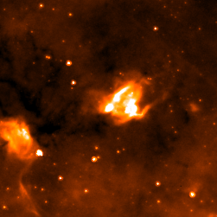
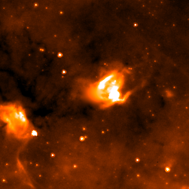
Measuring YBs
Isolate YB from background.
Measure flux.
Students create GUI, catalog interface.
Apply to entire YB catalog.
YB 1153
YB 1153 Removed
YB 1156
YB 1156 Removed
Notes:
Ideally, we want to measure properties of all the newly discovered YBs in a consistent manner, not just those with counterparts in other catalogs.
The two YBs featured here show different backgrounds, one isolated, one not.
In the process of automating a method to measure the amount of flux at different wavelengths for all YBs.

Slide 7
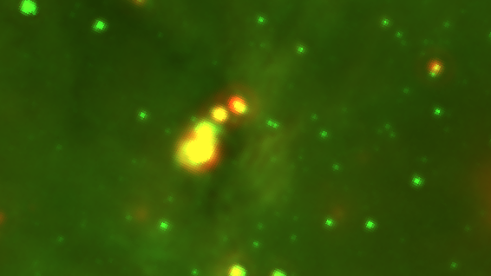
Are Citizen Scientist Identifications Reliable?
Some catalog entries are “fake yellowballs” (mature stars, ISM).
Pilot study suggests this fraction is small, but significant.
Exploring the nature of “unassociated” YBs (~14%).
Comparing YB sizes from models to user-supplied sizes.
Will inform design of future Zooniverse projects.
Notes:
Using YB1312.png enlarged to 10” width then cropped as background. Spacing of text altered to avoid the central bright source.

Slide 8
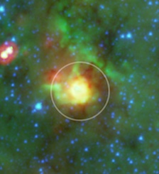
Summary
Citizen scientists found > 6,000 Yellowballs (YBs) in the Milky Way.
YBs are young star-forming regions.
YBs span an enormous range in luminosity and mass.
Some YBs host massive stars, but many do not.
YBs harbor forming stars still embedded in their birth clouds.
How do stellar properties link to their birth clouds?
Grace Wolf-Chase: gwolfchase @ adlerplanetarium.org, (630) 414-2128
Notes:
Higher resolution studies will be very important to study what’s happening within YBs – e.g., how matter accumulates onto “cores” within the “clumps”.
YBs present a great opportunity to compare the environments which are and are not producing massive stars at similar stages of evolution.

