Slide 1
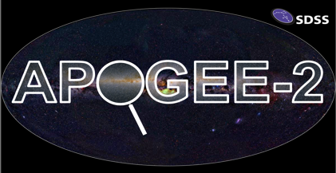


The Elements of Life Mapped Across the Milky Way by SDSS/APOGEE
Jon Holtzman (APOGEE-2 Survey Scientist)/ Sten Hasselquist (Ph.D student)
New Mexico State University
Department of Astronomy

Slide 2
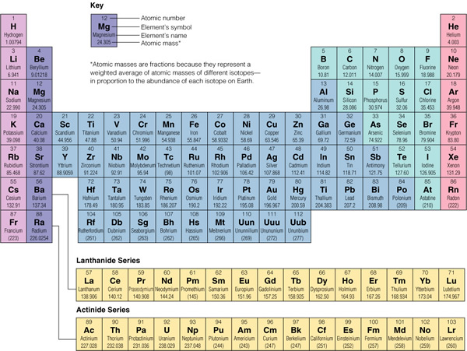
Astronomy = physics + chemistry + geology + biology + math + ….
Notes:
Astronomy : crossroads of physics, chemistry, geology (planetology), biology…
Today we’ll touch on chem, bio, planetology
Starting with chem, here’s a periodic table to a chemist
Astronomer might have different view...
Astronomy is exciting to me because I think it is a crossroads science, encompassing components of physics, chemistry, geology (or planetology), biology, and perhaps others all wrapped together in the language of math.
Today is a fun presentation for me because we’re actually going to touch on a few aspect of chemistry, biology, and planetology in astronomy.
Starting with chemistry, the periodic table presents a compilation of the elements as a chemist might describe them.
A typical astronomer, however, might have a very different view of the periodic table…

Slide 3
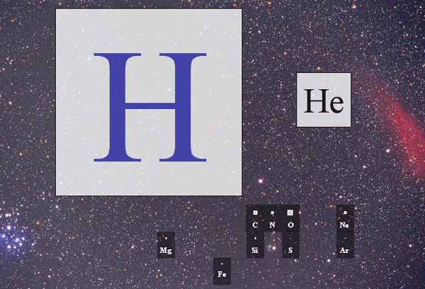
The Astronomer’s Periodic Table
Credit: supernovacondensate.net
Notes:
Rel abundance of elements in the Universe: H, He, and “metals”
This periodic table shows the typical relative abundances of different elements in the Universe: for the most part the Universe is composed of hydrogen and helium, with just trace amounts of all of the other elements, often fondly and generally incorrectly referred to as as metals.

Slide 4
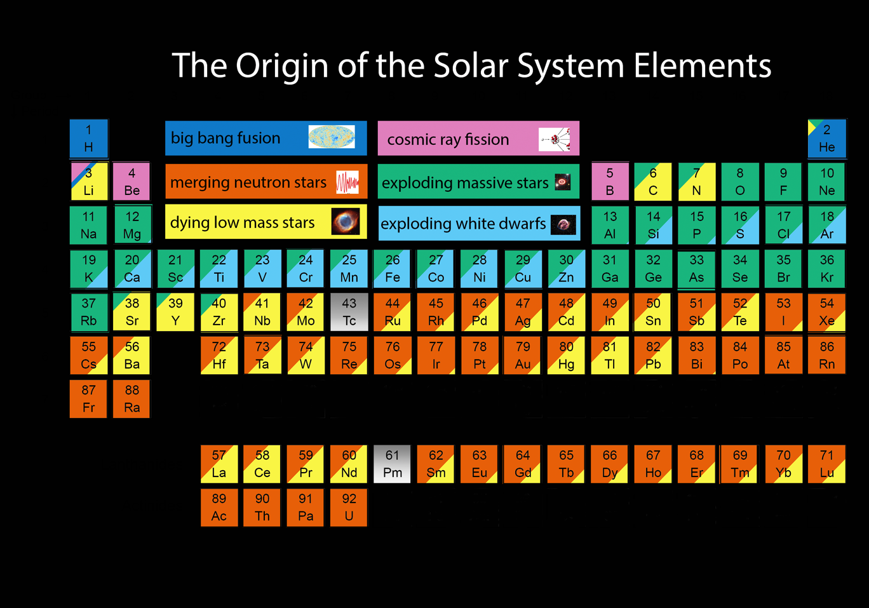
The astro-chemists periodic table
credit: Jennifer Johnson, Ohio State University
Notes:
Astro-chemistry: lots of information
Origin of elements in stars, but different types
This periodic table shows…
To an astro-chemist, there’s a significant amount of information in the relative abundances of different heavier elements.
This arises because, while the heavier elements are essentailly all thought to be synthesized in stars, different elements are synthesized in different types of stars, and on different timescales.
This periodic table schematically shows the contributions of different processes to the synthesis of different elements.

Slide 5
Key elements of life: CHNOPS
credit: Jennifer Johnson, Ohio State University
Notes:
This periodic table highlights the biology part: the 6 elements that are thought to be critical to life as we know it; CHNOPS
Human interest story of today is to describe how the abundance of these elements of life vary across our Milky Way galaxy.
I’m going to turn things over to my student, Sten Hasselquist, who is going to tell you how we do this.

Slide 6
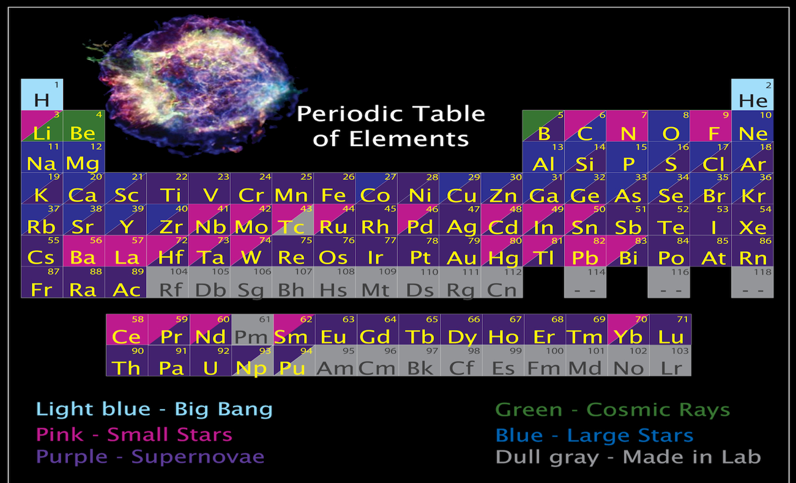
Origin of the elements
Key elements of human life
Notes:
This periodic table highlights the biology part: the 6 elements that are thought to be critical to life as we know it.
Human interest story of today is to describe how the abundance of these elements of life vary across our Milky Way galaxy.
I’m going to turn things over to my student, Sten Hasselquist, who is going to tell you how we do this.

Slide 7
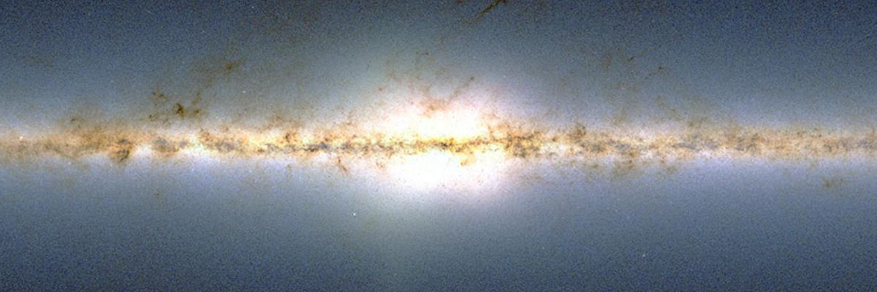
APOGEE
Near-infrared, detailed spectra of hundreds of thousands of Milky Way stars
  IR allows probing of more obscured stellar populations: the Milky Way disk!
  Spectral detail allows measurements of abundances of 15-20 different elements… including the key elements of life!
Notes:
Mapping enabled by APOGEE
APOGEE works in IR, so see across much of Galaxy
APOGEE measures compostions…
To map the elements of life across the Milky is enabled by the APOGEE portion of SDSS.
APOGEE can do this because it works in infrared light, allowing us to penetrate the dust in our Galaxy and see stars across the Galaxy. As is in shown in the image, the disk of the Milky Way has a of dust, which make it hard to see to significant distances, but since infrared penetrates dust better than visible light, we are able to see across much of the Galaxy.
At the same time, APOGEE allows us to measure the composition of stars, and in partiular, the abundance of all of the elements of life
Here’s how we do this:

Slide 8

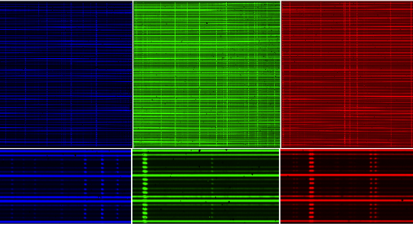
Spectra of lots of stars!
← Different stars →
Wavelength →

Slide 9
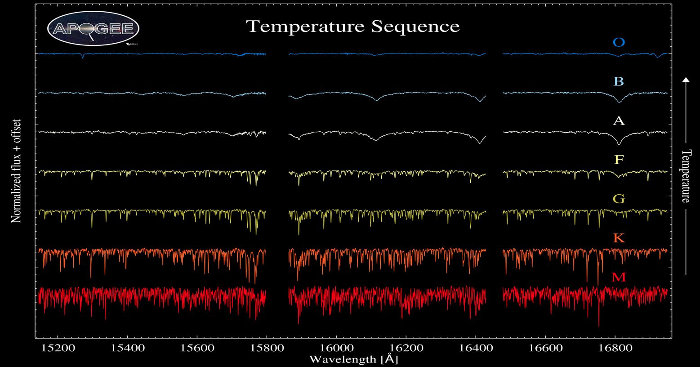
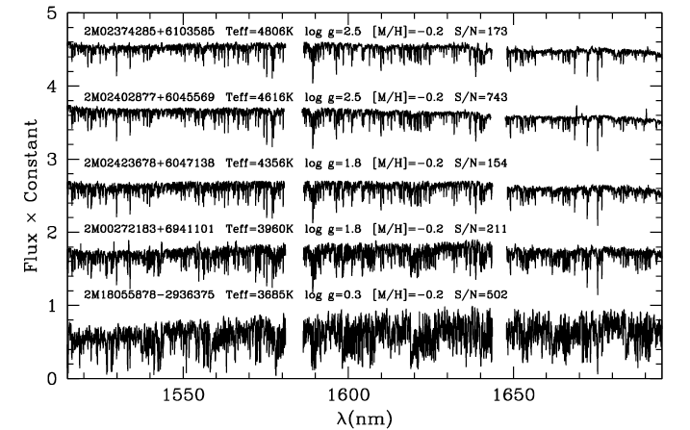
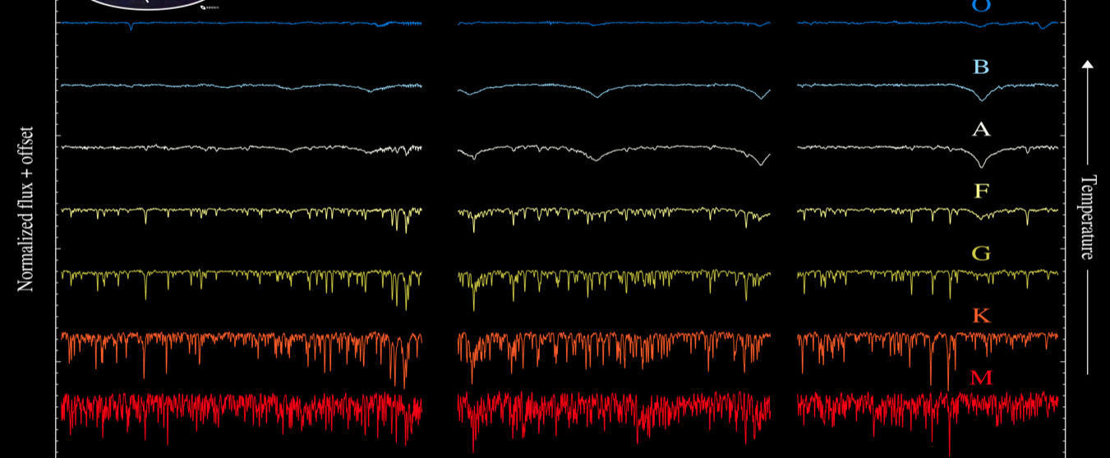
Temperature effects

Slide 10
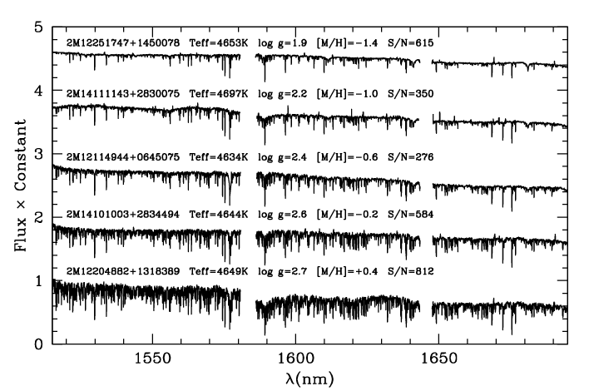
Abundance effects
Notes:
APOGEE records spectra, which give the brightness of many different wavelengths of infrared light.
Figure: absorption line depths, example of five stars
Use this to make maps
-----
- APOGEE records spectra, which give the brightness of many different wavelengths of infrared light.
- This figure shows APOGEE spectra of five different stars, and you can see that they spectra don’t all look the same. The hundreds dips that you see in each spectra result from the absoprtion of light by different elements, and the more of an element there is, the deeper the dip.
- So this set of five stars represents stars with different elemental abundances, with the top one having the lowest abundance, and the bottom one the highest.
- To make our maps of the elements of life, we focus in on different regions of spectrum that are sensitive to each different element, and measure the abundance in each of over a hundred thousand stars, and put it all together into a map.

Slide 11
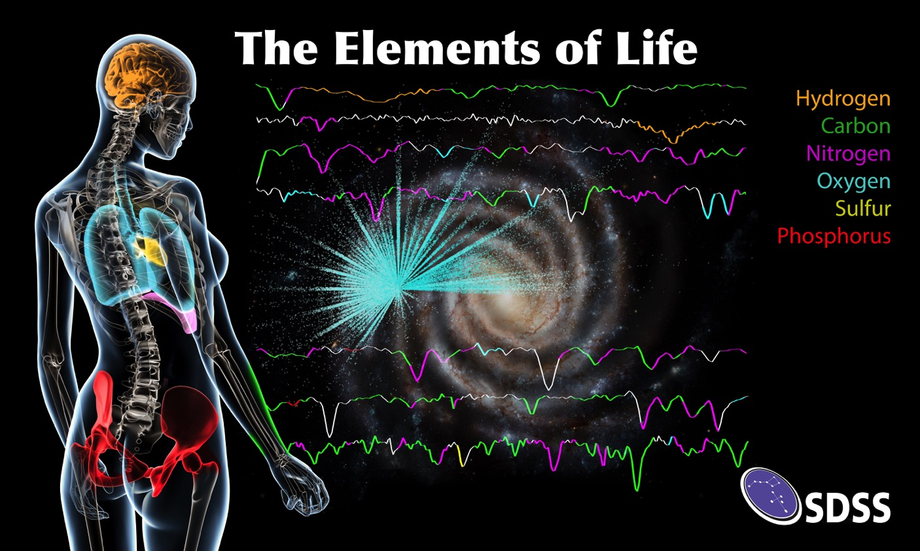
Notes:
Here’s a cool-looking summary of what we’re getting. The body on the left indicates that humans are composed of several key elements, associating some parts with some of the key elements: oxygen in the lungs, phosphorus in bones, etc.
The wiggly are one APOGEE spectrum, where we’ve color coded the regions that are affected by the abundance of the key elements of life:
Carbon in green, nitrogen in magenta, and so on as indicated by the element key.
Finally, the picture in the middle is an artists rendition of the Galaxy, with the location of the APOGEE stars superposed. The saturation of the colored points indicate the abundance of oxygen of stars at each location. Although it’s bit subtle to see, these indicate our main result: stars in the inner region of the Milky Way have a higher abundance of oxygen than stars in the outer regions.

Slide 12
APOGEE maps of all of the elements of life!
Oxygen
Nitrogen
Carbon
Sulfur
Phosphorus
Notes:
- This figure shows the comparable maps for the key elements.
- As it turns out, the same is true for all of the elements of life: there is a higher abundance in the central portions of the Galaxy.
- Astrophysically, what this tells us is that the pace of star formation was faster in the inner parts of the Galaxy than in the outer parts. Since we think that originally there were no elements of life, this implies that the basic builing blocks of life were probably available earlier in the inner regions of the Galaxy than they are where we live.
- While we can only speculate what this might mean for the existence or nature of life in other regions of the Milky Way – note that we’re not claiming the detection of life! – it’s still pretty interesting to be able to consider this.
- Measurements like these are also interesting from the point of view of planets, because the nature of planets may depend critically on the relative abundances of different heavy elements. Johanna is going to tell you more about this.

