Slide 1
ALMA Sinks Its Into 74 Nearby Galaxies
To Discover How Galaxies Manufacture Stars
Erik Rosolowsky for the PHANGS team
PI: Eva Schinnerer (Max Planck Institute for Astrophysics)
Data Lead: Adam Leroy (The Ohio State University)
rosolowsky@ualberta.ca • 780-399-6465

Slide 2
Background: Star factories build the galaxies we see
Galaxies are built up from the stars made in molecular clouds.
Molecular clouds are the “star factories” of the Universe.
Star formation takes millions of years.
Low-mass galaxies form stars more vigorously than high-mass galaxies.
Are there relatively more star factories in low-mass galaxies? OR
Are the star factories in low-mass galaxies more efficient?
Molecular clouds
and young stars

Slide 3
We are taking the first census of 100,000 star factories
Carbon Monoxide light (CO) highlights the gas in molecular clouds.
ALMA* efficiently maps CO light, making this first census possible.
ALMA is surveying 74 galaxies for the PHANGS** team.
This census shows us how molecular clouds evolve.
20 hours of observing with older telescope
1 hour of observing with ALMA
*The Atacama Large Millimeter/submillimeter Array
**Physics at High Angular Resolution in Nearby GalaxieS

Slide 4
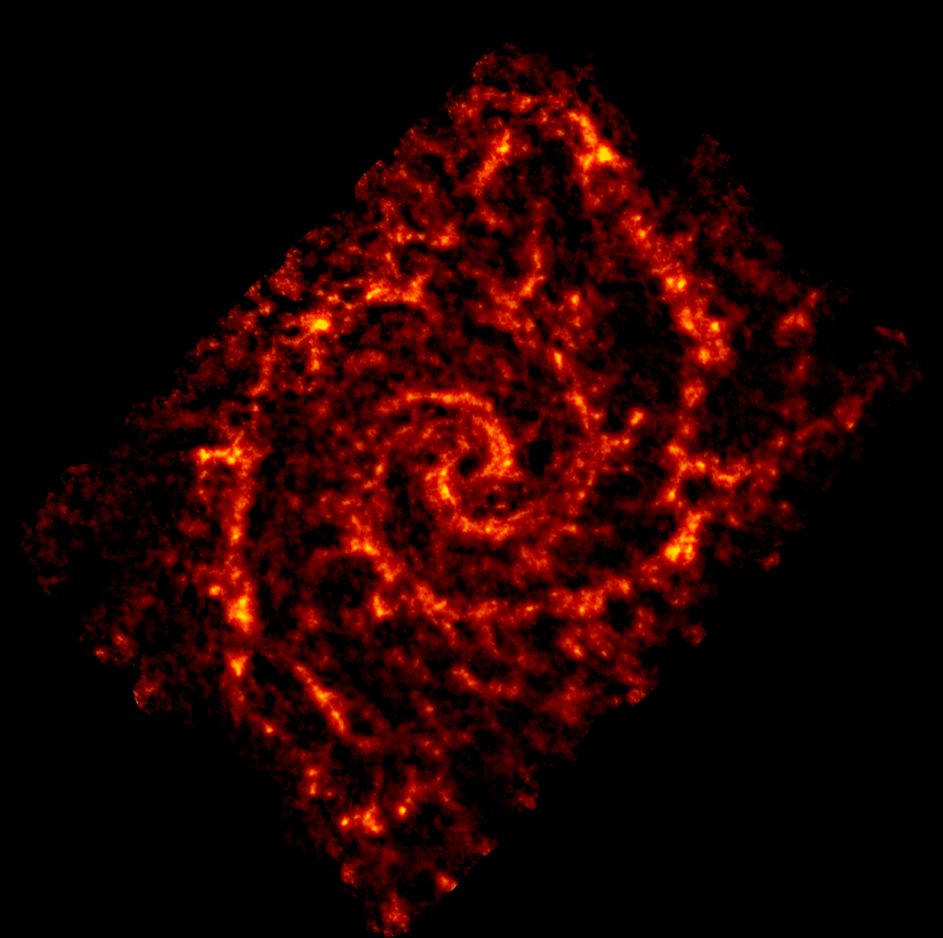
Every bright spot in our maps is a molecular cloud 100,000 times the mass of the Sun
A single star factory can make 10,000 stars during its life.
We measure star formation efficiency by counting the youngest stars.

Slide 5
PHANGS is the first survey large enough to study the role of the host galaxy
74 galaxies cover:
Mass of 2% to 200% of the Milky Way
Star formation rates from 10% to 400% of the Milky Way

Slide 6
Result: Star factories in high-mass galaxies appear less efficient compared to those in low-mass galaxies
High
Andromeda
Galaxy
Our Galaxy
Star formation efficiency
Vertical bars show range of efficiencies
Low
Low Mass
Mass of Galaxy
High Mass
The next question we working to answer is “why?”

Slide 7
PHANGS links molecular clouds to their host galaxies
Molecular clouds are the “star factories” of the Universe.
PHANGS observes enough galaxies to deduce the influence of the host on molecular clouds.
Star factories in high-mass galaxies appear less efficient vs. those in low-mass galaxies.
rosolowsky@ualberta.ca • 780-399-6465

