Slide 1
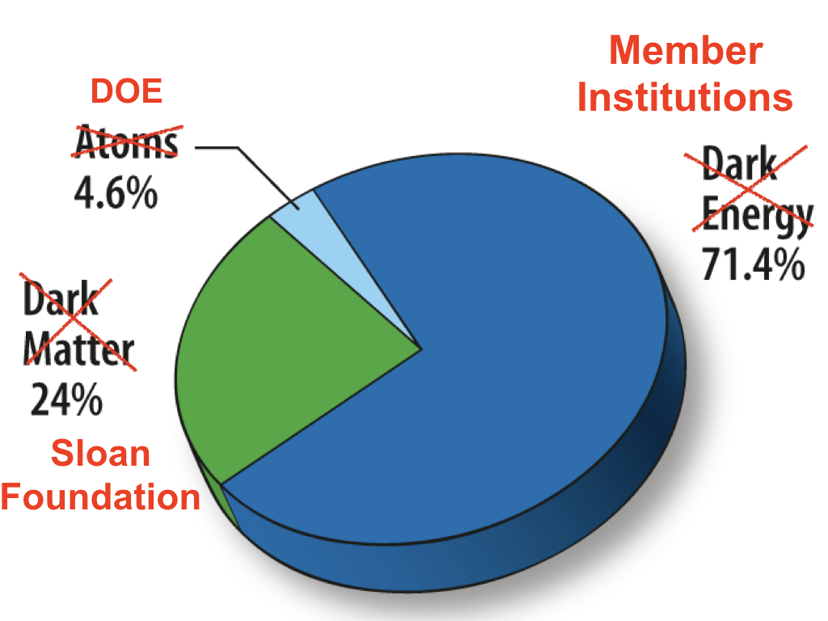
How Does SDSS Keep Going and Going? Past, present and future plans.
@SDSSurveys
Karen Masters
Spokesperson for the Sloan Digital Sky Survey-IV
Haverford College/University of Portsmouth
@KarenLMasters
Notes:
For the briefing, it is worth trying to remember what I was asked last year. I know there was a question about the future (i.e. SDSS-V), and also (from Feinberg!) about whether hand plugging wasn't a bit old fashioned. Seems like you should be prepared for those questions.
The main point is that ARC is planning for a next generation SDSS that will determine chemical abundances of millions of stars in the Milky Way and extremely high physical resolution observations of nearby galaxies. The process is at its very beginning. If you are asked how this works or about plugging, you can say that we are planning for a robotic system (at each telescope) that can allow more rapid cadence observations. Juna can comment as to whether we should be more circumspect but I can't see a reason to be.
On your notes to slide-1 about manual plugging: manual plugging was old-fashioned when SDSS started, like the internal combustion engine, but it has remained the most reliable, cost-effective and efficient way to prosecute the largest spectroscopic surveys to date. (Or make the battery analogy for the bunny — they ain’t lithium ion but they work.)The game-changer for SDSS-V is the time-domain that necessitates a more rapid configurability.

Slide 2
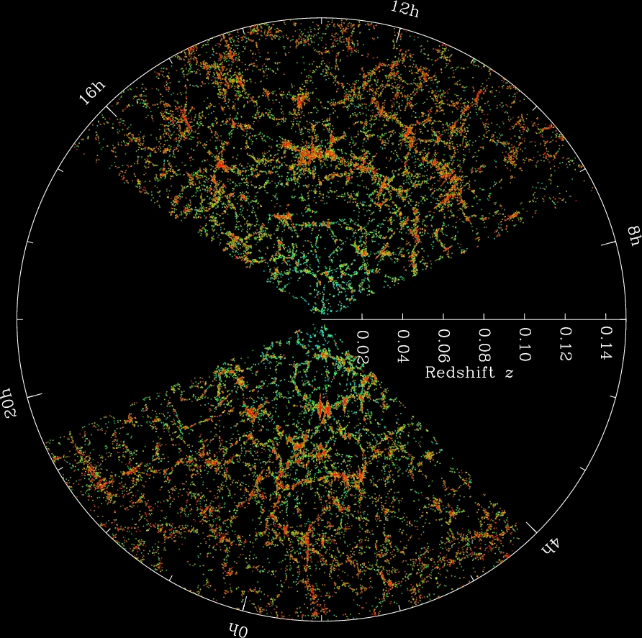
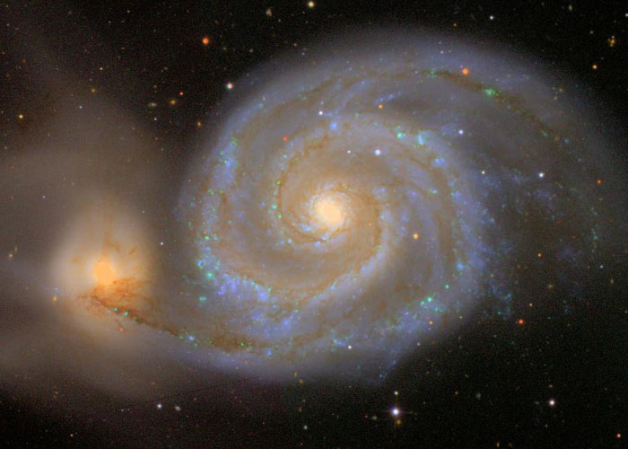
Nineteen Years of Sloan Digital Sky Surveys Data
15 public data releases
DR15 – December 2018
Images cover 35% of the sky
More than 4 million spectra
5000+ scientific papers
Cited more than 200,000 times
Notes:
Twenty years of observing

Slide 3
Sloan Digital Sky Survey IV
SDSS-IV 2014-2020
SDSS-V 2020-2025
Notes:
WHY BUY WHEN YOU CAN GET THE DATA FOR FREE?
Early access to the data.
Unique access to the expertise, collaborators who know the ins and out of the data.
A wonderful distributed set of science working groups to discuss your work with
Collaboration review which makes for better papers
Networking
MaNGA is the latest element of SDSS (compared to APOGEE-1->2 and BOSS->eBOSS) but from a science perspective (moving out in distance) I’d order from left to right: Apogee-2, MaNGA, eBOSS. This is not important.

Slide 4
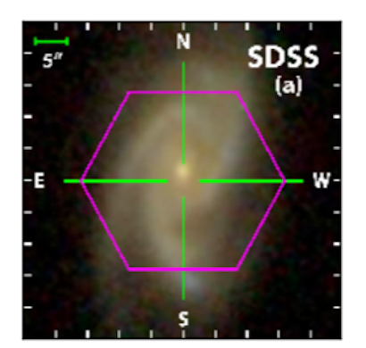
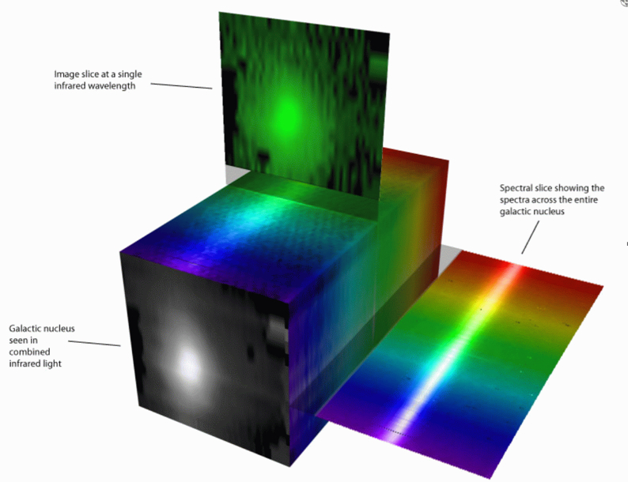
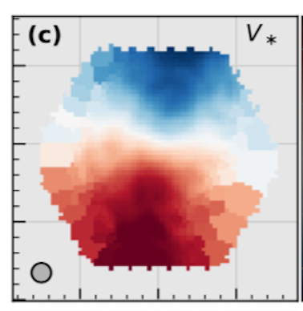
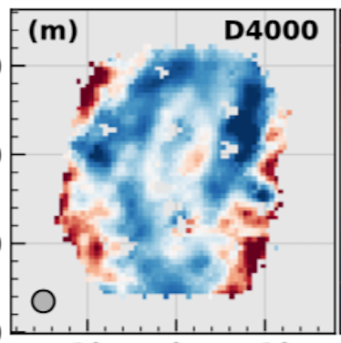
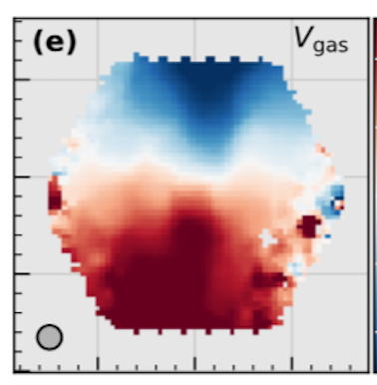
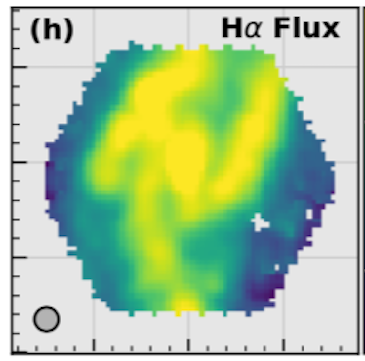
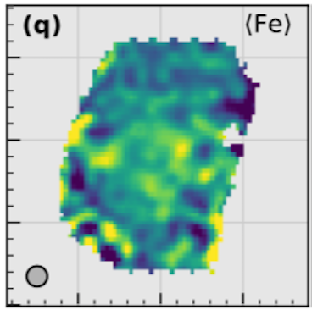
SDSS-IV MaNGA is the Largest Survey of its
kind in the World
4261 galaxies and growing
Galaxy image at one wavelength
Spectra at each point
Galaxy image
Image credit: Stephen Todd (ROE) and Douglas Pierce-Price (JAC)
https://dr15.sdss.org/marvin
Notes:
MaNGA is the biggest survey of its kind in the world, and still going. On track to exceed expectations due to the efficiency of our wonderful observers.
And now Marvin data access tools also public.

Slide 5
SDSS-IV APOGEE is the world’s only survey taking spectra of stars in both hemispheres

Slide 6
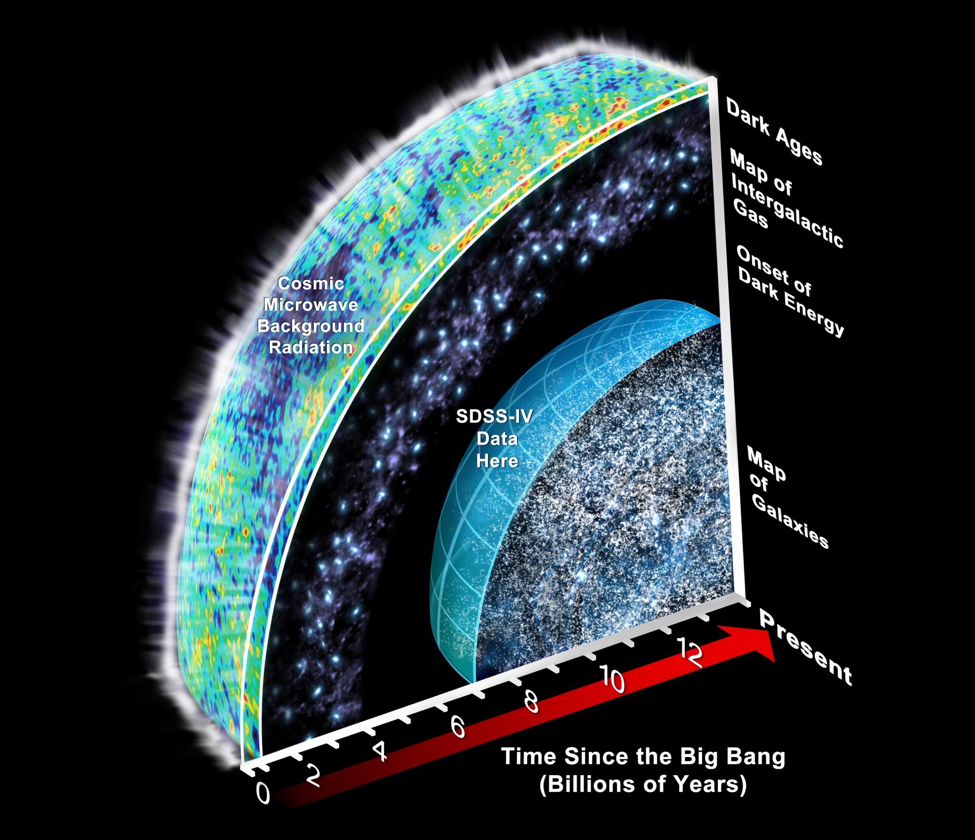
SDSS-IV eBOSS Finishes Observing in Feb 2019
Stay tuned for Cosmology results!
Notes:
eBOSS finishes the redshift surveying mission of SDSS in February -- stay tuned for its final results.

Slide 7
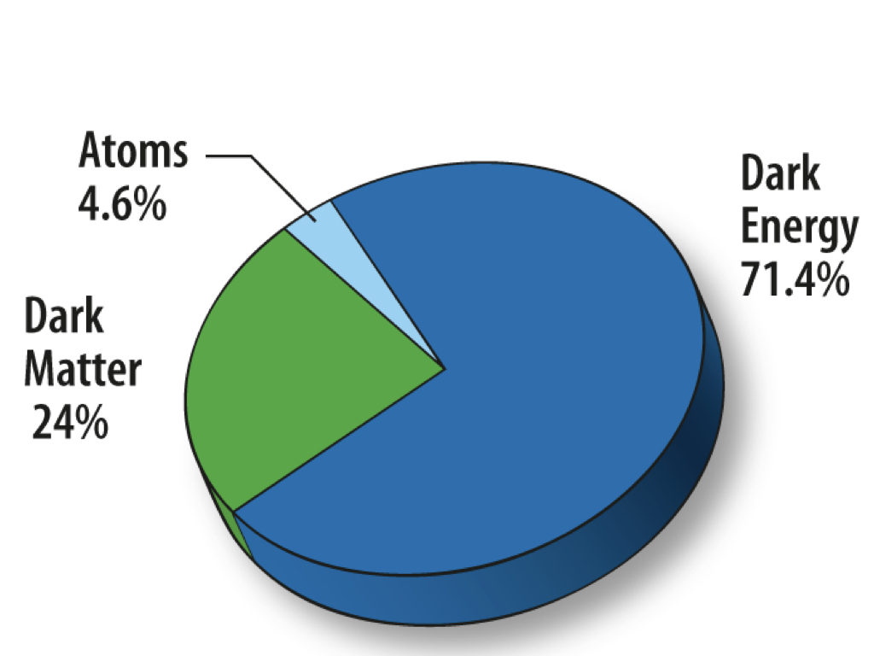
Content of the Universe

Slide 8
SDSS-IV Funding Pie
Notes:
We are member-funded. I think it might really be worth describing how unusual this is. We aren't just a large collaboration, but we really operate off of member funds. SDSS is 25% Sloan, 5% DOE, and 70% member institutions. See attached the silly pair of slides I've ever made on this, which you might consider ... Original is a NASA image so free to use.

Slide 9
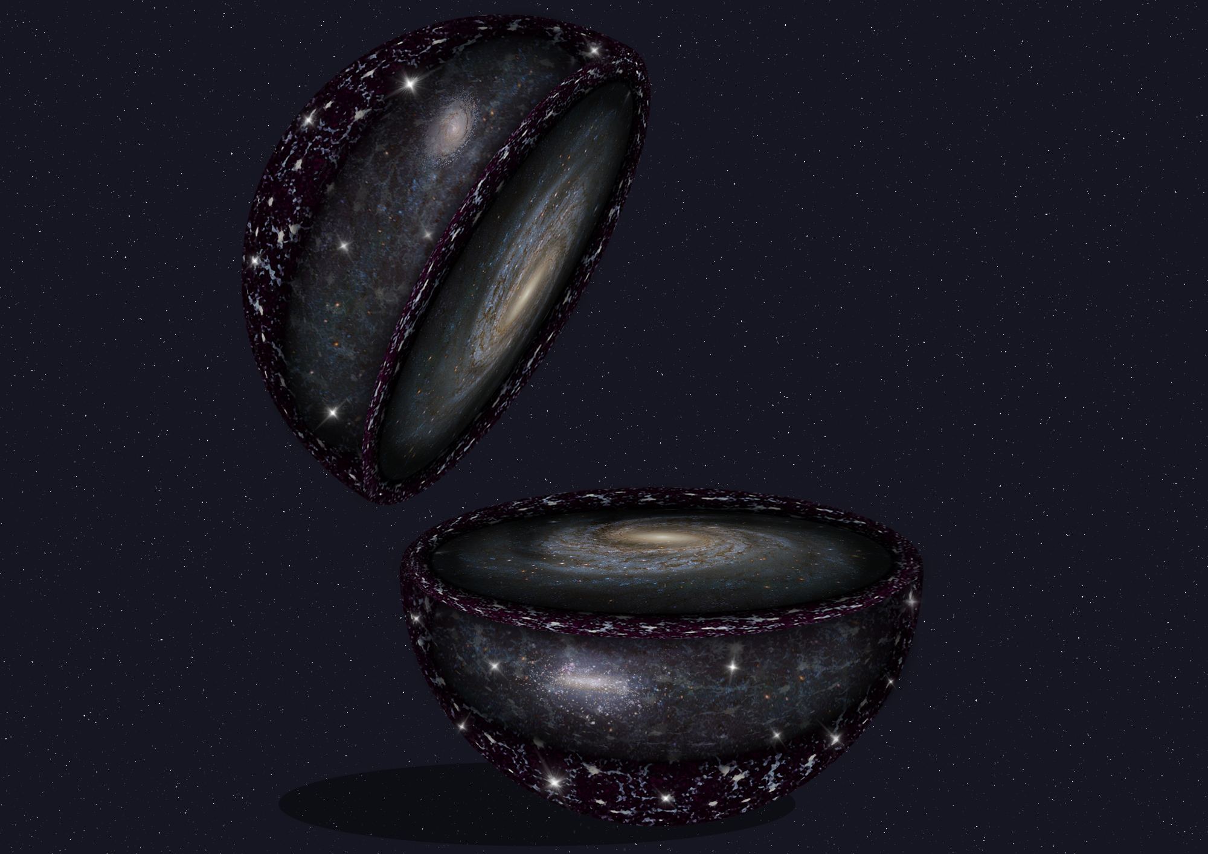
SDSS-V
Pioneering Panoptic Spectroscopy
2 hemispheres  10 spectrographs  6,000,000 objects
2020-2025
Formation of our Milky Way Galaxy
Supermassive black hole
growth
Stellar astrophysics
Stellar & interstellar interactions
Notes:
New technology 6x more sources
Observing stars in the Milky Way to black holes in distant galaxies in both hemisphere.

Slide 10
SDSS-V
Coming Soon
New institutions welcome to join (SDSS-IV/V combined deal)

Slide 11
SDSS-IV Press Items Today
It’s Never Too Late to Get Active: APOGEE Chemical Abundances of the Large Magellanic Cloud Reveal a Lazy Past and Active Present – David Nidever (Montana State University/NOAO)
Science in the Library: A New Library of Stellar Spectra for MaNGA – Renbin Yan (University of Kentucky)
Mining MaNGA for Mergers: Accurate Identification of Galaxy Mergers with Imaging and Kinematics – Rebecca Nevin (University of Colorado)
@sdssurveys
www.sdss.org

