Slide 1
Cold Quasars: Nature’s Jekyll and Hyde
Allison Kirkpatrick
University of Kansas
Email: akirkpatrick@ku.edu
Cell: 203-640-9151

Slide 2
Notes:
The life cycle of massive galaxies is a dramatic story, in which two disk galaxies collide, much as our own Milky Way will with Andromeda. This collision causes upheaval in the gas, pushing it towards the centers of the galaxies and falling into the supermassive black holes hidden there. This new gas supply causes these black holes to “turn on”, gravitational accelerating all gas around them and superheating it, becoming active galactic nuclei. The heat causes feedback of winds and jets into the now singular host galaxy, and a quasar has been born.

Slide 3
Feeding of Active Galactic Nuclei
Transitioning quasars are a missing link
X-ray Detected Dual AGN
Infrared Detected Obscured AGN
Dust-Reddened Quasar
Luminous Blue Quasar
Elliptical Galaxy
Lots of Gas and Dust
Little Gas and Dust
Kocevski et al. (2015)
Notes:
Quasars are the most luminous objects in the universe. They are the most active of galactic nuclei. They are almost universally produced by major mergers. Initially, as galaxies start to collide, we will see two active galactic nuclei (or AGN), and as gas is funneled towards the center, the AGN become obscured by gas and dust and we can no longer see them directly. As the AGN merge, the quasar phase has arrived. Now the supermassive black hole is eating the most material it will consume in it’s life, and it is starting to burp out winds, so to speak. These winds clear away all the dust, leaving a blue quasar behind, which then fades into a passive, or dead, elliptical galaxies. We infer that red quasars turn into blue quasars, but it has never been witnessed. Transitioning quasars are a missing link…until now.

Slide 4
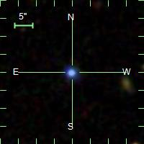
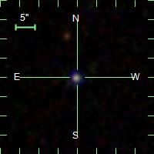
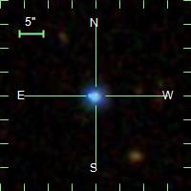
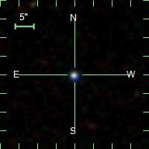
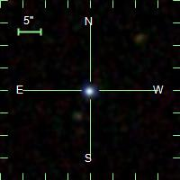
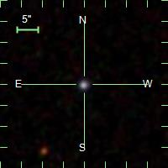
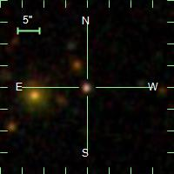
The Missing Links:
22 X-ray and optically bright blue quasars in the very
distant universe
Notes:
Out of a survey of thousands of AGN, we found 22 very special quasars that we believe are transitioning and actively quenching their host galaxies. These quasars are all located about 6 – 12 billion light years away, when the universe was less than half it’s current age.
Top row: 475, 2509, 2651, 3065, 3122, 3414,
Middle row: 3716, 3819, 3857, 3960, 3997, 4077
Final row: 4252, 4324, 4336, 4472, 4520, 4668
Leftovers: 4899, 5074, 5097, 5122
Probably doesn’t look like much. Quasars usually don’t. Universe was 2 to 7 billion years ago.

Slide 5
A Blue Quasar with Dust
This galaxy is one of the most luminous X-ray sources in our survey, L_{x} = 10⁴⁶ erg/s
Optical image,
Legacy Survey
NASA/JPL
Age of the Universe is 5.6 Billion years in this images
X-ray and optical emission arises in the vicinity of the supermassive black hole
Notes:
This galaxy is one of the most luminous X-ray sources in our survey, and this light has traveled to reach us over the past 7 billion years. To put it’s X-ray energy output in context, it would be the equivalent of ten trillion suns shining on the Earth. This incredibly energy is powered by gravitational accretion onto the supermassive black hole at the center. The blue color signifies the absence of dust around the black hole. Dust makes things red, like when the sun passes through more of the atmosphere at sunset

Slide 6
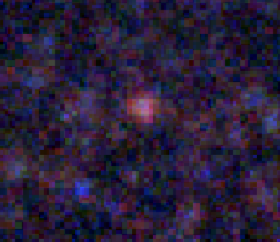
A Blue Quasar with Dust
This galaxy is one of the most luminous X-ray sources in our survey, L_{x} = 10⁴⁶ erg/s
This galaxy has 100 times more dust than the Milky Way
Optical image,
Legacy Survey
Far-IR image,
Herschel Space Observatory
Age of the Universe is 5.6 Billion years in this images
Notes:
And yet, when we go looking for dust and gas directly, we find this. This red blob is emission from large dust grains, mixed with gas, in this same galaxy. Again, this galaxy is one of the brightest in the field. Now, this doesn’t look like much, due to the resolution of Herschel, but here is what we think we would see if we were up close.

Slide 7
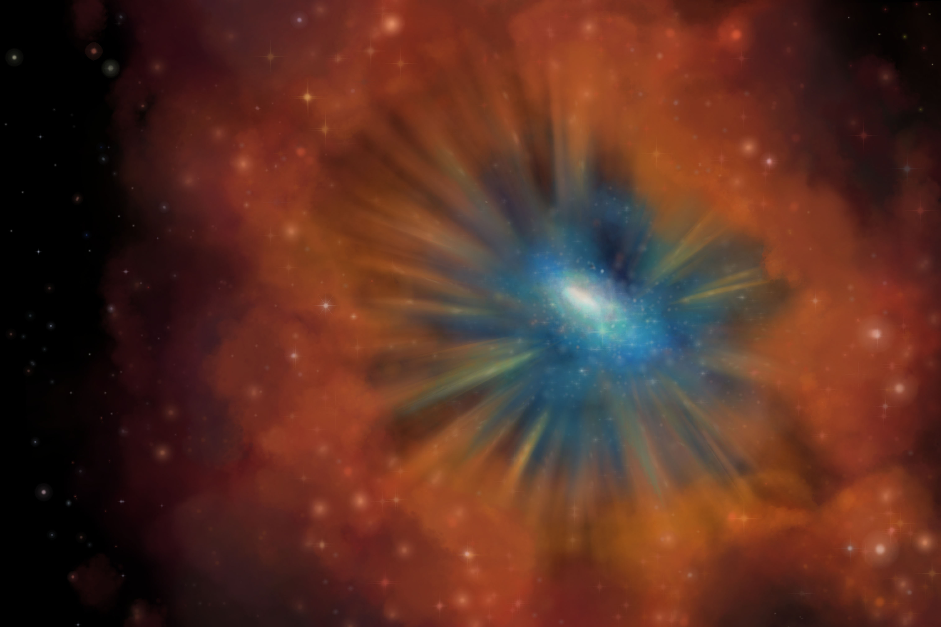
Winds are moving through the galaxy clearing the gas and dust
Image credit: M. Vigeant

Slide 8
Cold Quasars are Retiring
Prior to now, quasars with dust were “red” and quasars without dust were “blue”
4% of quasars are blue but also have dust and gas
This new population of Cold Quasars are rare and short-lived
The Cold Quasar phase is a transition as a galaxy rids itself of the fuel to make stars
Soon, the galaxy will enter the passive retirement of its life
AURA/STScI/NASA/JPL
NASA/CXC/NRC/STScI/NRAO/VLA
Notes:
They only last millions of years

