Slide 1
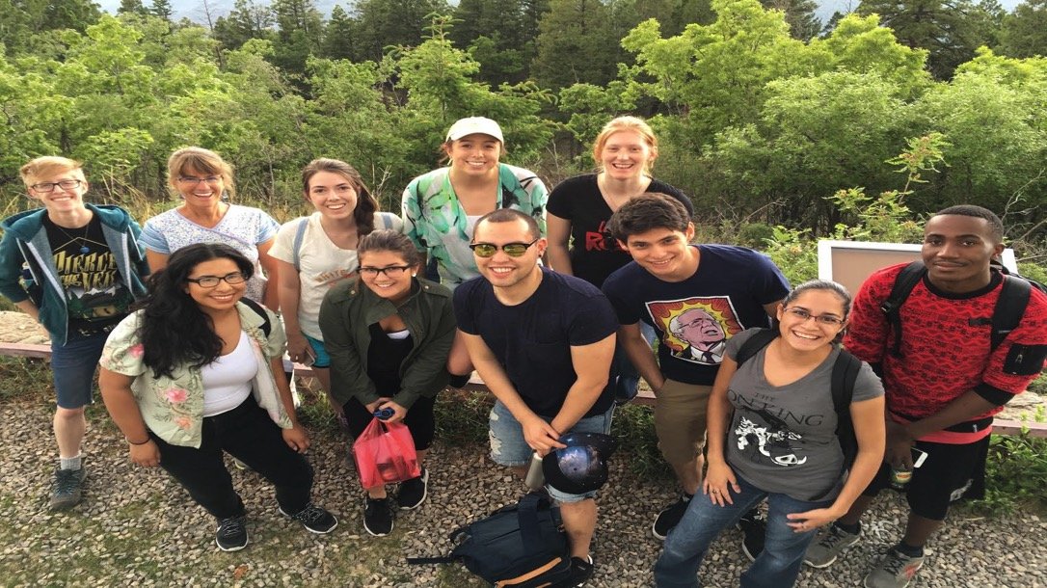
Efforts to Promote Inclusivity in SDSS
COmmittee for INclusivity in SDSS (COINS)
Kelly Holley-Bockelmann

Slide 2
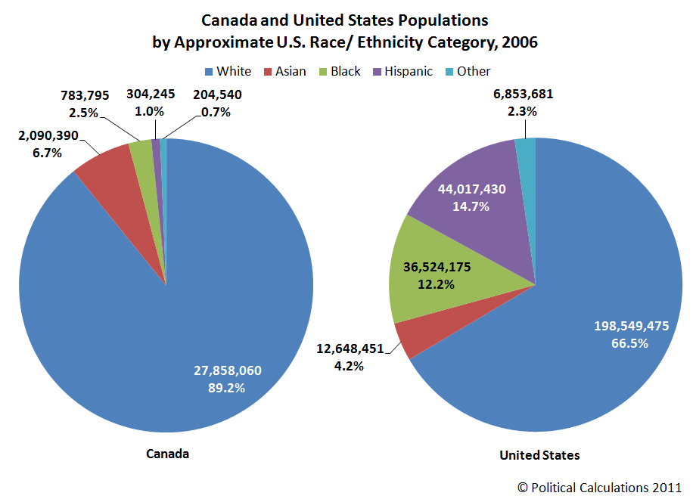
Racial minorities in astronomy are underrepresented by an order of magnitude
Asian
Hispanic
Hispanic
Other
Astronomy
US
African American
Asian
White
White
African American
Nelson, 2007
Likewise, ~10% of the SDSS survey are minorities

Slide 3
COINS Identified Barriers to Equity in SDSS Science…
Very high cost for institutions to join
Insufficient on-ramping for new collaborators
Lack of financial support and research opportunities for students
…and started and SDSS REU + FAST

Slide 4
Faculty and Student Teams (FAST) -- designed to broaden participation through research partnerships with SDSS members
Support transitions into SDSS collaboration
Geared toward fostering meaningful research collaborations
Flexible definition of eligibility to ensure minority talent not excluded
Faculty + minority students
Minority faculty + PhD student
Faculty team from a Minority Serving Institution

Slide 5
FAST teams are paired with SDSS scientists to ease transition into collaboration
Free membership in collaboration
Mentorship and training (not just access to data)
Faculty summer support
Travel to meetings/for collaborating
Student research stipend
Access to centralized computing
At Apache Point Observatory during bootcamp

Slide 6
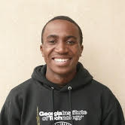
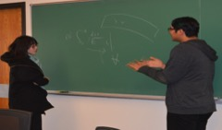
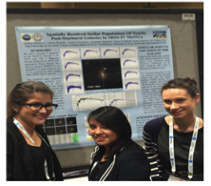
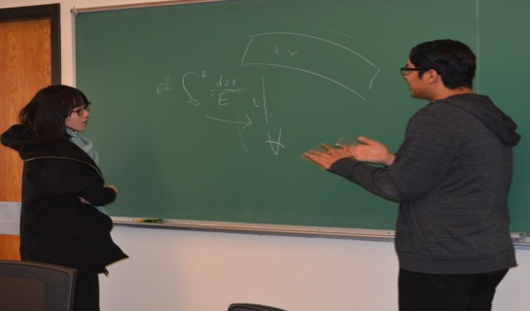
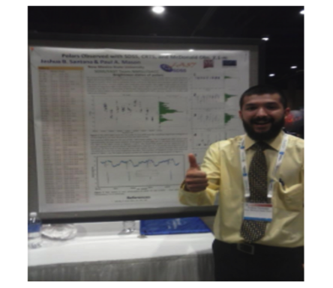
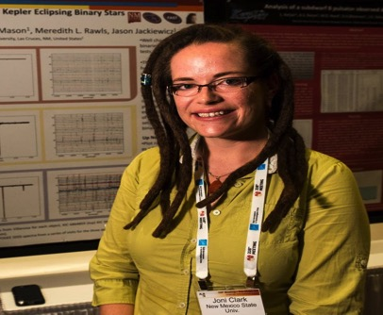
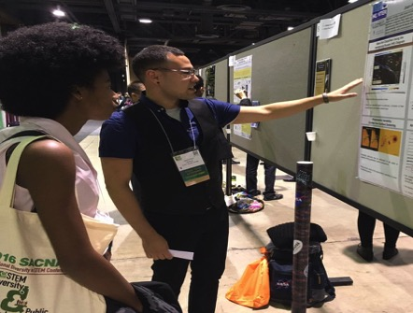
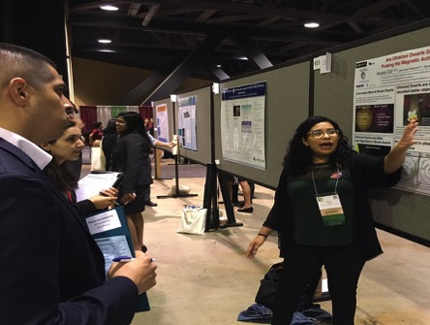
2016 FAST Teams
Spectroscopic Analysis of Ultracool Dwarfs
FAST faculty: Adam Burgasser
Students: Christian Aganze, Christopher Theissen, Jennifer Werk
SDSS Collaborators: Sarah Schmidt and Jennifer Johnson
Wavelet Analysis of Large Scale Structure in eBOSS
FAST advisor: Jesús Pando
Students: Noel Garcia, Taurean Ford, Kevin Kadowaki
SDSS Collaborator: Ashley Ross
Stellar population distributions and star formation histories of post-starburst (or 'E+A') galaxies in the MaNGA survey
FAST advisor: Charles Liu
Students: Ashley Betances, Alaina Bonilla, Andrea Gonzalez, Olivia James, Christina Migliore, Muhammed Wally, Nicole Wallack, Olivia Weaver
SDSS Collaborator: Karen Masters
Stellar population distributions and star formation histories of post-starburst (or 'E+A') galaxies in the MaNGA survey
FAST advisor: Charles Liu
Students: Ashley Betances, Alaina Bonilla, Andrea Gonzalez, Olivia James, Christina Migliore, Muhammed Wally, Nicole Wallack, Olivia Weaver
SDSS Collaborator: Karen Masters
Wavelet Analysis of Large Scale Structure in eBOSS
FAST advisor: Jesús Pando
Students: Noel Garcia, Taurean Ford, Kevin Kadowaki
SDSS Collaborator: Ashley Ross
Characterizing Kepler Eclipsing Binaries Observed with SDSS/APOGEE
FAST advisor: Paul Mason
Students: Christina Solis, James Vesper, Joshua Santana, Jonathan Delgado
SDSS Collaborator: Jason Jackiewcz
Alaina, Andrea, and Christina at their first AAS meeting, 2016
APOGEE/Kepler Overlap Yields Orbital Solutions For A Variety of Eclipsing Binaries
FAST advisor: Meredith Rawls
Student: Joni Clark Cunningham
SDSS Collaborator: Jason Jackiewcz
Yunyun Wu (left) and Noel Garcia (right) talk about the 2-point correlation function, 2016
Using TDSS to Examine the Magnetic Variability on the Coolest Stars
FAST advisors: Kelle Cruz and Emily Rice
Students: Jean-Paul Ventura, Aurora Cid
SDSS collaborator: Sarah Schmidt
Joshua Santana at his first AAS meeting, 2016
Joni Clark Cunningham at her first AAS meeting, 2016
Jean-Paul Ventura (left) and Aurora Cid (right) at the SACNAS meeting, 2016

Slide 7
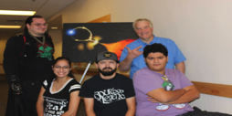
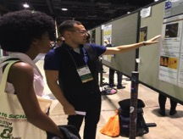
2016 FAST Teams
Characterizing Kepler Eclipsing Binaries Observed with SDSS/APOGEE
FAST advisor: Paul Mason
Students: Christina Solis, James Vesper, Joshua Santana, Jonathan Delgado
SDSS Collaborator: Jason Jackiewcz
Using TDSS to Examine the Magnetic Variability on the Coolest Stars
FAST advisors: Kelle Cruz and Emily Rice
Students: Jean-Paul Ventura, Aurora Cid
SDSS collaborator: Sarah Schmidt
APOGEE/Kepler Overlap Yields Orbital Solutions For A Variety of Eclipsing Binaries
FAST advisor: Meredith Rawls
Student: Joni Clark Cunningham
SDSS Collaborator: Jason Jackiewcz
Stellar population distributions and star formation histories of post-starburst (or 'E+A') galaxies in the MaNGA survey
FAST advisor: Charles Liu
Students: Ashley Betances, Alaina Bonilla, Andrea Gonzalez, Olivia James, Christina Migliore, Muhammed Wally, Nicole Wallack, Olivia Weaver
SDSS Collaborator: Karen Masters
Wavelet Analysis of Large Scale Structure in eBOSS
FAST advisor: Jesús Pando
Students: Noel Garcia, Taurean Ford, Kevin Kadowaki
SDSS Collaborator: Ashley Ross
Characterizing Kepler Eclipsing Binaries Observed with SDSS/APOGEE
FAST advisor: Paul Mason
Students: Christina Solis, James Vesper, Joshua Santana, Jonathan Delgado
SDSS Collaborator: Jason Jackiewcz
Alaina, Andrea, and Christina at their first AAS meeting, 2016
APOGEE/Kepler Overlap Yields Orbital Solutions For A Variety of Eclipsing Binaries
FAST advisor: Meredith Rawls
Student: Joni Clark Cunningham
SDSS Collaborator: Jason Jackiewcz
Yunyun Wu (left) and Noel Garcia (right) talk about the 2-point correlation function, 2016
Using TDSS to Examine the Magnetic Variability on the Coolest Stars
FAST advisors: Kelle Cruz and Emily Rice
Students: Jean-Paul Ventura, Aurora Cid
SDSS collaborator: Sarah Schmidt
Joshua Santana at his first AAS meeting, 2016
Joni Clark Cunningham at her first AAS meeting, 2016
Jean-Paul Ventura (left) and Aurora Cid (right) at the SACNAS meeting, 2016

Slide 8
2016 FAST Snapshot
57% women
66% underrepresented minorities
>25% 1st generation college students
15 AAS abstracts
~4 to go on to PhD
This past year I was very close to leaving the field I love so dearly. FAST connected me with mentors who refreshed and rejuvenated my love of astronomy. and inspired me to pursue a PhD in Astrophysics.
Joni Clark Cunningham, FAST NMSU

