Slide 1
1st Results from CHIME/FRB
American Astronomical Society Press Briefing
Wednesday Jan 9, 10:15am
Prof. Victoria Kaspi & Ms Deborah Good
on behalf of the CHIME/FRB Collaboration
vkaspi@physics.mcgill.ca dgood@phas.ubc.ca

Slide 2
CHIME/Fast Radio Burst Team
UBC
  Mandana Amiri
  Dr. Davor Cubranic
  Meiling Deng
  Deborah Good
  Mateus Fandino
  Prof. Mark Halpern
  Carolin Hofer
  Dr. Alex Hill
  Prof. Gary Hinshaw
  Nikola Milutinovic
  Tristan Pinsonneault-Marotte
  Dr. Richard Shaw
  Prof. Ingrid Stairs
  Don Wiebe
  Prateek Yadav
Perimeter Institute
  Utkarsh Giri
  Dr. Dustin Lang
  Masoud Rafiei Ravandi,
  Prof. Kendrick Smith
WVU: Prof. Kevin Bandura
McGill University
  Bridget Andersen
  Mohit Bhardwaj
  Paula Poubel
  Dr. Jojo Boyle
  Shiny Brar
  Pragya Chawla
  Jean-Francois Cliche
  Prof. Matt Dobbs
  Dr. Emmanuel Fonseca
  Adam Gilbert
  Prof. David Hanna
  Alex Josephy
  Prof. Vicky Kaspi
  Marcus Merryfield
  Dr. Daniele Michilli
  Charles Moatti
  Dr. Arun Naidu
  Chitrang Patel
  Ziggy Pleunis
  Dr. Seth Siegel
  Dr. Shriharsh Tendulkar
  Andrew Zwaniga
University of Toronto
  Tomas Cassanelli
  Nolan Denman
  Prof. Bryan Gaensler
  Ajay Gill
  Ryan Mckinven
  Dr. Cherry Ng
  Dr. Hsiu Hsien Lin
  Prof. Ue-Li Pen
  Dr. Mubdi Raham
  Andre Recnik
  Ian Tretyakov
  Prof. Keith Vanderlinde
DRAO
  Dr. Tom Landecker
  Dr. Paul Scholz
NRAO: Dr. Scott Ransom
MIT:
  Prof. Kiyo Masui
  Dr. Juan Mena-Parra

Slide 3
Fast Radio Bursts
Brief (~ms) radio bursts
Seen mainly at 1.4 GHz
  None yet seen below
  ~700 MHz
Estimated rate:
~1,000 /sky/day @ 1.4 GHz
Dispersion measures
too large for Milky Way
Extragalactic, probably cosmological
ORIGIN UNKNOWN!
One known repeating FRB rules out cataclysmic models for this source
Lorimer et al. 2007 Science

Slide 4
Key FRB Questions:
What are they?
Are there different classes?
Over what range of radio frequency are
they observable?
  Seen mostly at 1.4 GHz and above
  Some seen in 700 – 900 MHz range
  Not seen below 400 MHz … why?
    Intrinsically fainter?
    Scattered away?
    Absorbed?

Slide 5
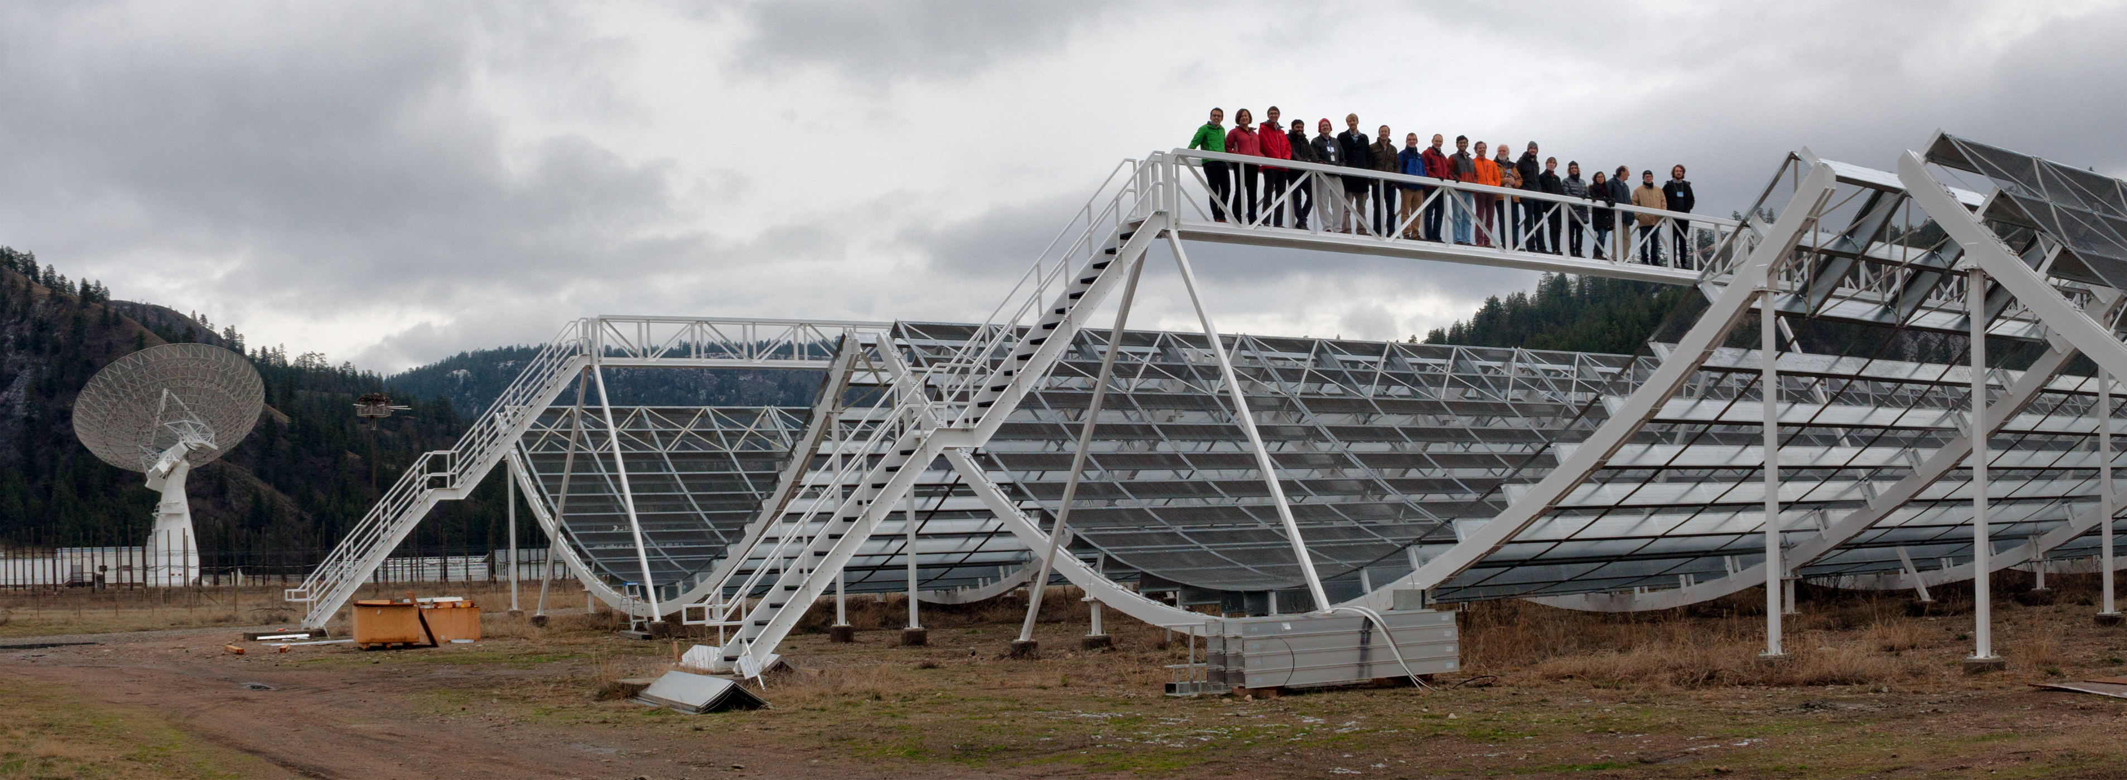
CHIME: Canadian Hydrogen Intensity Mapping Experiment
chime-experiment.ca
Penticton, BC at DRAO
4 20 m x 100 m cylinders
Transit telescope
256 dual-pol antenna feeds per axis
  Input data rate 13 Tb/s
  reduced in real time
400-800 MHz
FOV: E-W 2.5º-1.3º,
N-S ~120º

Slide 6
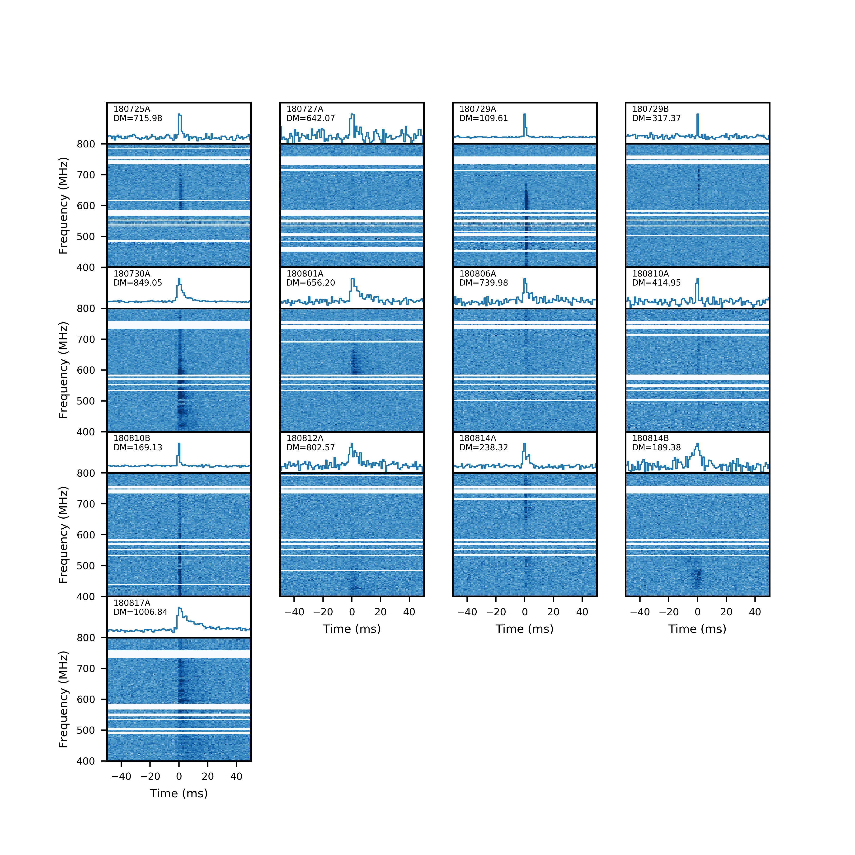
CHIME/FRB Pre-commissioning: July & August 2018
13 events detected during phase when telescope no where near full sensitivity
  Calibration strategies being tested
  Telescope was being
  turned off and on
ATEL #11901
CHIME/FRB Collaboration,
Nature Paper 1

Slide 7
CHIME FRBs: Down to 400 MHz!
Several seen to bottom of CHIME range
No scattering seen for 5/13 events
Not absorbed
Good news for low-frequency surveys e.g. LOFAR, MWA etc.
800 MHz
400 MHz
800 MHz
400 MHz

Slide 8
CHIME FRBs: Most show scattering!
7/13 have > 1 ms of
scattering @ 600 MHz
Search code biased
against more scattered pulses
Simulations show hard to get so much scattering unless FRBs in ‘special’ locations in galaxies

Slide 9
CHIME/FRB Discovery of 2nd Repeater FRB 180804.J0422+73
Burst structures
reminiscent of those of 1st repeater (R1)
R2 DM=189 pc/cc
  < half that of R1
  D < 500 Mpc
  Z < 0.1
New opportunity for FRB localization, galaxy ID
That 1/13 CHIME FRBs repeats
suggests that repeaters
may not be so rare!

Slide 10
Summary: CHIME/FRB 1st Results
CHIME detects FRBs down to 400 MHz
  Some completely unscattered
    Good news for low-frequency surveys!
  Most highly scattered
    Clues to the environments of FRBs: must be in
    “special” locations
CHIME/FRB detects 2nd repeating FRB
  Burst structure similar to that of R1: clue about repeaters?
  New chance for localization
  Suggests repeating FRBs not very rare

Slide 11
REMAINING SLIDES IN RESERVE IN CASE OF RELEVANT QUESTIONS

Slide 12
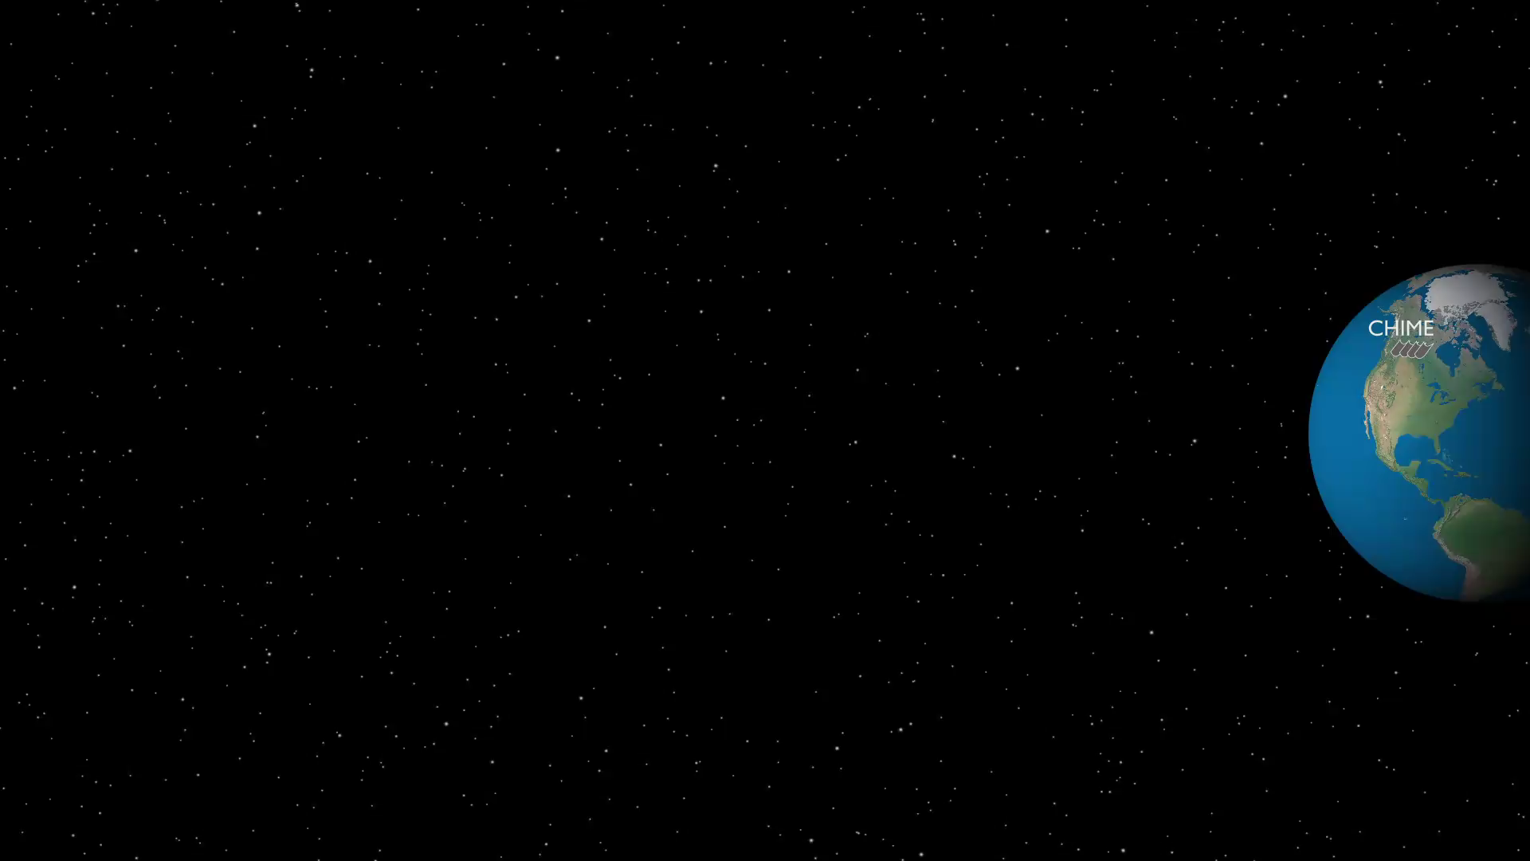

Slide 13


Slide 14
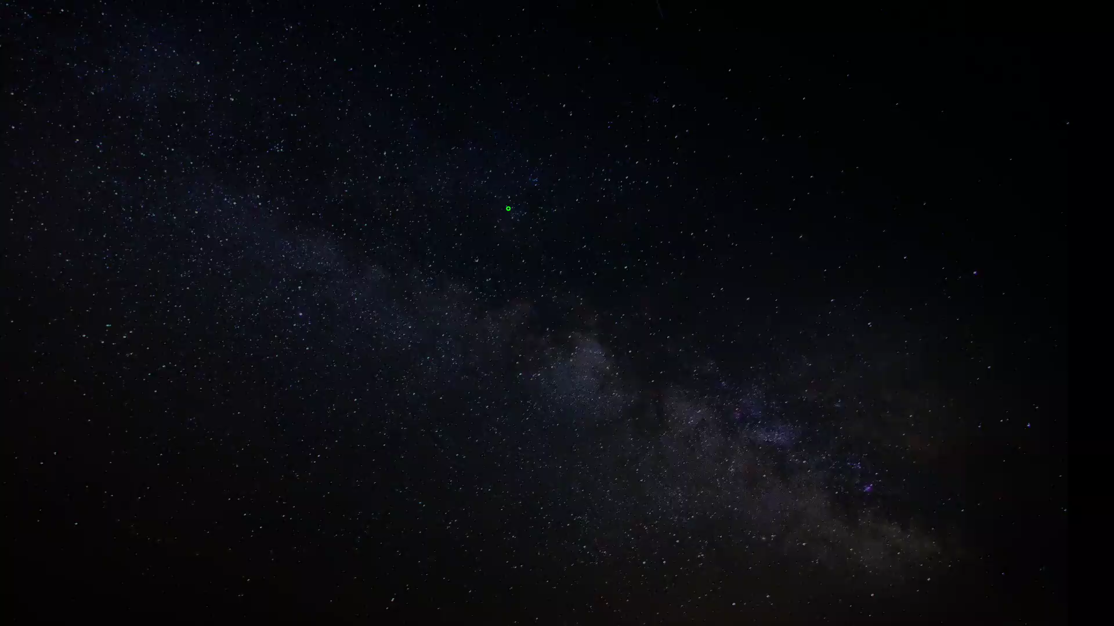

Slide 18
CHIME System Diagram

Slide 19
CHIME/FRB
X-Engine
F-Engine

Slide 20
Theories for FRBs
2 classes:
  Cataclysmic:
    Supernova?
    Compact object merger?
    Annihalating mini black holes?
    …
  Non-cataclysmic:
    Neutron star or magnetar?
    Compact object interaction with AGN?
    Cosmic string cusps?
    …
See online FRB Theory Wiki for more models!

Slide 21
Repeating FRB
Until now, only one
repeater discovered:
FRB 121102
Rules out cataclysmic
models for this source
Interesting burst
structure seen in
repeater
Localized to dwarf
galaxy at z=0.2

