Slide 1
Measuring the local ISM along the sight lines of the two Voyager spacecraft with HST/STIS
Julia Zachary¹, Seth Redfield¹, Jeffrey Linsky²
1. Astronomy Department, Wesleyan University, Middletown, CT;
2. JILA, University of Colorado, Boulder, CO
Poster 340.34
JZ contact info: jzachary@wesleyan.edu, SR contact info: sredfield@wesleyan.edu

Slide 2
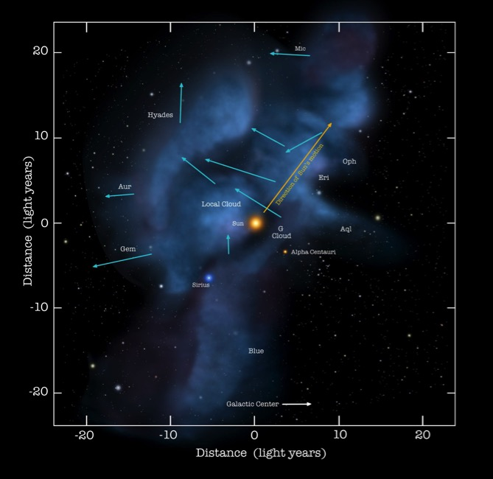
Background
The interstellar medium (ISM) is the space between the stars containing clouds of gas and dust.
The interaction between the outward pressure of the solar wind and the surrounding ISM is the heliosphere, a bubble enclosing the Solar System.
The Voyager spacecraft are now moving out of heliosphere and into the ISM.
Credit: NASA/Goddard/Adler/U.Chicago/Wesleyan

Slide 3
Big picture
We obtain unique, simultaneous measurements – in-situ and line-of-sight – from two seasoned NASA missions, the Voyager spacecraft and the Hubble Space Telescope (HST).
If the Voyager spacecraft are on a road trip through the galaxy, then they are the street view to HST’s Google Maps.
With the announcement of Breakthrough Starshot, we now are considering missions through interstellar space and need to know about the structure of the ISM.

Slide 4
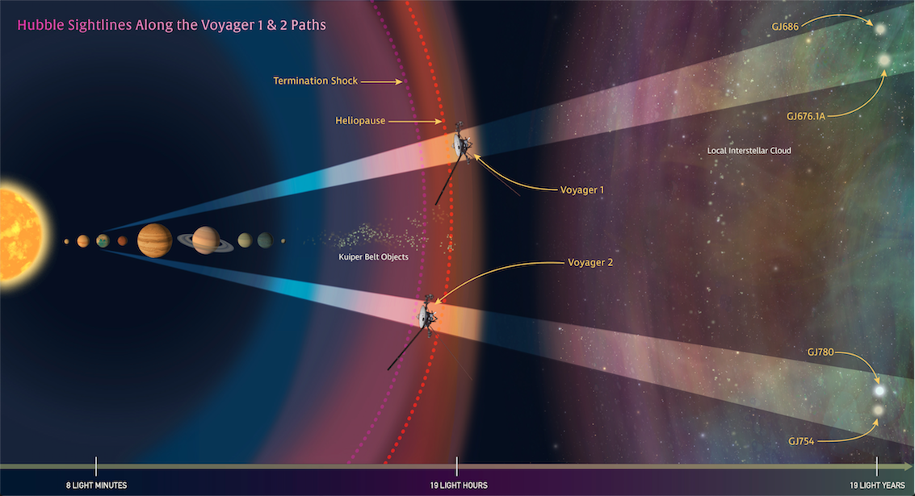
Credit: NASA/STScI

Slide 5
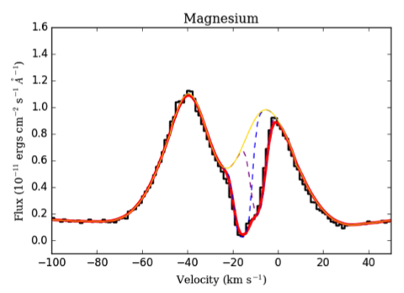
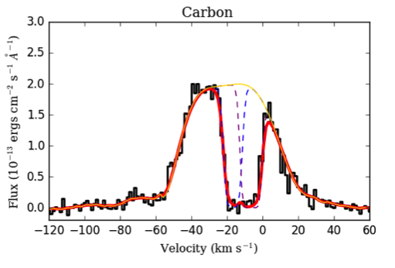
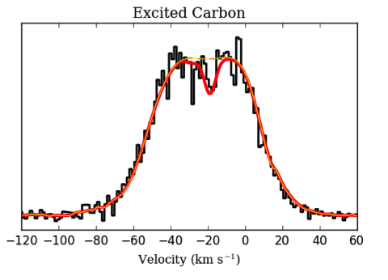
Spectroscopic measurements of the ISM
The black line is the observed HST spectrum, the gold line is the shape of the missing stellar emission, the dashed blue and purple lines are absorption from two ISM clouds, and the red line is the final combined fit to the data.

Slide 6
Conclusions
We have acquired high-resolution spectra along sight lines that canvass the same ISM that the Voyager spacecraft are currently measuring, connecting two of NASA’s highly successful and enduring missions.
We demonstrate that the local ISM into which the Voyager are moving is a complex and rich environment. Though we observe the closest stars in those directions, we see multiple ISM cloud absorbers.
Like Voyager, we too measure electron density and find that one of the absorbing clouds has a similar density, while the other cloud’s density is slightly higher.
JZ contact info: jzachary@wesleyan.edu, SR contact info: sredfield@wesleyan.edu

