Slide 1
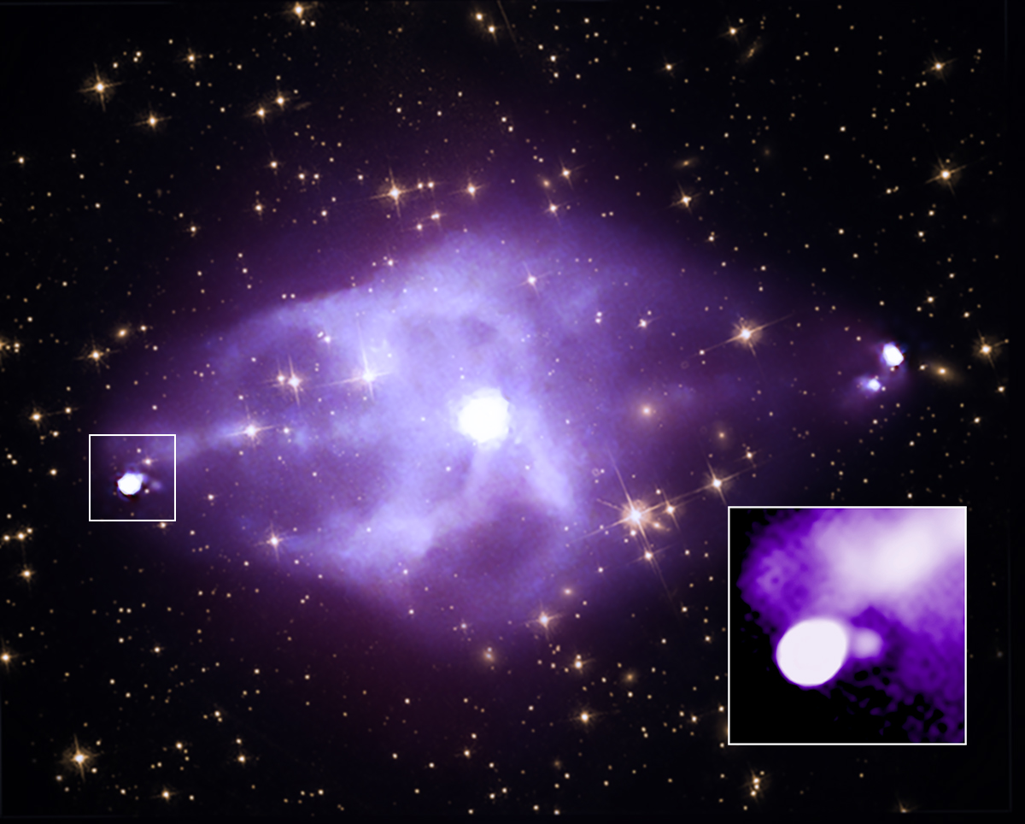
Ricocheting Black Hole Jet Discovered By Chandra
The X-ray Cavity Around Hotspot E in Cygnus A: A Bubble Inflated by the Outgoing Jet (243.16)
Amalya Johnson, Paul Nulsen, Bradford Snios
Notes:
Hi everyone my name is Amalya Johnson and today I will be talking about our discovery of a ricocheting jet from a black hole in the radio galaxy Cygnus A and the hole that this jet has punched through a cloud of energetic particles.
So here we have an image of Cygnus A using X-ray data from Chandra, and zoomed in here is where we found the jet to be ricocheting off the surrounding gas, and the region of the galaxy that we focused on for this research.

Slide 2
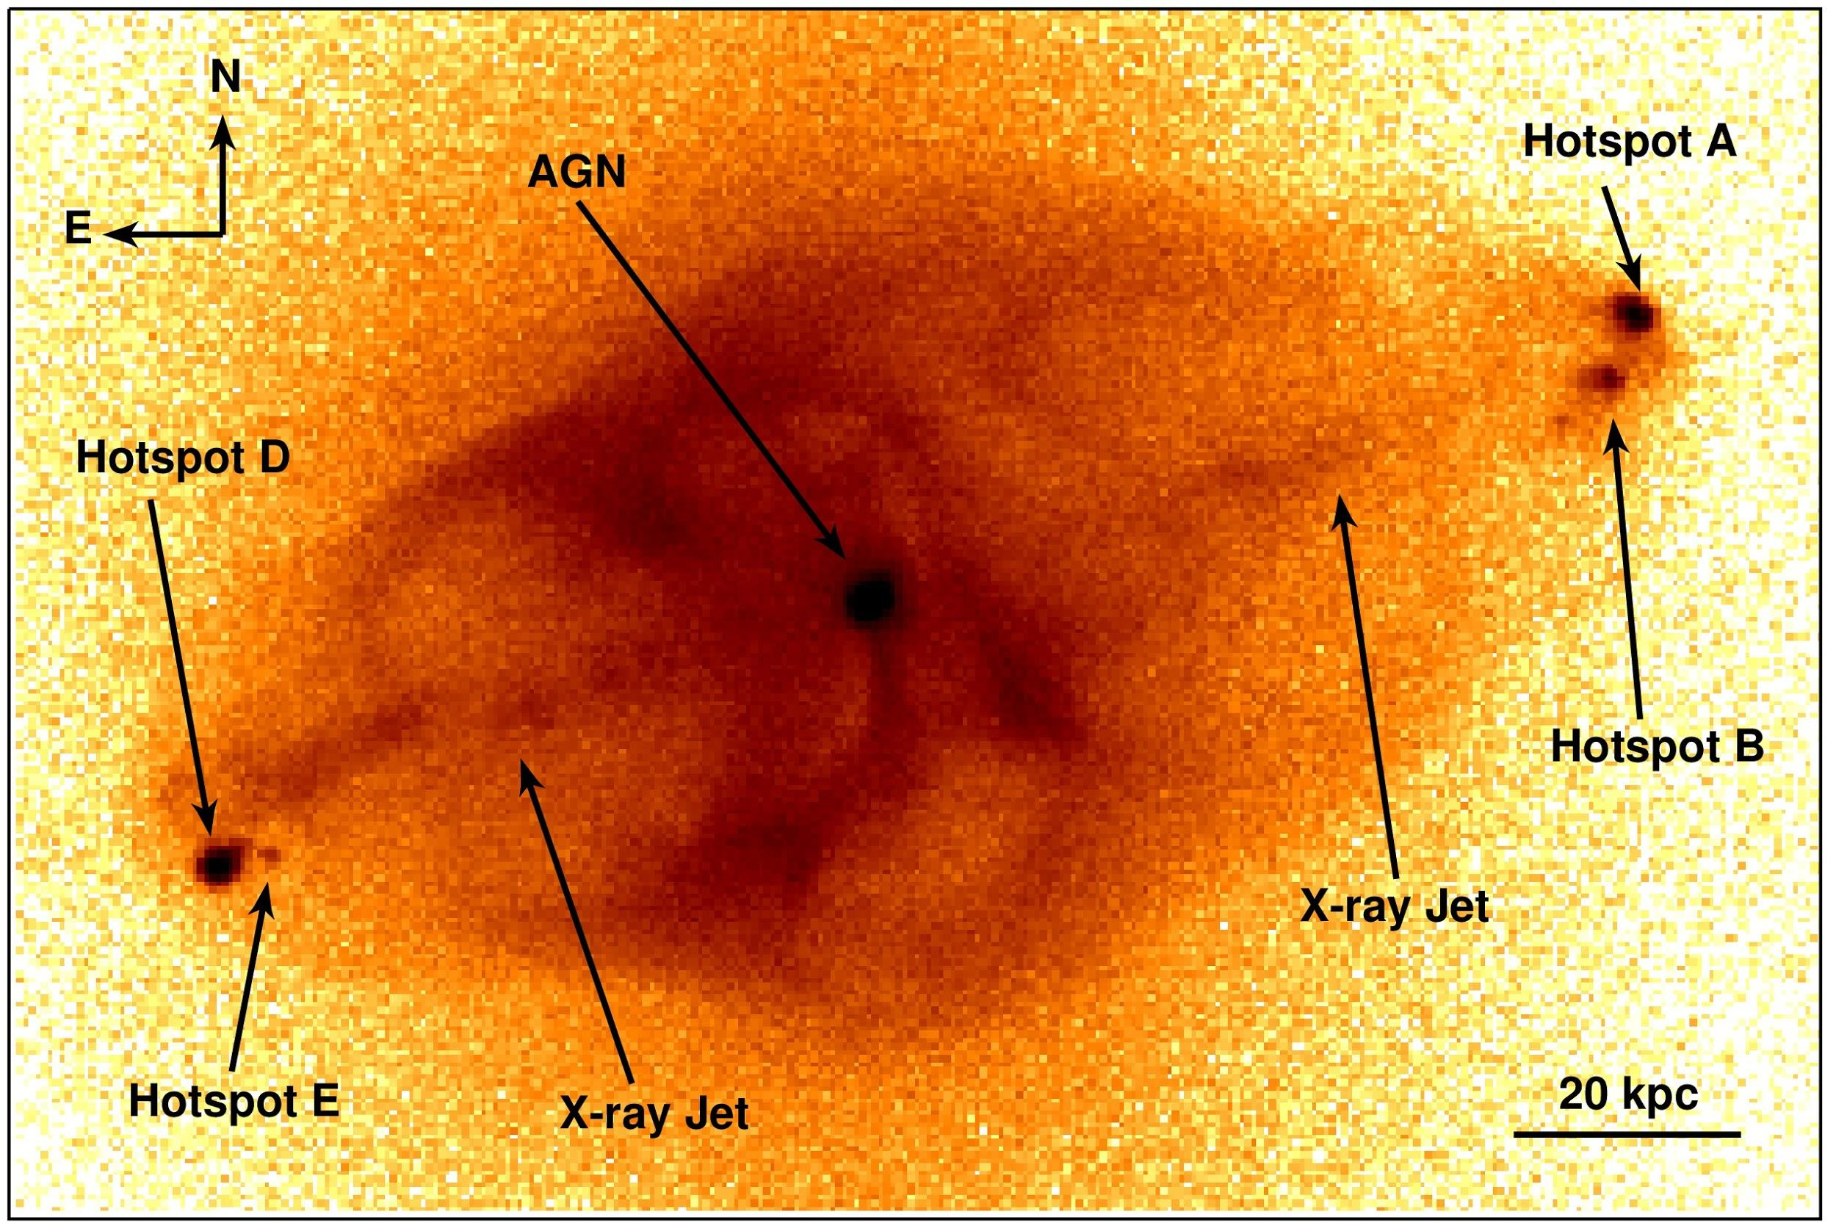
Cygnus A: A powerful nearby radio galaxy
Distinct hotspots, radio jets, and lobes
Black hole creates jets that interact with surrounding gas
600 million light years away (close!)
Notes:
So a brief overview of Cygnus A:
Cygnus A is a radio galaxy about 600 million lightyears away from Earth. While this may seem far, it is actually exceptionally close when comparing it to galaxies of similar luminosity and jet power which are found at much higher distances.
At the center of the galaxy there is a supermassive black hole that when matter accretes onto it, a pair of jets are created that flow outward from the center and carry vasts amount of power into the surrounding environment. These jets produce lobes that emit electromagnetic radiation that we can see in the radio, which is why it is called a radio galaxy, and also in the x-ray, which is why we can study it using Chandra.
At the edge of the lobes, when the jets ultimately strike the surrounding gas, we see hotspots on the east and west sides of the system that are the location of the jet striking with the intergalactic gas and depositing large amounts of energy there and exciting particles

Slide 3
Investigating Hotspot E…
Smaller hotspot
Apparent dim region surrounding the hotspot
A hole within the radio lobe?
Empty of X-ray emission?
Notes:
This work began with focusing on hotspot E, the smaller hotspot on the eastern side of the system, and investigating the dim region that appears to envelope the hotspot.
Due to the extensive Chandra observations of this galaxy, which was over 23 days, astronomers were able to notice that their seemed to be a region lacking any x-ray emission around this hotspot.
This feature was of interest because it had not been seen before in galaxies like Cygnus A and it is not seen around any other hotspots in Cygnus A.

Slide 4
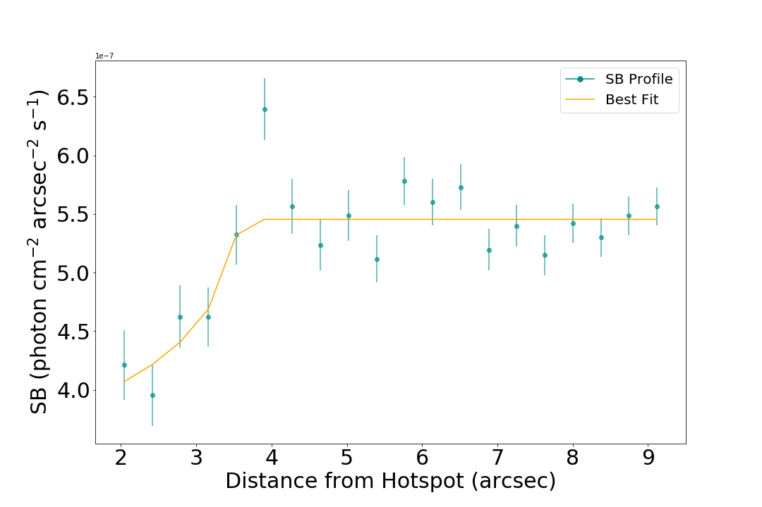
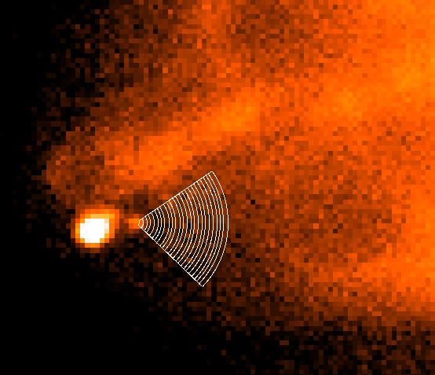
Analysis: Surface Brightness Profile
Hotspot E & Spherical Hole
1 x 10⁻⁷
Notes:
To investigate this region and see if it was actually lacking any x-ray emission, we measured and compared the emission from the dim region and from parts of the galaxy close to it.
We used surface brightness profiles to measure emission, these are just plots of brightness as a function of radial distance.
This plot is centered at Hotspot E and shows brightness as a function of distance from the hotspot.
Here we see the region of semi-constant emission that is the nearby lobe, and the hole that lacks significant emission.
The image on the left shows the regions that correspond with each point on the plot.
For the analysis we assumed the hole was a sphere, but after comparing our measurements with nearby regions, we found that it is actually deeper than it is wide.
This discovery, that the whole is deeper than it is wide, is what lead us to believe that hotspot E is the primary hotspot where the jet is first hitting the surrounding gas. And it is being deflected in such a way that we are looking down the line of sight of the jet moving away from us.

Slide 5
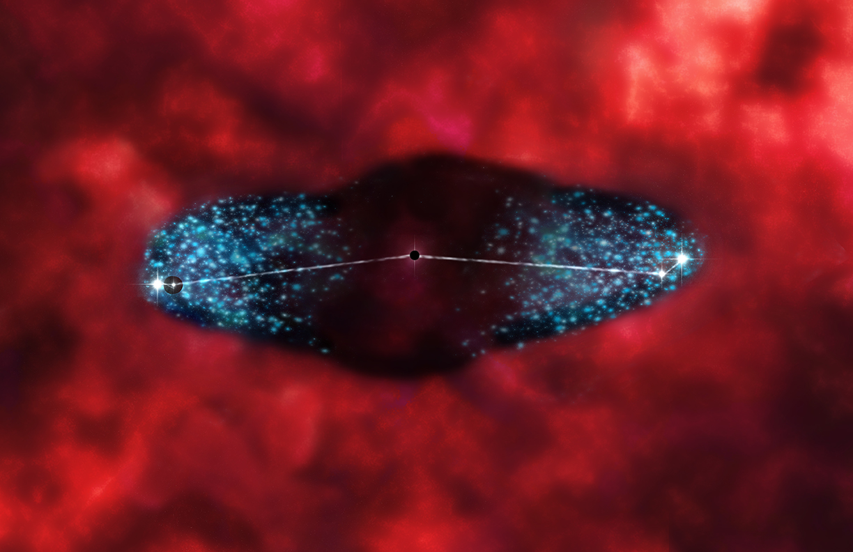
East vs. West: Relative Brightness
Jet collides with the intergalactic gas at hotspot E and deflects towards hotspot D
The deflected jet punches a hole through the cloud of energetic particles
Same thing could be occurring in the west but the jet is deflected at a closer angle towards us
Hotspot D
Hotspot E
Notes:
Discovering that the hole is deeper than it is wide leads to a more elaborate understanding of the movement of the jet at hotspot E.
At this location, the jet collides with the intergalactic gas, and excites particles there.
It is then deflected away from us, and continues towards hotspot D where it ultimately deposits the rest of its energy. And that’s why this location is brighter.
The deflected jet creates a hole as it goes through the energetic particles, and thats why we interpret it as a spherical cavity when looking at it from Chandra.
The same process could be occurring on the western side but it is moving at a closer angle to our line of sight so we see a brightness rather than a dimness — it could be moving more across our viewpoint rather than away from us.

Slide 6
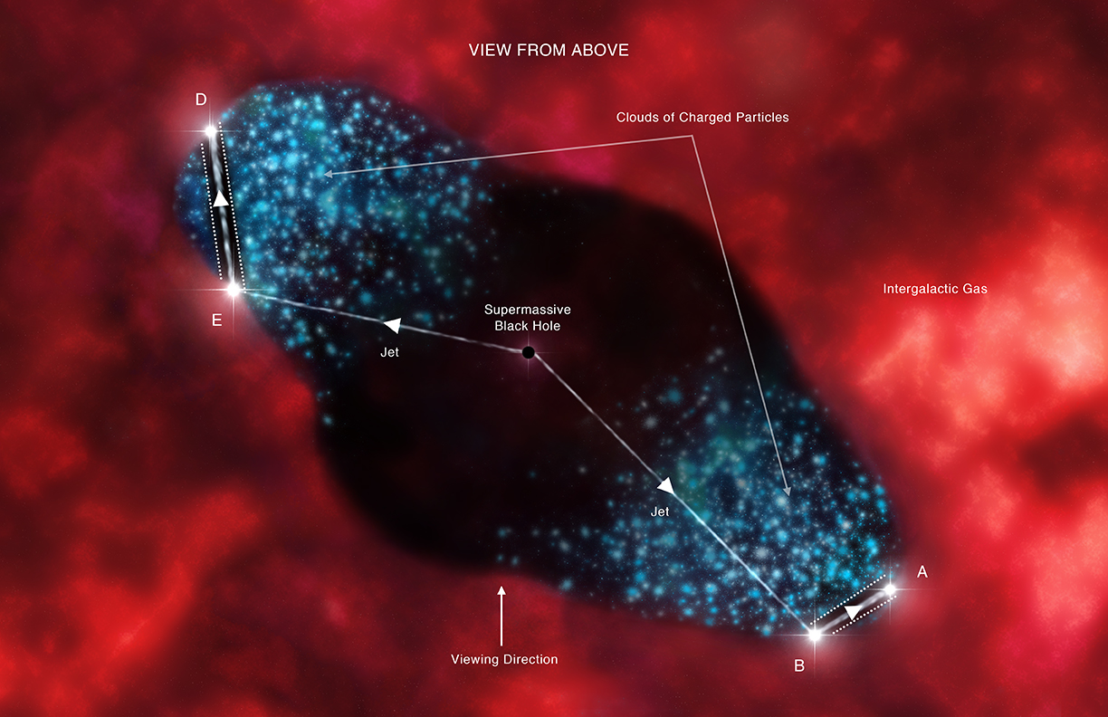
Implications
Jets play a significant role in the limitation of star formation of massive galaxies
Insight into how jets and black holes interact with their surroundings
Close measurements on the impacts of this jet can be used in models to understand specific properties of jets
VIEW FROM ABOVE
Notes:
This image is an interpretation of what this movement would look like from above, to clarify the type of deflection that we believe to be occurring at hotspots E and B.
This work is important because it confirms that hotspots E and B are the primary hotspots where the jet first hits the surrounding gas.
Since jets play such a significant role in galaxy formation, a greater understanding of how they work is important in understanding how massive galaxies evolve.
It gives insight into how jets and black holes interact with their surroundings.
And detailed analysis of Cygnus A is always significant because it gives us information about galaxies similar to it that are harder to study because they are further away.

Slide 7
Conclusions
The hole is the result of the jet colliding with the intergalactic gas
The hole is not spherically symmetric
Its apparent dimness suggests the jet is deflected away along our line of sight
Notes:
In conclusion, the hole is the result of the jet colliding with the surrounding gas.
It is not spherically symmetric but is deeper than it is wide.
And its apparent dimness suggests the jet is deflected away along our line of sight, supporting the idea that hotspot E is the primary hotspot where the jet first hits the surrounding gas.

