Slide 1
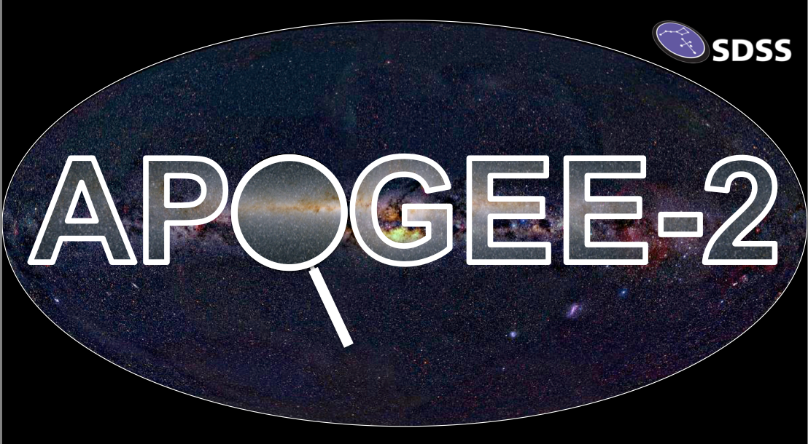
Between a Rock and a Hard Place: Can Garnet Planets Be Habitable?
Presenter: Johanna Teske
Carnegie Institution for Science
Wendy Panero Jennifer Johnson Cayman Unterborn Scott Hull

Slide 2
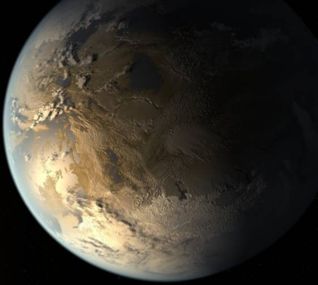
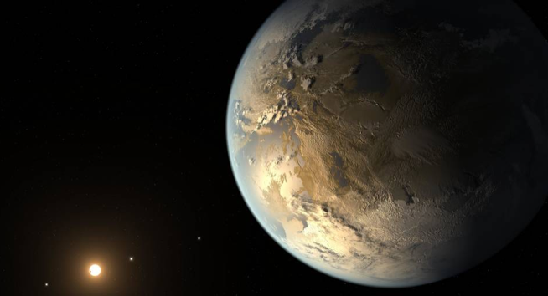
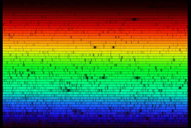
How do we determine exoplanet compositions?
Atmosphere spectroscopy,
direct
imaging
Planet mass and radius
Host star
composition
Degenerate; multiple possible compositions
Possible only for a small # of planets
Initial planet-forming ingredients help place constraints
Notes:
In fact, this conclusion is further complicated studies that have shown that there is considerable degeneracy in these mass-radius relations (e.g., Dorn et al., 2015), with multiple compositions, core mass fractions, and mantle mineralogies producing planets of similar density. Fortunately, the degeneracy in these models is greatly reduced when the composition of the host star is assumed to be a proxy for that of the exoplanet, acting as a powerful third constraint.

Slide 3
How is exoplanet composition related to habitability?
Notes:
Flowchart representing the concept of whole planet coupling. Climate influences tectonics through the role of surface temperature in a planet's tectonic regime (i.e., stagnant lid versus plate tectonics), while the tectonic regime in turn affects climate through volatile cycling between the surface and interior. The tectonic regime also influences whether a magnetic field can be generated by dictating the core cooling rate. Finally, the strength of the magnetic field influences atmospheric escape, and therefore long‐term climate evolution.

Slide 4
How is exoplanet composition related to habitability?
Earth-likeness?
Sustained surface liquid H₂O
Atmosphere & Climate
atmospheric
escape
surface temperature
rock weathering
volatile
recycling
Magnetic
Field
Tectonics
core cooling
Based on Foley & Driscoll 2016, Fig. 1
Notes:
Flowchart representing the concept of whole planet coupling. Climate influences tectonics through the role of surface temperature in a planet's tectonic regime (i.e., stagnant lid versus plate tectonics), while the tectonic regime in turn affects climate through volatile cycling between the surface and interior. The tectonic regime also influences whether a magnetic field can be generated by dictating the core cooling rate. Finally, the strength of the magnetic field influences atmospheric escape, and therefore long‐term climate evolution.

Slide 5
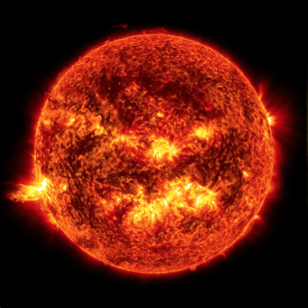
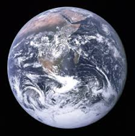
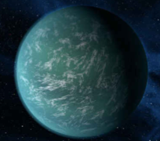
From Star to Planet
Solar composition
condensation of elements from nebula
differentiation into core, mantle, crust
evolution over time
Host star abundances from SDSS/APOGEE
How
Earth-like?
Different composition
Not to scale
Image credits: NASA/Ames/JPL-Caltech
Notes:
Planet is Kepler-22b
Orbits G5 star
Less metals than sun

Slide 6
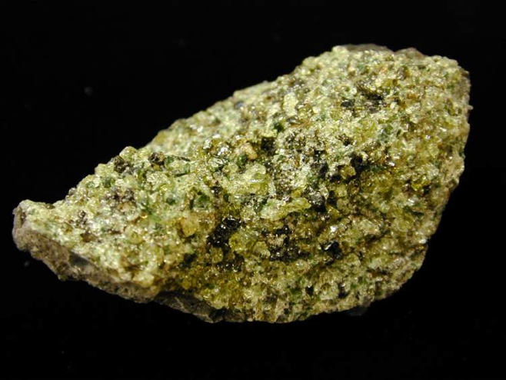
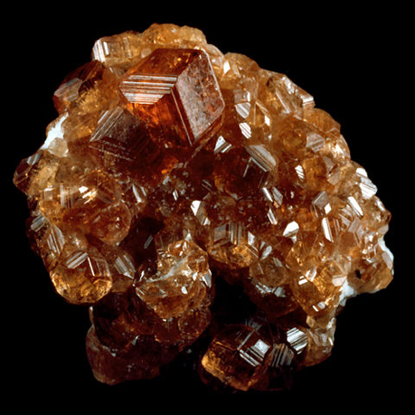
Olivine
vs.
Garnet
X₃Y₂(SiO₄)₃
X=Ca, Mg, Fe, or Mn
Y=Al, Fe, Cr
Si-rich
(Mg,Fe)₂(SiO₄)
Mg-rich
Notes:
Olivine less stiff than garnet -- helps plate tectonics

Slide 7
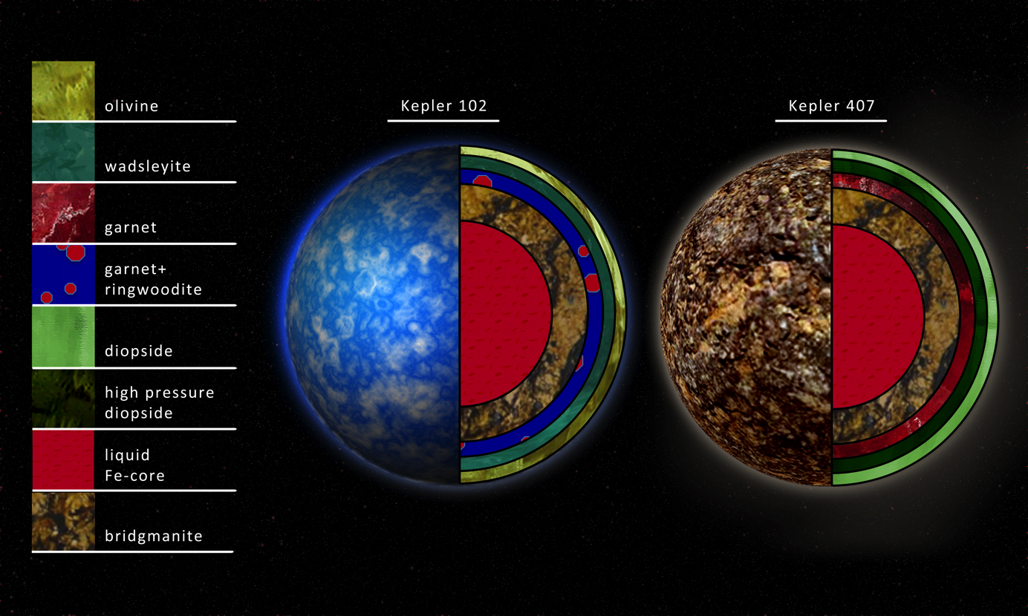
Kepler 102
Olive
Kepler 407
Janet
Image credit: Robin Dienel, Carnegie/DTM
Different abundance patterns result in drastically different planets.
Notes:
Mg/Si for Kepler-102 = 1.23, Mg/Si for Kepler-407 = 0.78
Mg/Si for Sun = 1.04
cpx - clinopyroxene (commonly augite/diopside): Ca(Mg,Fe)Si2O6 - bright green.opx - orthopyroxene (commonly enstatite): (Mg,Fe)SiO3 - dark green/brown
ol - olivine, with three phases that vary by pressure, alpha (just olivine - olive green), beta (also called wadsleyite- blue green), gamma (also called ringwoodite - brilliant blue).
gt - garnet here, composition is (Mg,Fe)3Al2Si4O12 (pyrope, deep red/red wine)

Slide 8
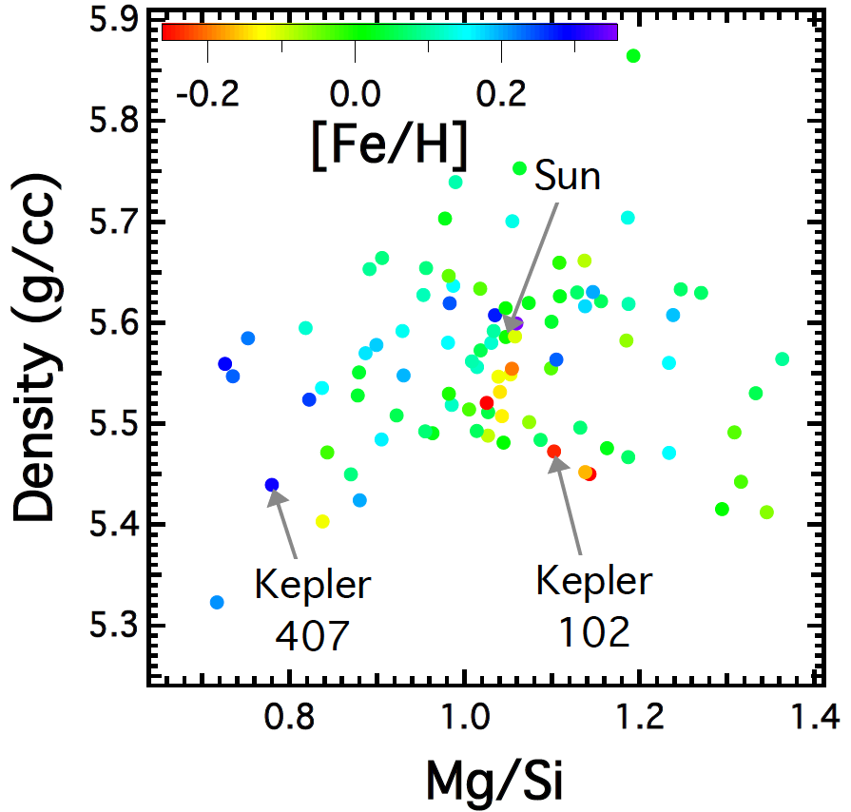
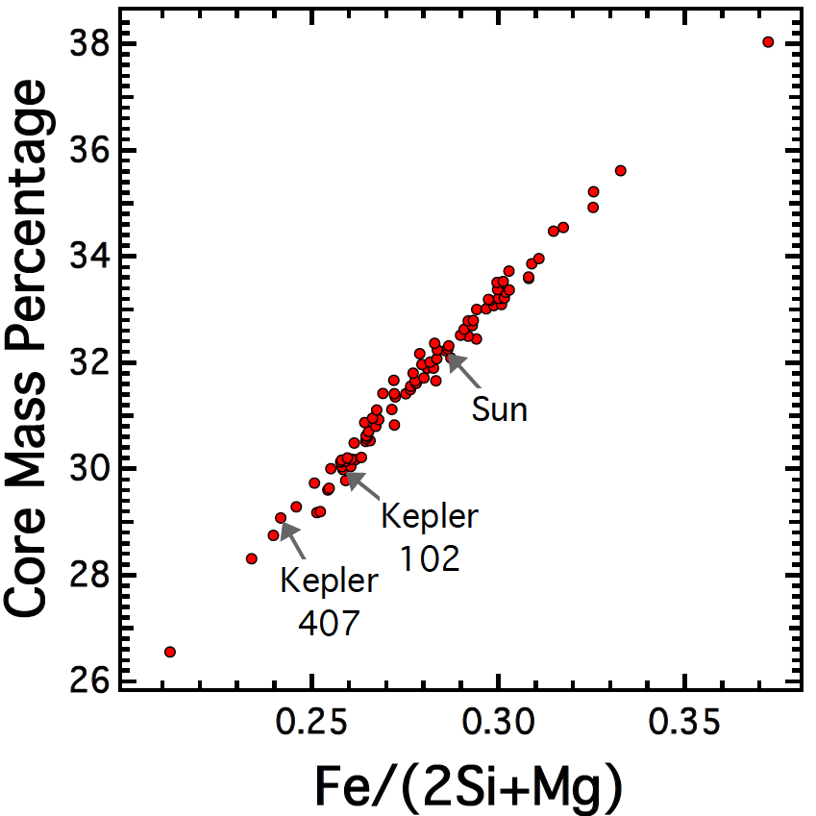
Different abundance patterns result in drastically different planets.

Slide 9
Between a Rock and a Hard Place: Can Garnet Planets Be Habitable?
The host star abundances from SDSS/APOGEE give us important constraints on exoplanet interior composition and structure.
Our results point to a wide variety in known rocky planets.
We can use this new information to assess how Earth-like exoplanets are.
@johannateske
@APOGEEsurvey @sdsssurveys
@CarnegiePlanets @CarnegieAstro @CarnegieScience

