Slide 1
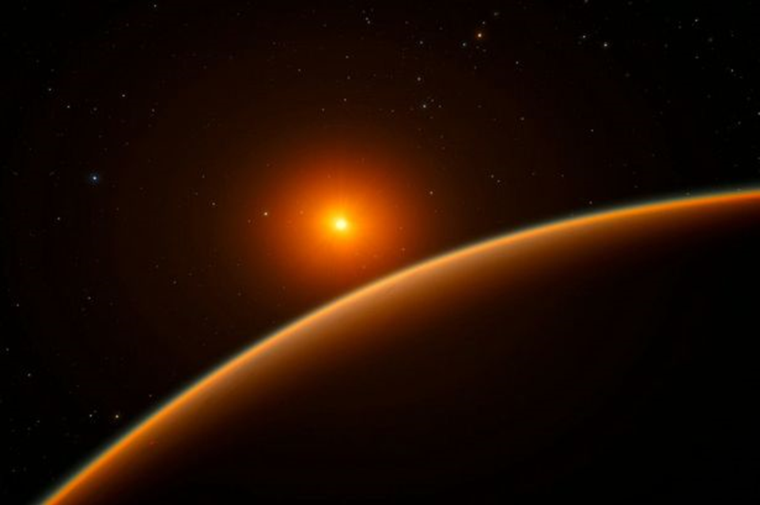
X-Ray, UV, & optical Irradiances of Barnard’s Star Super-Earth Planet: ‘Can Life find a way’ on such a Cold Planet? (AAS #467.11)
Edward Guinan & Scott Engle
Villanova University
Ignasi Ribas
IEEC, ICE, Barcolona, Spain
[edward.guinan@villanova.edu]

Slide 2
Living with a Red Dwarf
www.astronomy.villanova.edu/livingwithareddwarf/opener.htm
Program supported by grants
from NASA (HST, Chandra, XMM-
Newton) & NSF/RUI.

Slide 3
The original “Living With a Red Dwarf” Program logo (not NASA approved)

Slide 4
Barnard’s Star claims to Stardom
In 1916 E.E. Barnard finds that Barnard’s Star (M3.5V; V= +10.5 mag) has the largest stellar proper motion =10.5”/yr. and a distance of 6 light years.
From astrometry since 1930s Peter van de Kamp (1960s -1970s)
reported two Jupiter-size planets with orbital periods of 11 yrs
and 27 yrs. Found later to be bogus arising from changes in the
telescope optics. HST --No Jupiter mass planets.
Super-earth planet, Barnard b, reported by Ribas et al. 2018 from
20+yrs of RV observations: P = 233-d, Mp x sin i = 3.25ME,
r = 0.404 AU., T= -168 C. Angular separation = 220 mas –possible to Image!

Slide 5
Barnard Star b
Nov. 14, 2018
Nature Letter
“A candidate super-Earth planet orbiting near the snow line of Barnard's star Planet”
Ribas et al. 2018 63, 365
Super-earth Exoplanet found orbiting the closest single star to the Sun

Slide 6
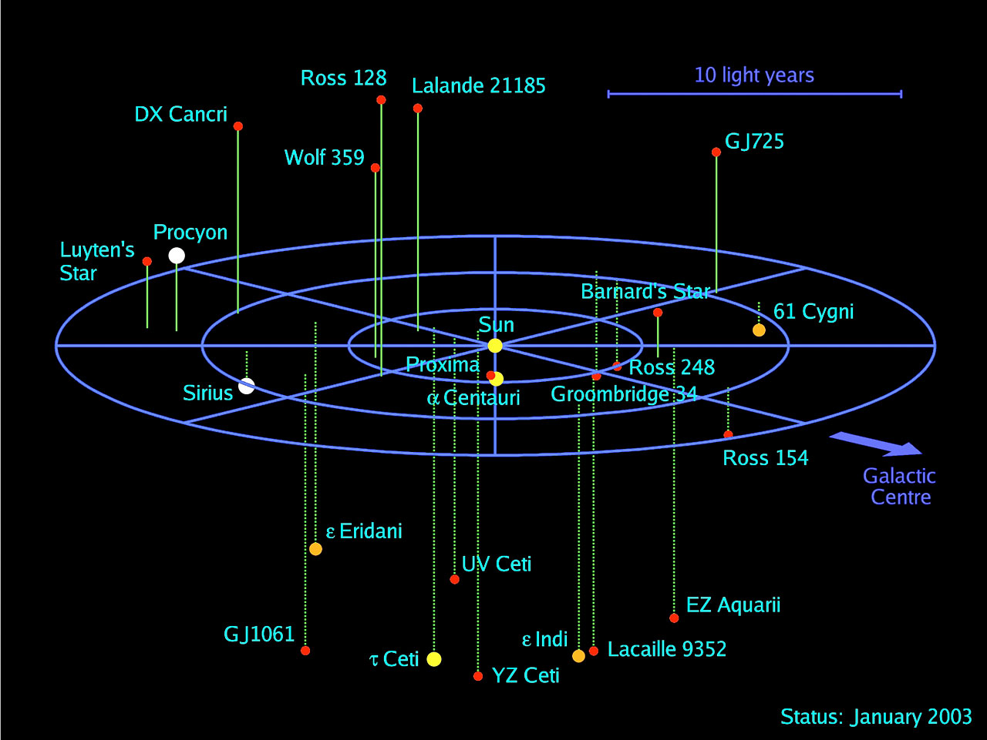
.
Stars Hosting Planets within ~ 15 Light years
Barnard Star b
Latest addition:
Nov. 14, 2018
As part the “Living
with a Red Dwarf”
Program, Photometry,
UV and X-ray observations of most stars within 15 ly of the Sun have been carried out. Barnard Star observed since 2003.
Not plotted
Kapteyn Star: 12.8 ly
Wolf 1061 14.0
GJ 687 14.8
GJ 674 14.8
GJ 876 15.3

Slide 7
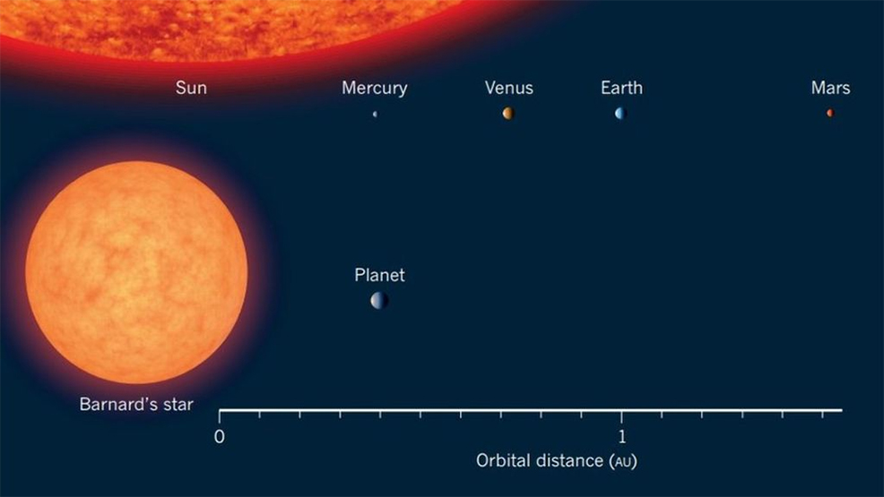
Barnard b
Mp > 3.25 ME
T = -168 C
P = 233-d
A = 0.404 AU
Rp ~ 1.5 RE (if rocky)
M3.5V
L/Lo = 0.003
Age: 8.5 Gyr
Barnard’s Star-Planet compared to the inner Solar System. Barnard b is at the same distance (0.40AU) from its host M3.5 star as Mercury is from the Sun. However, the low luminosity of M3.5V star (L = 0.0033 Lsun) results in the planet receiving ~2% of the radiation received by the Earth from the Sun.

Slide 8
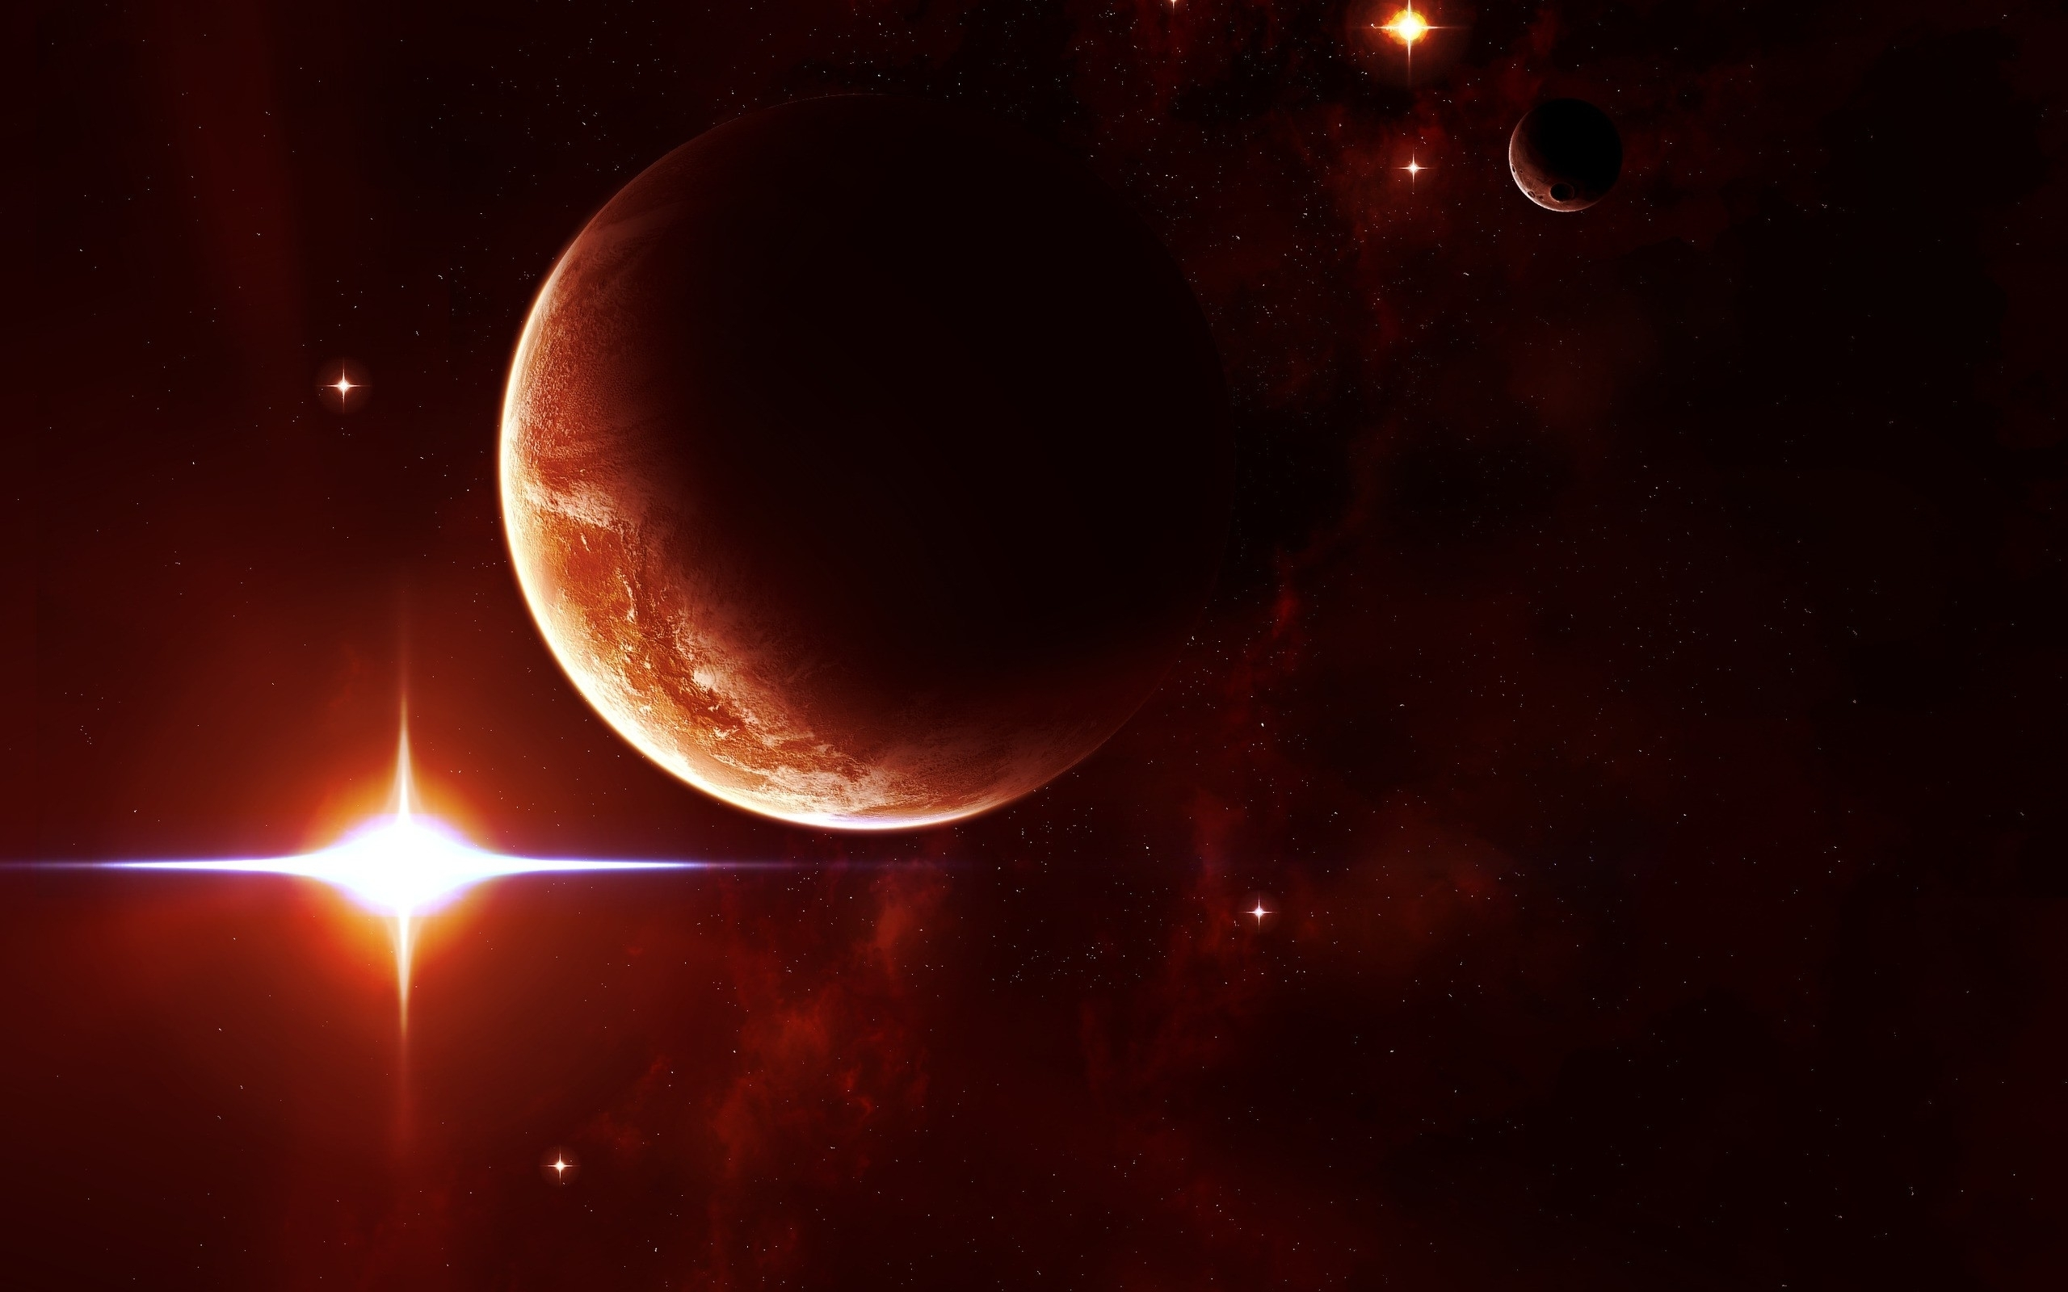
Results: X-ray / UV/ Optical Irradiances of Barnard b Relative to Earth-Sun
Planet S/SE Fx/Fx-E Fuv/Fuv-E
Barnard b 0.02 0.5 0.35
Proxima b 0.65 650 130
All
Because of the strong X-ray/UV emissions of
red dwarf stars, planets located in the habitable
zones of red dwarfs (e.g. Proxima-b) receive
very large doses of harmful X-UV radiation.
The X-ray and UV irradiances of Barnard b are
similar to / less than the Earth. Although cold,
Banrard b has earth-like X-UV stellar fluxes.

Slide 9
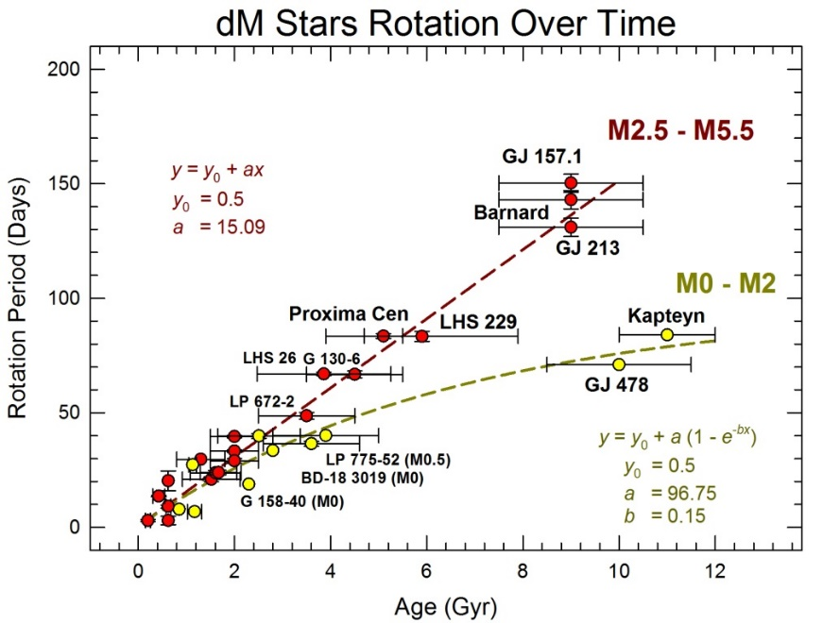
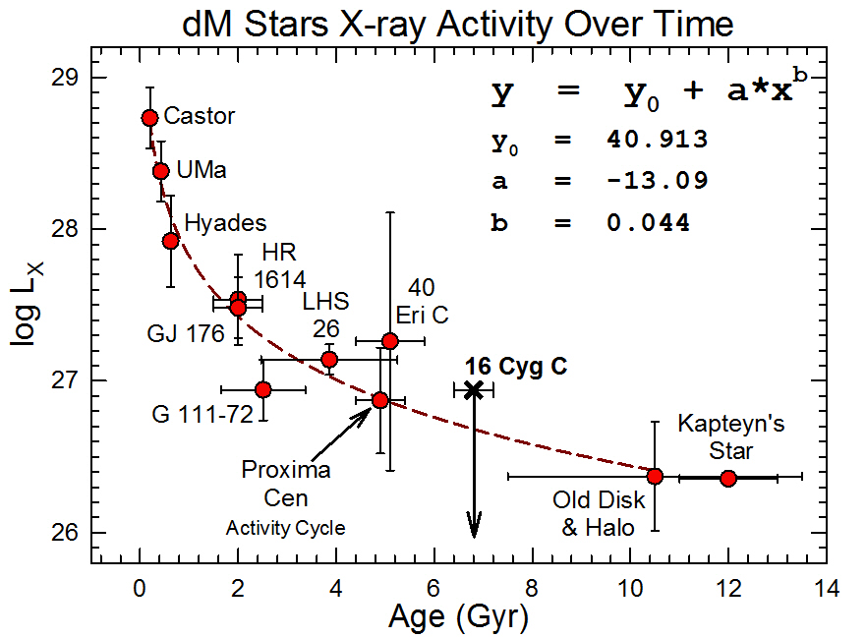
The Age of Barnard Star-Planet
The age of the star/planet = 8.6±1.2 Gyr was determined from Rotation-Age-Activity relations for red dwarfs from (Engle & Guinan et al. 2018), using input parameters from Toledo-Padron et al. (2018). (Prot = 145 d - Age = 8.6 +/-1.2 Gyr). Barnard’s Star low X-ray Luminosity (log Lx = 26.4 erg/s) and very weak Ca II H&K chromospheric emissions & large U,V,W space motions agree with this age. Also has sub-solar metal abundances; Fe/H = -0.13.
Barnard X
Barnard X

Slide 10
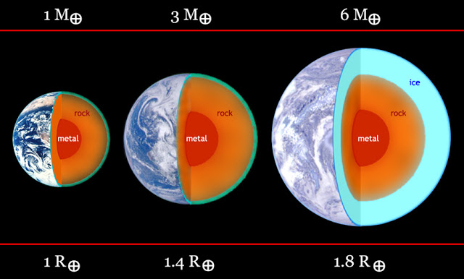
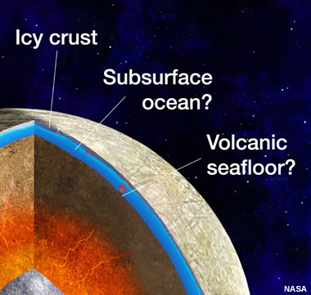
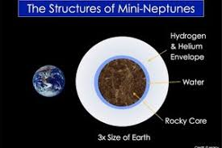
Can Barnard b be Habitable - Could life find a way
Barnard b receives only 2% of radiation as the Earth and thus is cold (T = -168 C).
As a super-earth (M >3.3 M⊕), it could possess a large, hot (liquid) iron core & have enhanced geothermal energy.
Geothermal energy could heat the exterior of the planet via plumes and vents.
If water is present, the planet would be ice-covered, but from geothermal heating could have regions of subsurface water that could provide niches for life. (analogs: Europa and subsurface lakes of Antarctica)
If more massive, then the stronger gravity could retain an H2/He atmosphere and it would be Mini-Neptune (Dwarf Gas Giant)

Slide 11
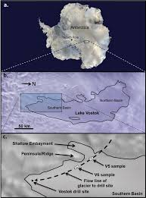
Sub-surface geothermal-heated Lakes in Antarctica: Possible Analog for liquid water on Barnard b

Slide 12
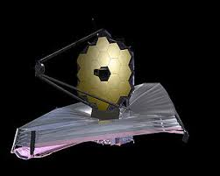
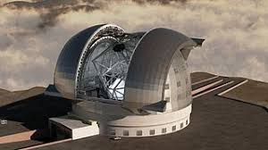
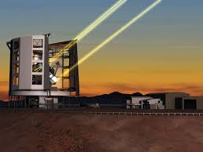
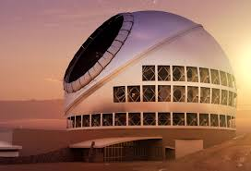
Imaging Barnard b
Although faint (Lp/Lstar ~ 3 x 10⁻⁹; H~+26 mag), Barnard b proximity & relatively large ~220 mas separation from its host star, make it an attractive target to image. It may be feasible to image Barnard b in Near-IR with JWST and AO systems on the GMT, TMT, and ELT. If Barnard b is a Mini-Neptune (Rp ~ 4.5 RE), then H ~+23.3 mag & could potentially be detected by VLT-SPHERE. Barnard b is only one
of handful of Earth-size exoplanets that be can be imaged.

Slide 13
Summary
Barnard Star/planet age = 8.6+/-1.2 Gyr. ~2x as old as the Sun
Barnard b receives only 2% instellation as Earth and is cold.
But unlike HZ red dwarfs, Barnard b receives Earth-like X-UV
irradiances. Less danger of sterilization and loss of water and atmosphere.
If Barnard b has water and is geothermally-active, this super-Earth could harbor sub-surface liquid water where primitive life “could find a way”.
With a planet-star angular separation of 220 mas, Barnard b could be imaged with future large telescopes.

Slide 14
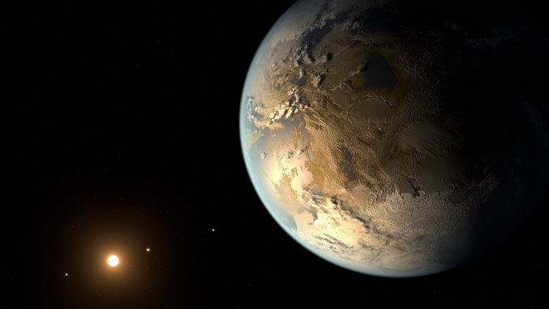
Thank you!

Slide 15
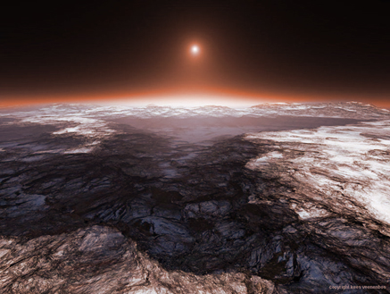
Maybe “Life can find a Way” on Barnard b
Barnard’s Star and its super-earth planet Barnard b are depicted in this ‘best case scenario’ for potential life –i.e.- geothermal heating melts ice, producing regions of liquid water near the surface. This is analogous to the numerous geothermal-heated subsurface lakes found in Antarctica as well as the tidally-heated sub-stellar ocean of Europa.

Slide 16
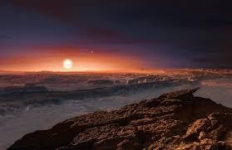
Some Closing remarks
> Barnard Star / planet age = 8.6 Gyr- 2X the age as the Sun
> Barnard b receives only 2% instellation as Earth and is cold.
> But unlike HZ red dwarfs, Barnard b receives Earth-like X-UV irradiances. Less danger of sterilization and loss of atmosphere.
> If Barnard b has water and is geothermally-active, it could harbor sub-surface liquid water where life “could find a way”.
> Barnard is nearby - With a planet-star angular separation of 220 mas, Barnard b could be imaged with future telescopes.

Slide 17
Thank you!

Slide 19
Some Take-aways
The age of the star/planet = 8.6±1.2 Ga was determined from Rotation-Age-Activity relations for red dwarfs from (Engle & Guinan et al. 2018), using input parameters from Toledo-Padron et al. (2018). (e.g. Prot = 142d -- Age = 8.6 Ga). X-ray, Ca II, Space Motions -agree with this age.
Habitable Zone exoplanets hosted by red dwarfs (due to the strong X-ray coronal and chromospheric emissions) results in X-ray irradiances of hundreds times stronger than Earth’s. The X-ray / UV fluxes received by Barnard b are similar to the Earth’s but its S/SE is only 0.02.
Barnard b receives only 2% of radiation as the Earth and thus is cold. But as a super-earth (M >3.3 M⊕), it could possess a large, hot (liquid) iron core & have geothermal energy. Geothermal energy could heat the exterior of the planet via plumes and vents. If water is present, the planet would be ice-covered, but from geothermal heating could have regions of subsurface water that could provide niches for life. (analogs: Europa and subsurface lakes of Antarctica)
Although faint (Lp/Lstar ~ 3 x 10⁻⁹; H~26 mag), Barnard b proximity & relatively large ~220 mas separation from its host star, make it an attractive target to image. It may be feasible to image Barnard b in Near-IR with JWST and AO systems on the GMT, TMT, and ELT. If Barnard b is a Mini-Neptune (Rp~4.5RE), then H~23.3 mag and could be detected by VLT/SPHERE.

Slide 20
Comparison of Barnard b with Earth and Prox Cen b
Property Earth-Sun Proxima b Barnard b Barnard b
[1.0 AU] [0.049 AU] [0.404 AU] (when young)
Age (Gyr) 4.57 5.1+/0.6 8.5+/-1.0 50 Myr
Mass (ME) 1.00 >1.27 >3.25 >3.25
Radius (RE) 1.00 1.1 ~1.5 ~1.5
S/SE 1.00 0.65 0.022 ~ 0.2
Teq (K) 255 [288] 227 [277] 105 [155] 186 [236]
<fx>* 0.25 c.g.s. 163 0.133 90
[650 fxE] [0.53 fxE] [370 fxE]
<f Ly-alf>* 7.38 130 2.59 34
(FUV) [17.6 fuv-E] [0.35 fuv-E] 4.6
S/SE = instellation relative to Earth-Sun at 1.0 AU; <f> mean irradiances [flux units: c.g.s = ergs/s/cm²]
X-ray and Ly-alpha Irradiances on Earth: 0.25 and 7.38 ergs/s/cm^{2;} Use <Lx> sun = 7.0 x 10⁺²⁶ erg/s Ayres 2018

