Slide 1
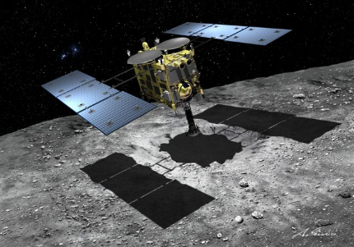
Landing site selection to provide key scientific and engineering findings from proximal operations and material sampling
Presented by Hikaru Yabuta
on behalf of Hayabusa2 LSSAA & LSS-IDS Team
Safety for landing
Scientific values
The best sampling
(Illustration: Akihiro Ikeshita)

Slide 2
Methodology of Landing Site Selection
Engineering evaluation (Safety)
Scientific evaluation
1. Safety score analyses
4. Science
・Rotation model
・Shape model
・Physical properties of surface
・Surface age and morphology
・Organic carbon
・Hydrous minerals
・Degrees of heating
・Other minerals
・Surface processes
2. Visual evaluation
Optical images from ONC
3. Feasibility analyses
・Temperature map
・Longitude accessibility
・Boulder density
5. Safety
6. Samplability (e.g. grain sizes)
Notes:
For the landing site selection, we focused on the regions that meet both safety for landing and scientific values.
In Methodology of Landing Site Selection, at first,
candidate sites were refined by engineering evaluation.
In The first step, the safety score analyses was conducted in terms of the surface roughness and the orientation of spacecraft position evaluated by the rotation model and shape model.
In the second step, visual evaluation was conducted about the presence of boulders from the images acquired by ONC.
The third step conducted feasibility analyses based on the surface temperature and the detailed distributions of boulders.
Scientific evaluation focused on physical properties, geology, and compositions of the surface, and
safety was evaluated again based on the scientific methods,
and samplability evaluated by distributions of grain sizes and boulders

Slide 3
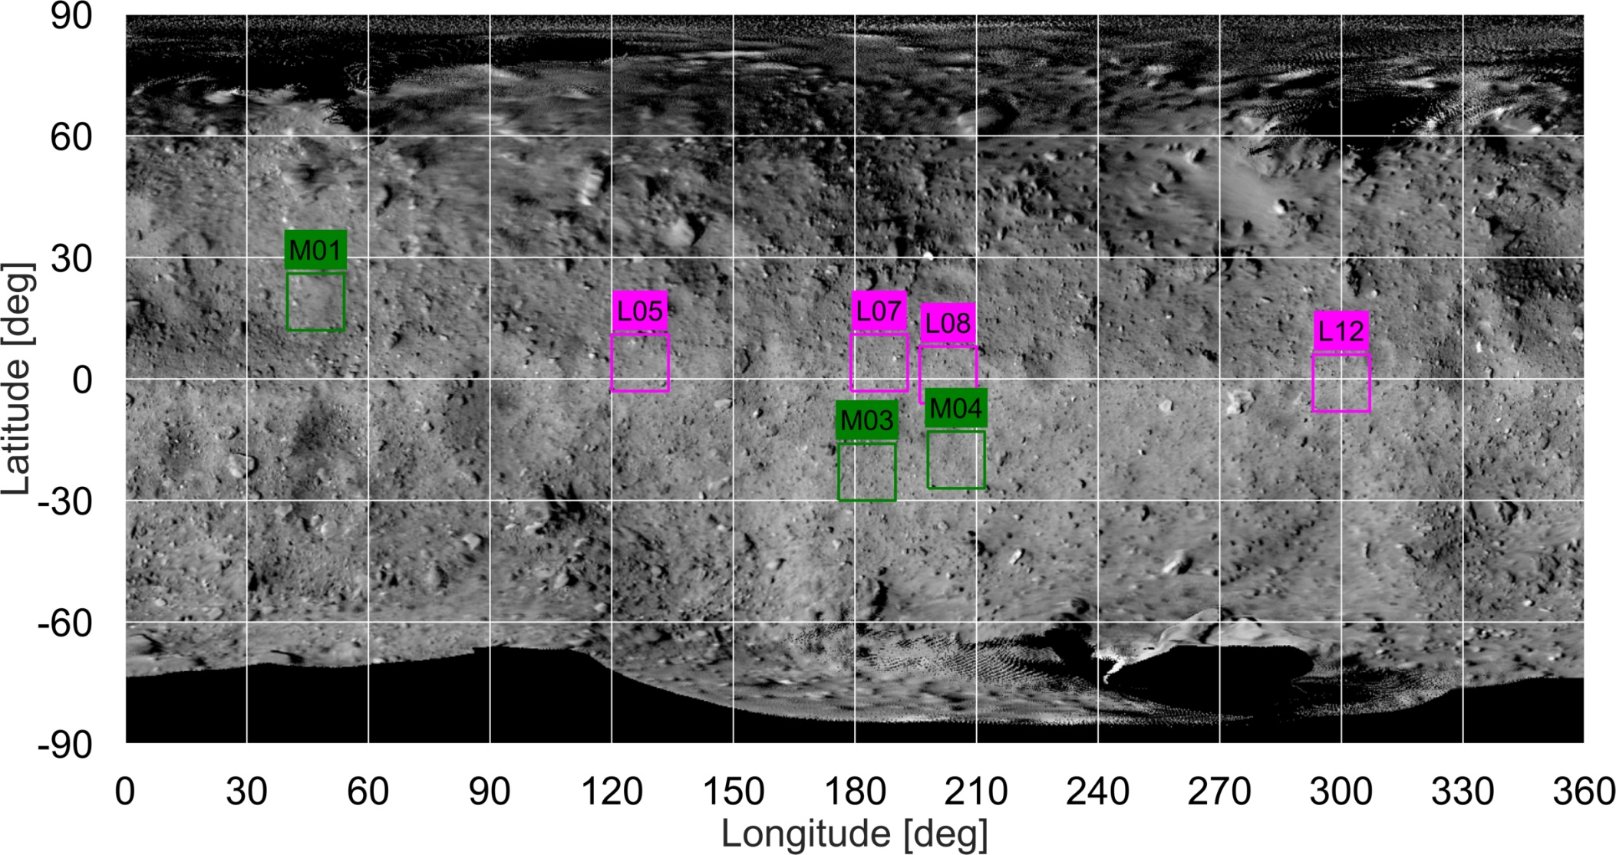
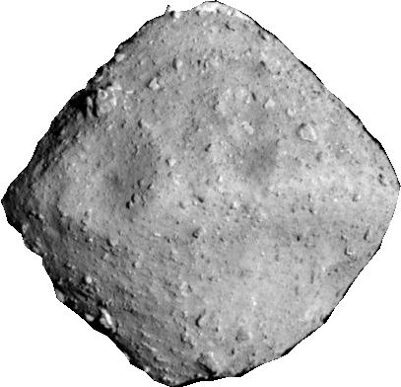
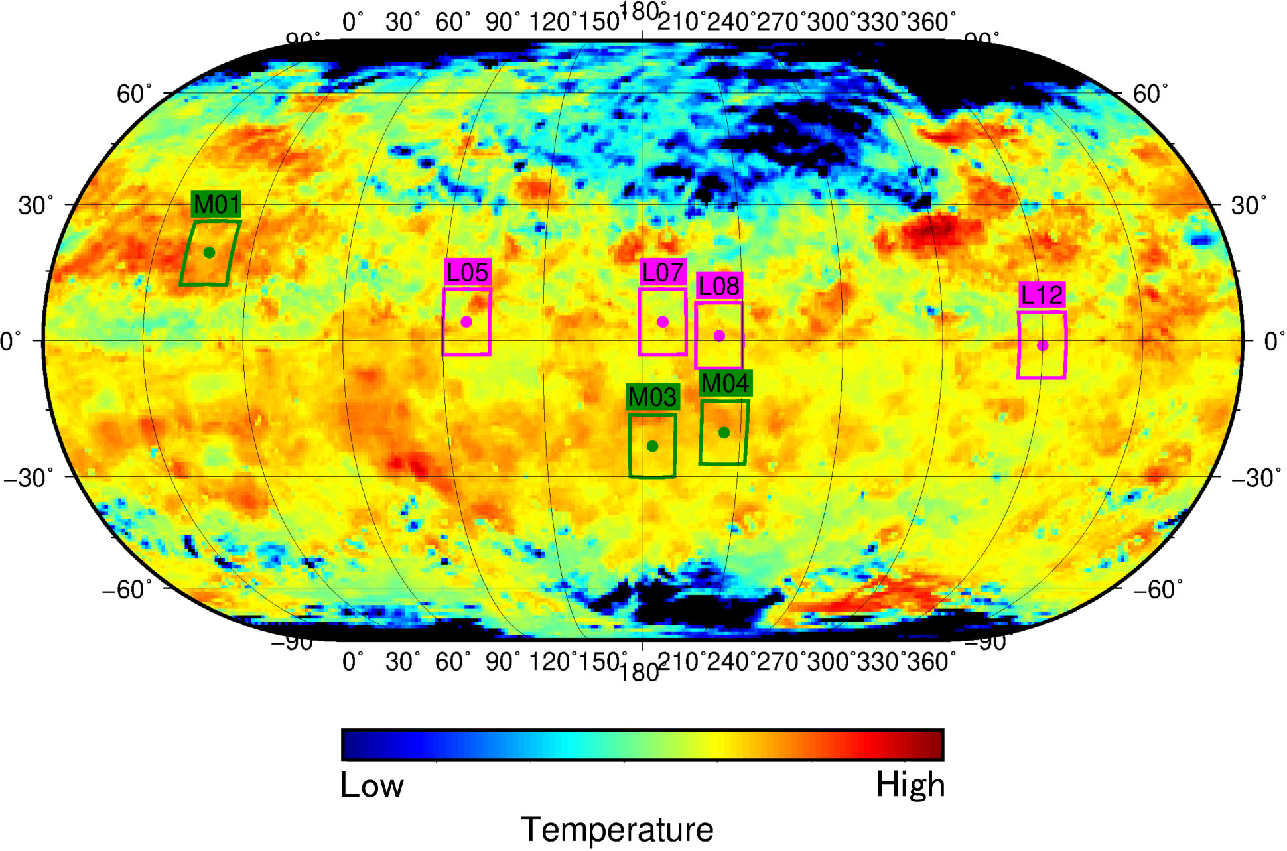
Engineering evaluation
Range on the celestial body where the spacecraft can land
Within 200m north and south of the equator (about ±30° latitude)
Sun
Spacecraft
Earth
Spacecraft movement
rotation axis
Surface conditions suitable for landing
※ ｔhis angle
Sun
Spacecraft
asteroid
Earth
Spacecraft movement
(Credit : JAXA/UTokyo/Kochi U/Rikkyo U/Nagoya U/Chiba Inst Tech/Meiji U/U Aizu/AIST/Ashikaga U)
Notes:
First, engineering evaluation selected the 7 possible landing site candidates, L5, L7, L8, L12 from the equatorial regions and M1, M3 and M4 from the mid-latitude selected from the safety score map.
Safety score map is based on the sub Earth distance, local solar angle, local slope and elevation maximum difference.
Thermal prediction results for the first touchdown were obtained by TIR.
Temperatures of Each sites are less than 350 K, which satisfied the safe landing condition.
サブアースとは、リュウグウ中心と地球を結んだ線です。
サブアース緯度とは、リュウグウ中心と地球を結んだ線とリュウグウ表面との交点の緯度です。
はやぶさ２の降下運用では、通信や熱などの探査機制約上、サブアースに沿って降下します。
サブアースから離れた場所を狙うことになりますと、リスクが上昇します。
TD地点に関しては、経度は時刻をずらすことで対応することができますが、
緯度は時期（地球、リュウグウの幾何的関係）によって決まるため、自由度があまりありません。
そのため、LSSの観点では、サブアース緯度を重視しております。

Slide 4
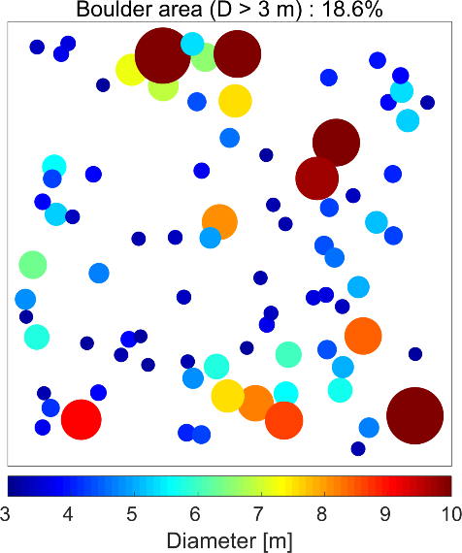
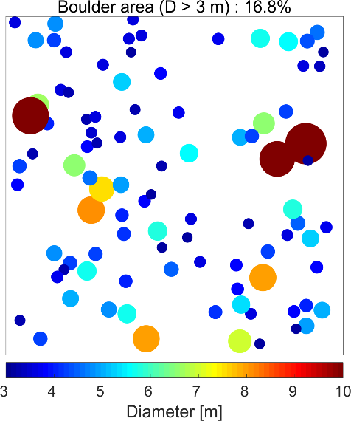
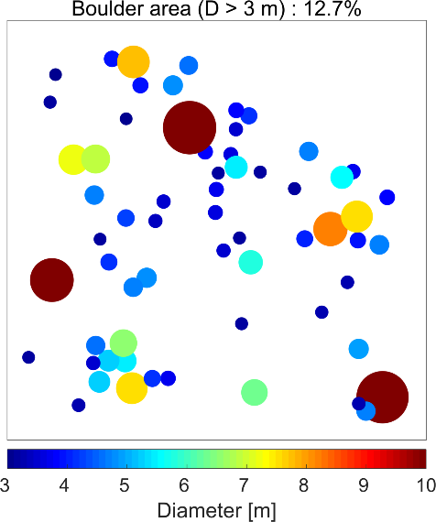
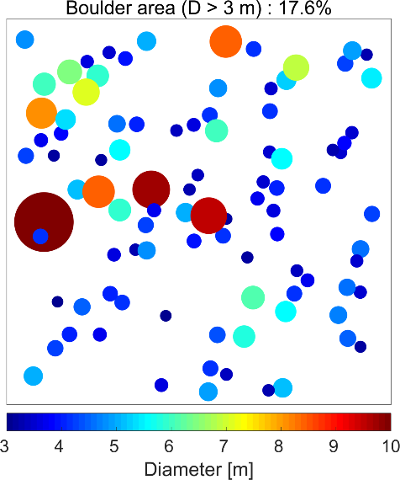
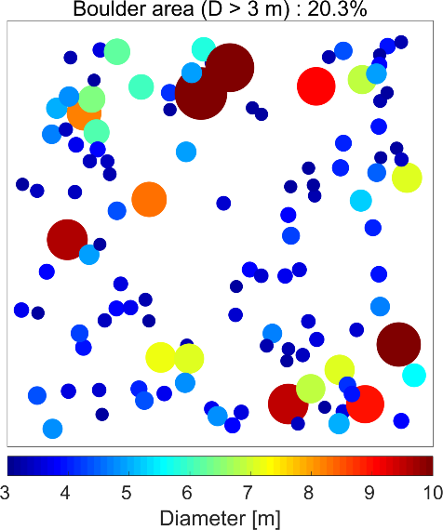
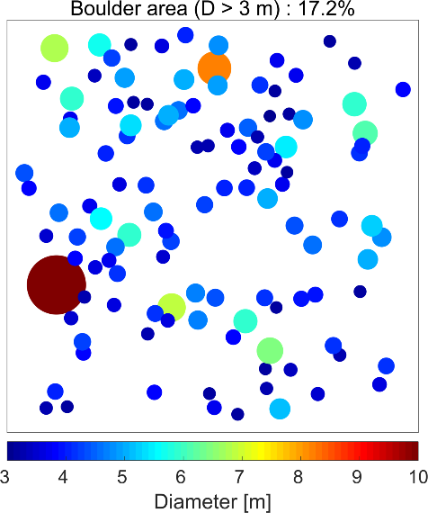
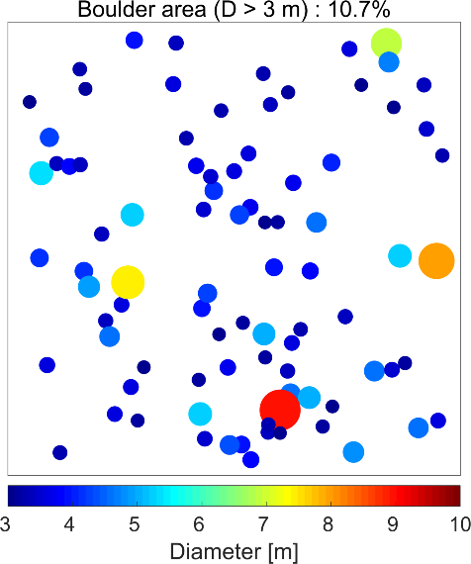
Narrow down the candidates: Boulder counting
L05
L07
L08
L12
M01
M03
M04
Distributions of boulders with a diameter > 3m
Lower latitudes are preferable for safe landing
(Credit : JAXA/UTokyo/Kochi U/Rikkyo U/Nagoya U/Chiba Inst Tech/Meiji U/U Aizu/AIST)
Notes:
Then the landing site candidates were narrowed down by counting boulders from the images acquired by ONC. The figure shows the distributions of boulders larger than 3 m diameter. As you can see any region looks like having almost equally many boulders, nevertheless, we tried to find where the areas occupied by boulders are small, and regarded L7, L8, and M4 as the preferable sites for safe landing.

Slide 5
Scientific evaluation
ONC-T spectral slope map
(Credit : JAXA/UTokyo/Kochi U/Rikkyo U/Nagoya U/Chiba Inst Tech/Meiji U/U Aizu/AIST)
Redder: Shift to longer wavelength, Bluer: Shift to shorter wavelength
L regions could be fresh and preferable
Notes:
This is a map of spectral slope in the visible wavelength based on the ONC data and shape model.
You can see a slight extent of heterogeneity across the candidate regions. L-regions are relatively bluish and M-regions are reddish.
Considering that spectral reddening is likely due to the secondary process such as space weathering, we prefer L regions showing bluer spectra that is probably reflected by primitive materials
スペクトルスロープマップはBOXAから作成（分光はBOXCはないので）
下のレイヤーの地形はBOXCから作成

Slide 6
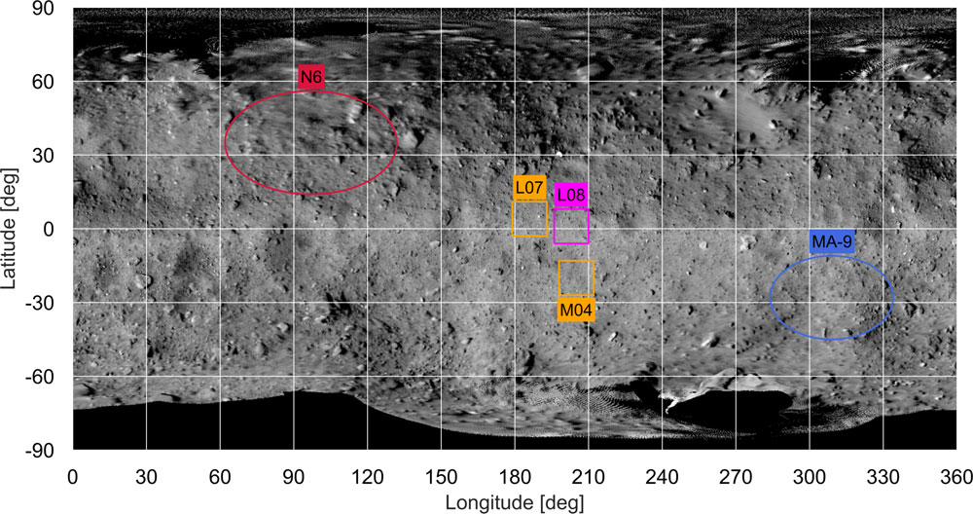
Total evaluation
・The surface of asteroid Ryugu is composed of the mixture of materials with different origins and processes.
・This will enable the sampling of materials which represent the whole Ryugu.
MASCOT
(Lander)
Touchdown
(Sampling)
MINERVAII
(Rovers)
(Credit : JAXA/UTokyo/Kochi U/Rikkyo U/Nagoya U/Chiba Inst Tech/Meiji U/U Aizu/AIST)
Notes:
In the total evaluation,
scientific scores, safety scores, and samplability scores were summed.
As a result, we selected L8, L7 and M4.
Landing sites for MASCOT and MINERVA-II-1 were evaluated by the individual instrument teams, respectively.
To sum up,
・The surface of asteroid Ryugu is composed of the mixture of materials with different origins and processes.
・This will enable the sampling of materials which represent the whole Ryugu.

