Slide 1

Evaluating the Dynamical Stability of Outer Solar System Objects in the Presence of Planet Nine
Juliette Becker, Fred Adams, Tali Khain, Stephanie Hamilton, David Gerdes
Contact me: Juliette Becker, jcbecker@umich.edu (425-876-9946)

Slide 2
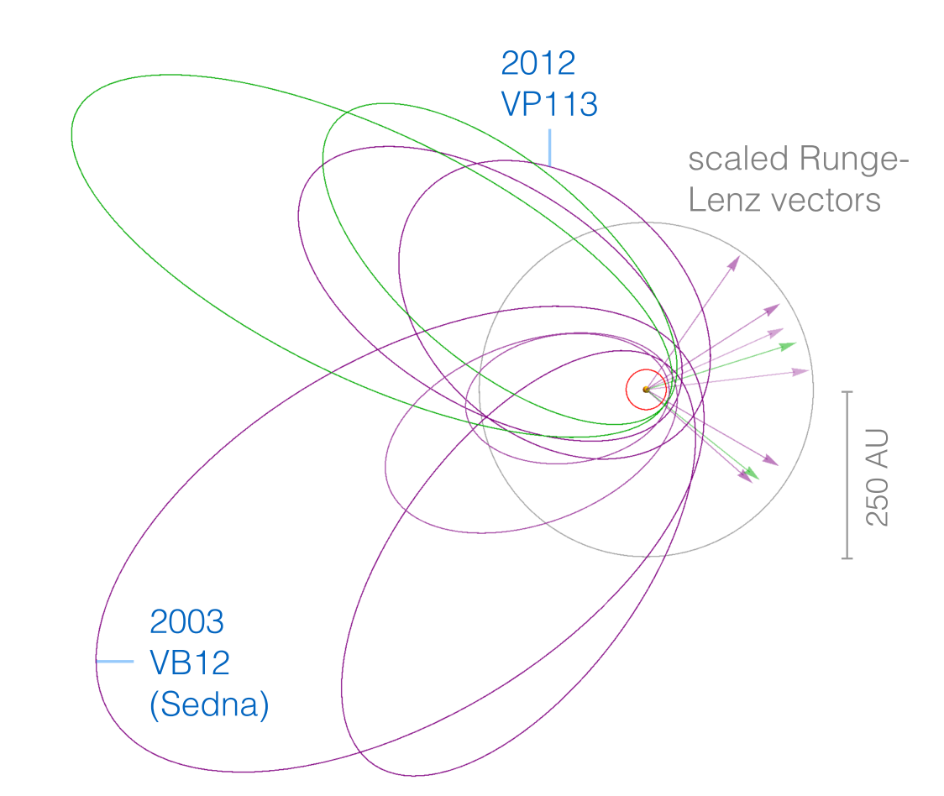
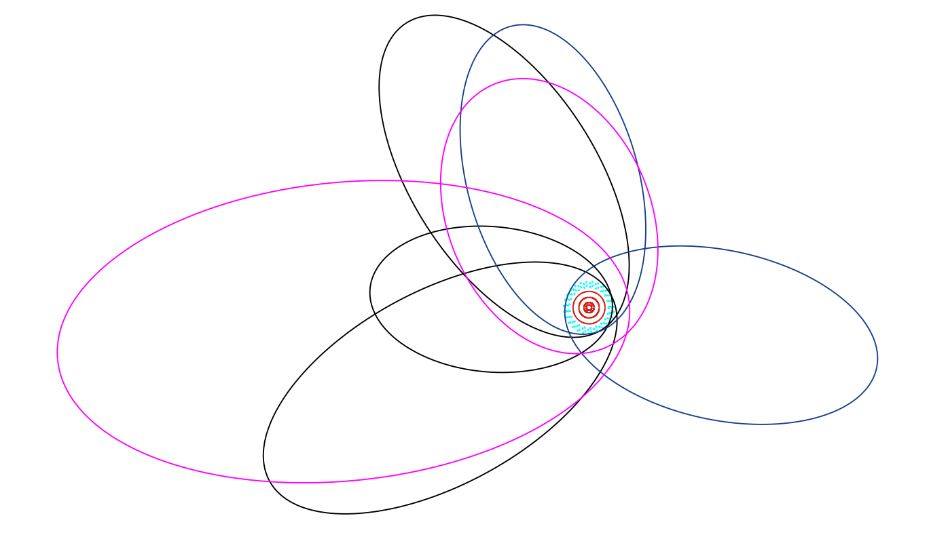
Planet Nine
Sheppard & Trujillo (2016)
Batygin & Brown (2016)

Slide 3
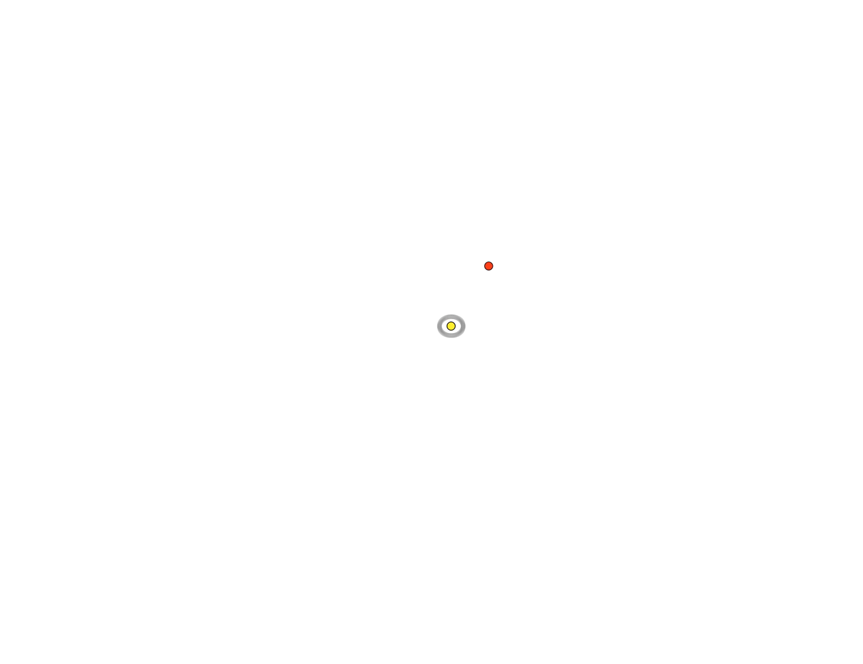
Some Trans-Neptunian Objects can live in a solar system without Planet Nine

Slide 4
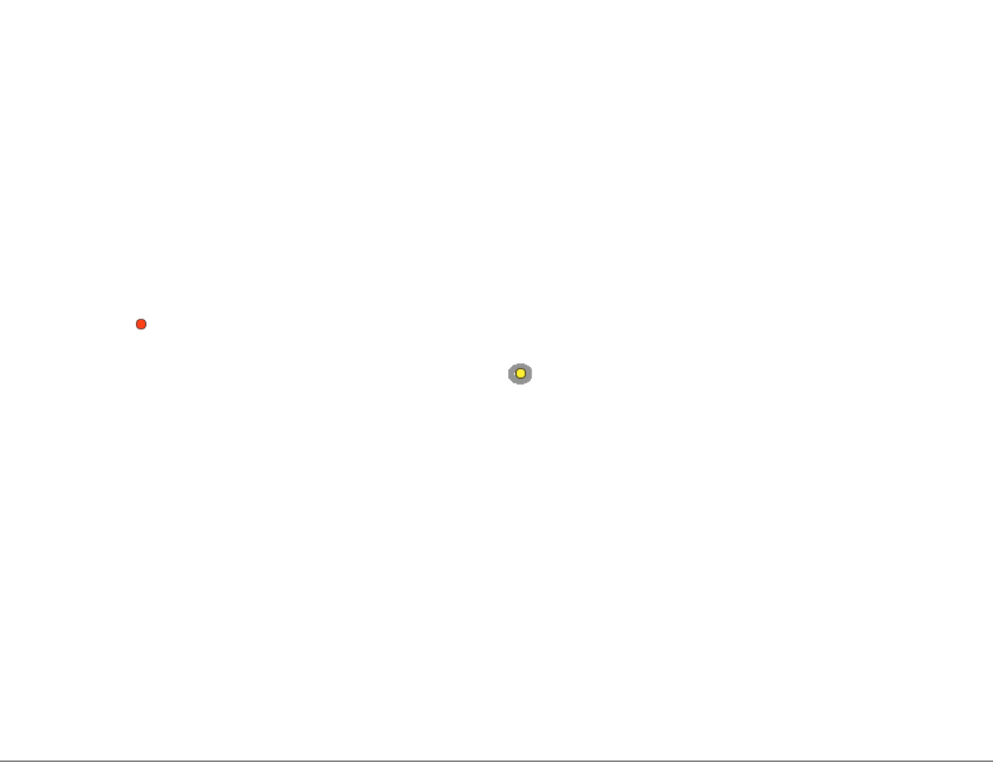
Other Trans-Neptunian Objects are ejected from the solar system (without Planet Nine)

Slide 5
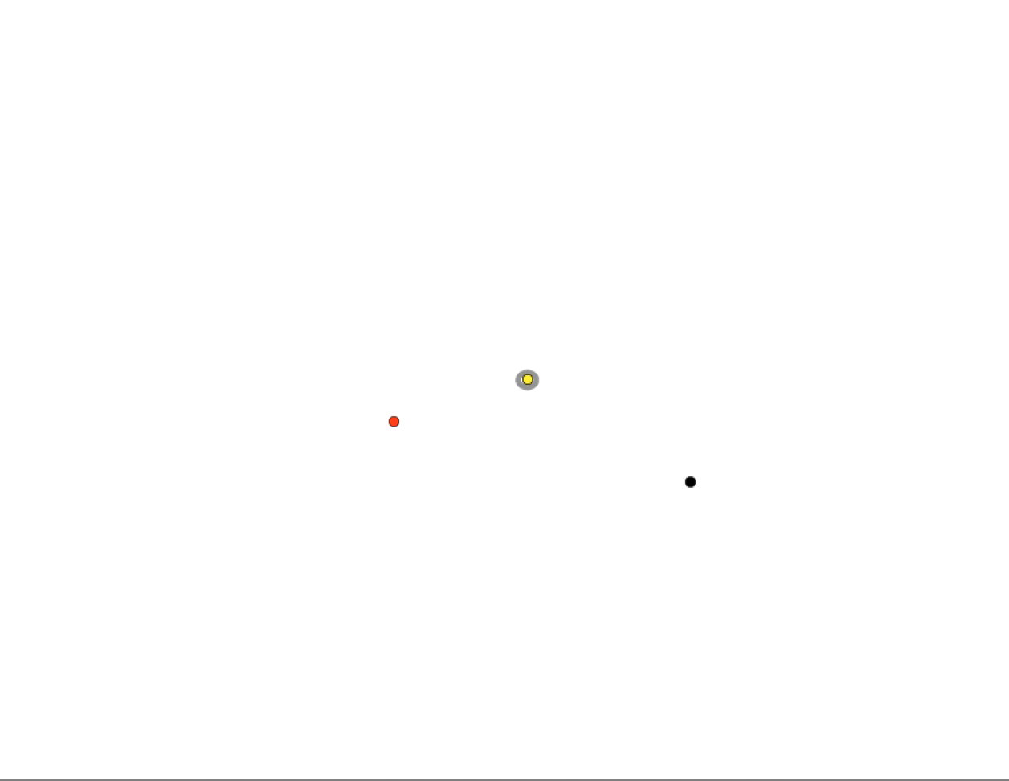
With Planet Nine, these Trans-Neptunian Objects are often prevented from leaving the solar system
Orbit of the TNO is in red
Planet Nine is in grey

Slide 6
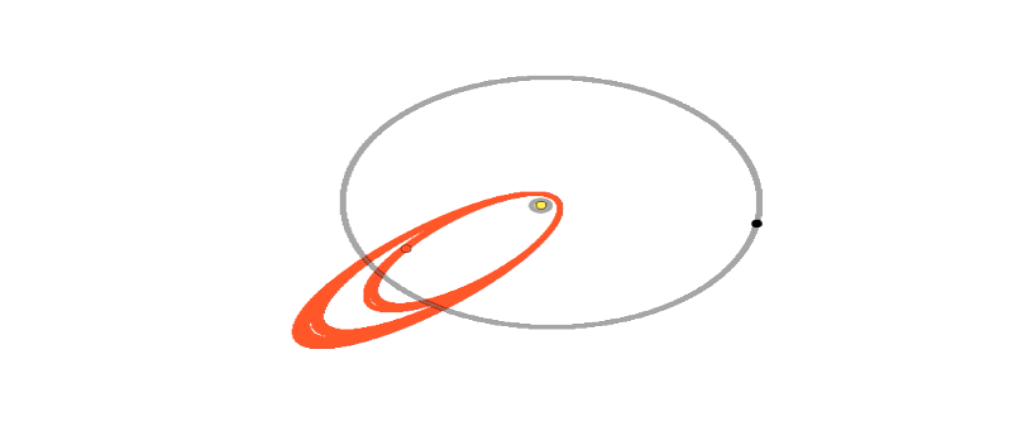
Without Planet Nine, TNOs interact with Neptune and are kicked out of the solar system.
With Planet Nine, TNOs “hop” between stable orbits over time. Planet Nine traps them in a new orbit when they would have been kicked out of the solar system

Slide 7
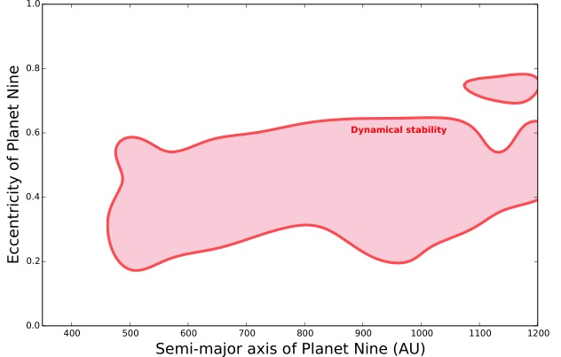
Our simulations answer the question: which orbits of Planet Nine are most likely to make the process I just described happen?

Slide 8
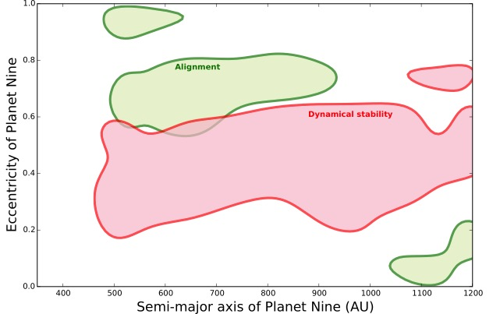

Slide 9
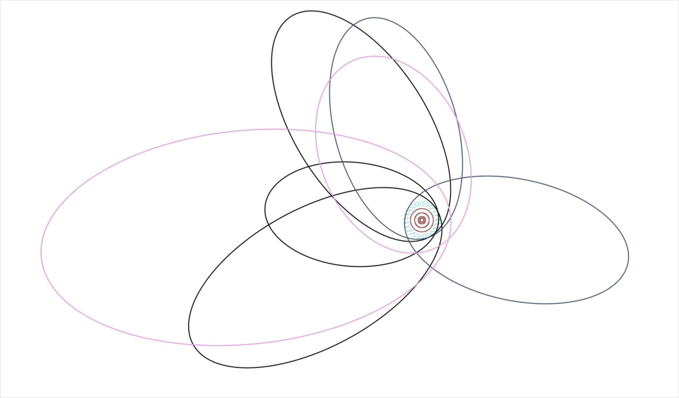
Caju: a new extreme TNO
Orbital elements:
a = 450 AU, e = 0.92, i = 54 degrees
Using data from the Dark Energy Survey, the DES TNO working group has discovered a new TNO.
This new object has an average distance from the Sun of 450 times the Earth’s distance from the Sun!
Its orbit is inclined 54 degrees relative to the solar system planets, and its orbit is extremely non-circular

Slide 13
Results
We find that certain versions of Planet Nine can prevent Trans-Neptunian Objects (TNOs) from being ejected from the solar system, allowing them to exist as we see them for longer.
Using data from the Dark Energy Survey, we have discovered a new extreme TNO (nicknamed Caju).
  It fits into the class of objects that was originally used to predict Planet Nine, and has the highest orbital inclination of any of these objects.
Contact me: Juliette Becker, jcbecker@umich.edu (425-876-9946)

