Slide 1
The Spiral Magnetic Field in the Central 5 Parsecs of the Milky Way
C. Darren Dowell (J.P.L.), SOFIA/HAWC+ science team
contact: charles.d.dowell@jpl.nasa.gov
© 2019 California Institute of Technology. Government sponsorship acknowledged.
related talk:
#316.05, Wednesday 3:40 PM
ISM & The Milky Way
Notes:
- Working with a team that built the HAWC+ instrument for SOFIA then used it to observe the Galactic Center and analyze the results.
- The image above shows a panoramic view of the observing team on a typical SOFIA flight.

Slide 2
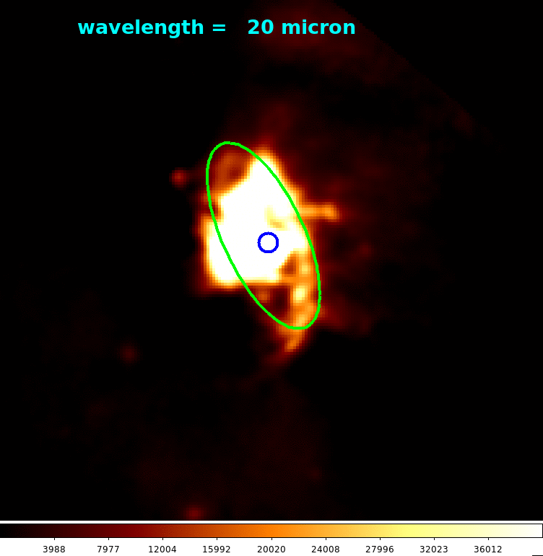
Complex, rotating Circum-Nuclear Disk is prominent at λ = 30 – 100 μm
3 parsecs
(10 lightyears)
20, 31, 37 μm: SOFIA/FORCAST
53, 89 μm: SOFIA/HAWC+
70, 160 μm: Herschel Space Observatory/PACS
350 μm: Caltech Submillimeter Observatory
Luminosity of our Galactic Center nucleus is only ~10⁷ L_{solar}
Still, it presents a unique opportunity to study Super-Massive Black Hole accretion and associated processes.
The neutral gas and ionized gas are traced well by dust emission at λ ≈ 50 μm. Very high altitude needed for observation.
Notes:
scale of Galactic nucleus
Animation not in time, but in wavelength. At this scale, time required for appreciable motion is thousands of years.
Far-infrared continuum radiation: emission from dust. Dust is mixed with gas – hydrogen and other things -- which is mostly neutral or molecular outside the ring and ionized inside the Ring.
Ring: inner edge of rotating, tilted Disk.
Ring moves outward with increasing wavelength. Hotter dust shows up better at shorter wavelengths, cooler dust shows up better at longer wavelengths.
Blue circle shows the position of the supermassive black hole, whose emission shows up only at the longest wavelength in the series.
At the longest wavelengths, the Circumnuclear Disk fades into the environment of other cool clouds of dust and gas in the Galactic Center. In this series, only 350 micron can be observed from a ground-based telescope, and even that needs a high dry site.
Best sampling of the Disk around 50 micron
The luminosity and mass are puny compared to the rest of the galaxy and AGN.
Still, this is a unique opportunity to study SMBH accretion and the various processes involved – strong gravitational potential, inspiralling gas, star formation episodes, outflows, magnetic phenomena.
L(Sgr A*) ~ 10e3 L_solar (Narayan et al. 1998)
L(Milky Way) ~ 10e10 L_solar
Bondi accretion radius ~ 1” = 0.05 pc
Images normalized to show Circum-Nuclear Ring – the inner edge of the CND, which does not have a fixed size with wavelength due to temperature weighting.
Ionized gas and hot dust in Northern Arm and East-West Bar are bright at lambda < 30 micron, but have low column density; in fact, there is a central cavity deficient in neutral gas.

Slide 3
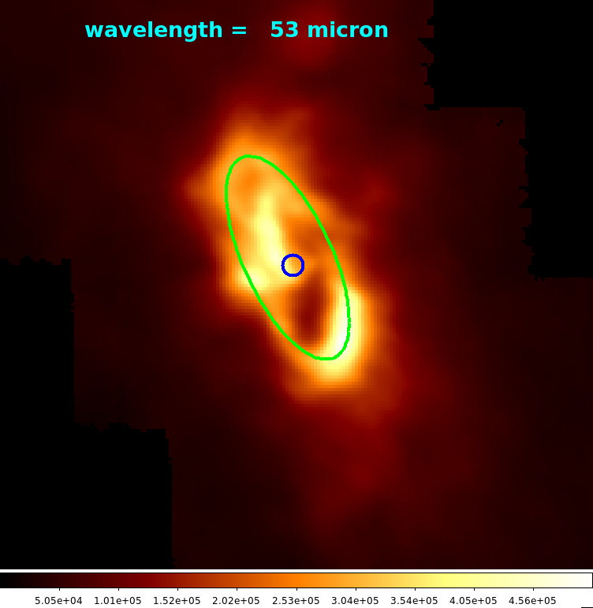
Complex, rotating Circum-Nuclear Disk is prominent at λ = 30 – 100 μm
direction of rotation
3 parsecs
(10 lightyears)
20, 31, 37 μm: SOFIA/FORCAST
53, 89 μm: SOFIA/HAWC+
70, 160 μm: Herschel Space Observatory/PACS
350 μm: Caltech Submillimeter Observatory
Luminosity of our Galactic Center nucleus is only ~10⁷ L_{solar}
Still, it presents a unique opportunity to study Super-Massive Black Hole accretion and associated processes.
The neutral gas and ionized gas are traced well by dust emission at λ ≈ 50 μm. Very high altitude needed for observation.
=> SOFIA/HAWC+ 53 μm imaging and polarimetry
Notes:
50 micron: samples both ionized streamers, Ring, and Disk
Direction of rotation is counterclockwise
polarization allows us to map direction of magnetic field

Slide 4
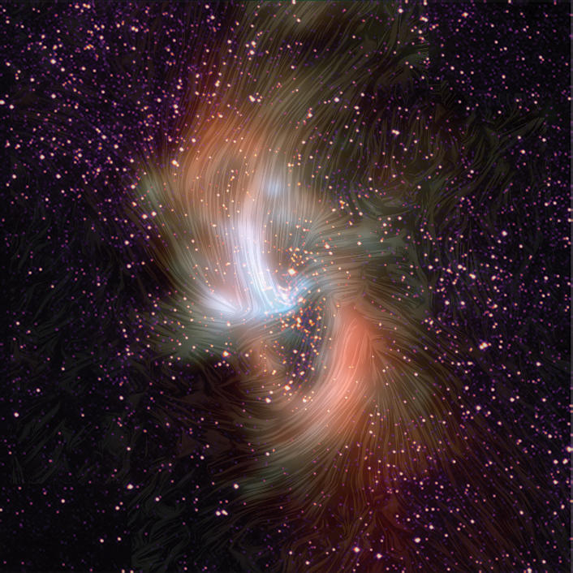
color scale: dust emission at 20 (blue) to 53 (red) μm (SOFIA/ FORCAST & HAWC+)
streamlines: magnetic field direction at 53 μm (SOFIA/ HAWC+)
stars: 1.9 μm (HST/NICMOS)
3 parsecs
(10 lightyears)
Notes:
This image combines the far-infrared emission from the earlier slides, but now also the stars in the Galactic Center, and the magnetic field structure measured with SOFIA/HAWC+.
Although some of this magnetic field structure has been mapped with previous observatories and instruments, this new map has more complete coverage and much better resolution of and sensitivity to the magnetic field in the neutral medium.
The stars are concentrated in the center, and this central cluster is responsible for heating the gas and dust.
Hotter dust shows up as blue, and cooler dust shows up as red.

Slide 5
Notes:
SMBH is a point of symmetry of the magnetic field structure.
This arises in part from orbital motions of the gas. For example, the hot streamers of gas which enter the central cavity.
Tendency for field to follow elongated features. Likely arises from shear of gas clouds by gravity.
Field only partially follows the ring. Not tightly wound by many orbits.
Impression of field lines which cross the ring from outside to inside.

Slide 6
Role of Magnetic Field
The gravity of the black hole dominates the dynamics of the Galactic Center.
The role of the magnetic field has been a mystery.
SOFIA/HAWC+ observations reveal that the magnetic field is strong enough to constrain the turbulent and thermal motions of gas.
The magnetic field can channel the matter.
SOFIA in flight
Notes:
Easier for gas to move along magnetic fields than perpendicular to them.
On the other hand, magnetic fields can be shaped by motions of the gas.
The stronger the field, the more it guides the gas.

Slide 7
Inferences
The magnetic field lines from SOFIA/HAWC+ portray channels allowing gas flow from outside to inside the Disk (or vice versa).
Many field lines appear to follow orbital paths that were previously known.
Future modeling of gas accretion will need to take into account a magnetic field strong enough to resist sources of turbulence.
key part of addressing the longstanding question of why our black hole is quiet while others are active.
to be submitted to Astrophysical Journal
contact: Darren Dowell, Charles.D.Dowell@jpl.nasa.gov

Slide 8
Inferences
The magnetic field lines from SOFIA/HAWC+ portray channels allowing gas flow from outside to inside the Disk (or vice versa).
Many field lines appear to follow orbital paths that were previously known.
Future modeling of gas accretion will need to take into account a magnetic field strong enough to resist sources of turbulence.
key part of addressing the longstanding question of why our black hole is quiet while others are active.
to be submitted to Astrophysical Journal
contact: Darren Dowell, Charles.D.Dowell@jpl.nasa.gov

