Slide 1
FRB 121102 : Closing in on a Fast Radio Burst
Shami Chatterjee shami@astro.cornell.edu
Casey Law claw@astro.berkeley.edu
Jason Hessels J.W.T.Hessels@uva.nl
Shriharsh Tendulkar shriharsh@physics.mcgill.ca
Sarah Burke-Spolaor sspolaor@nrao.edu

Slide 2
FRB 121102 : Closing in on a Fast Radio Burst
Speakers:
Shami Chatterjee, Casey Law, Jason Hessels, Shriharsh Tendulkar, Sarah Burke-Spolaor.
Other team members also at this meeting:
Matthew Abruzzo (undergrad), Elizabeth Adams, Geoff Bower, James Cordes, Paul Demorest, Vicky Kaspi, Joseph Lazio, Scott Ransom, Andrew Seymour, Robert Wharton (grad student).

Slide 3
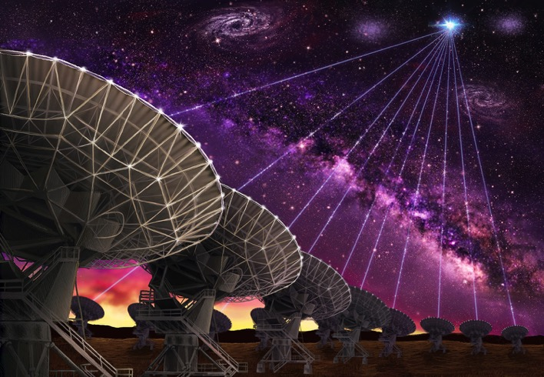
Precision Localization of FRB 121102 with the Very Large Array
Casey Law
University of California, Berkeley
claw@astro.berkeley.edu; (510) 859 3636

Slide 4
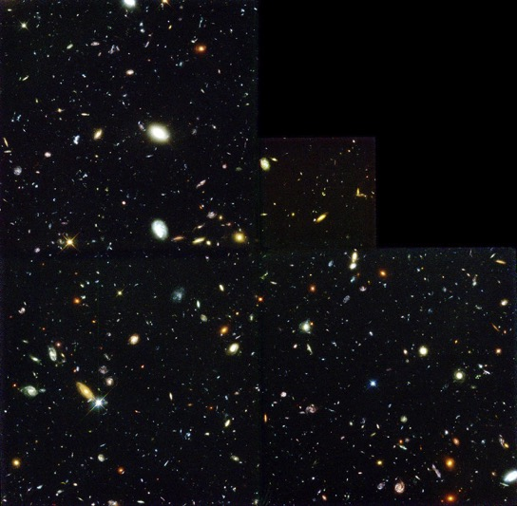
Where’s the FRB?
Arecibo localization
VLA localization
Casey Law — @caseyjlaw

Slide 5
Millisecond radio imaging with the VLA
100x faster = 100x more data.
Finding a needle in a Terabyte haystack.
Casey Law — @caseyjlaw

Slide 6
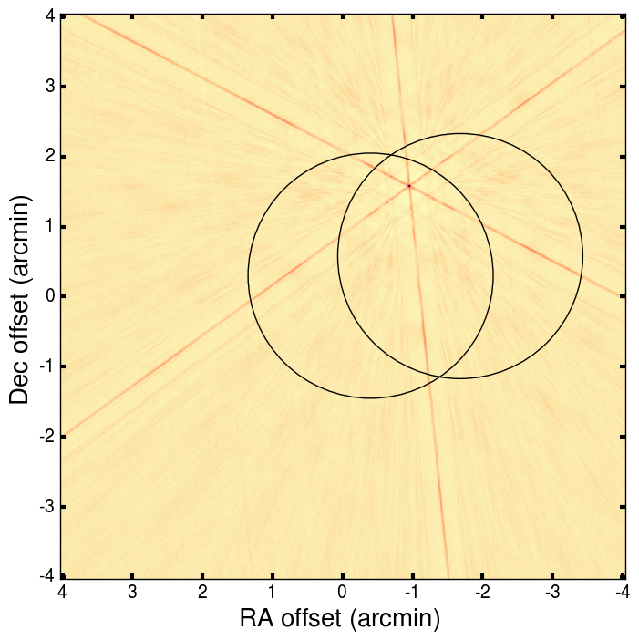
Finally, on 23 August 2016…
Casey Law — @caseyjlaw

Slide 7
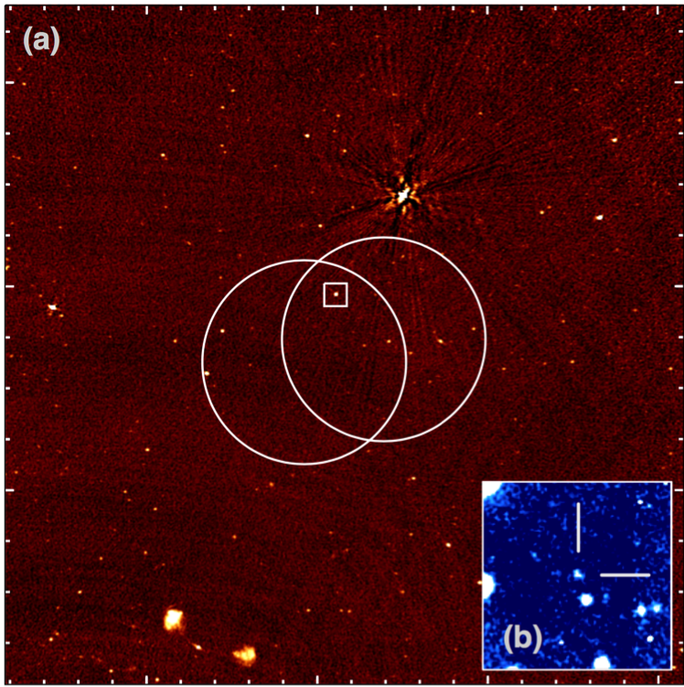
Where’s the FRB?
There it is!
(9 times!)
Faint persistent optical + radio counterpart.
Casey Law — @caseyjlaw

Slide 8
FRB 121102 : Closing in on a Fast Radio Burst
Shami Chatterjee shami@astro.cornell.edu
Casey Law claw@astro.berkeley.edu
Jason Hessels J.W.T.Hessels@uva.nl
Shriharsh Tendulkar shriharsh@physics.mcgill.ca
Sarah Burke-Spolaor sspolaor@nrao.edu
High-Res Artwork:
https://www.dropbox.com/sh/v1rt8rx9cc5qbnb/AAA71nNscgiHy-dwncWwcpJ1a?dl=0

