Slide 1
MORE MYSTERY OBJECTS DETECTED
NEAR MILKY WAY’s
SUPERMASSIVE BLACK HOLE
Randall Campbell, W. M. Keck Observatory
Anna Ciurlo, University of California Los Angeles
Mark Morris University of California Los Angeles
Andrea Ghez University of California Los Angeles
Tuan Do University of California Los Angeles
Gunther Witzel University of California Los Angeles
Breann Sitarski Giant Magellan Telescope
Rainer Schödel Istituto de Astrofisica de Andalusia
randyc@keck.hawaii.edu; (808) 557-6548
ciurlo@astro.ucla.edu; (310) 873-7603
Notes:
New measurements of existing data spanning the last 12 years
- We first set out to look at the gas dynamics in the very central region
- and found Perhaps some interesting results
- Galactic center team
- Tag team presentation
- VS program

Slide 2
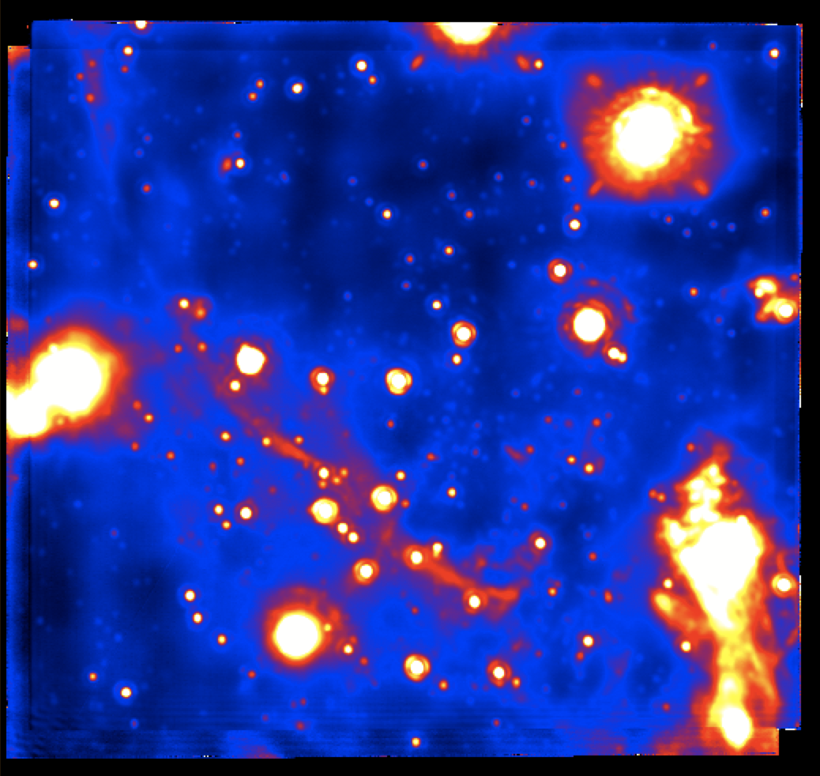
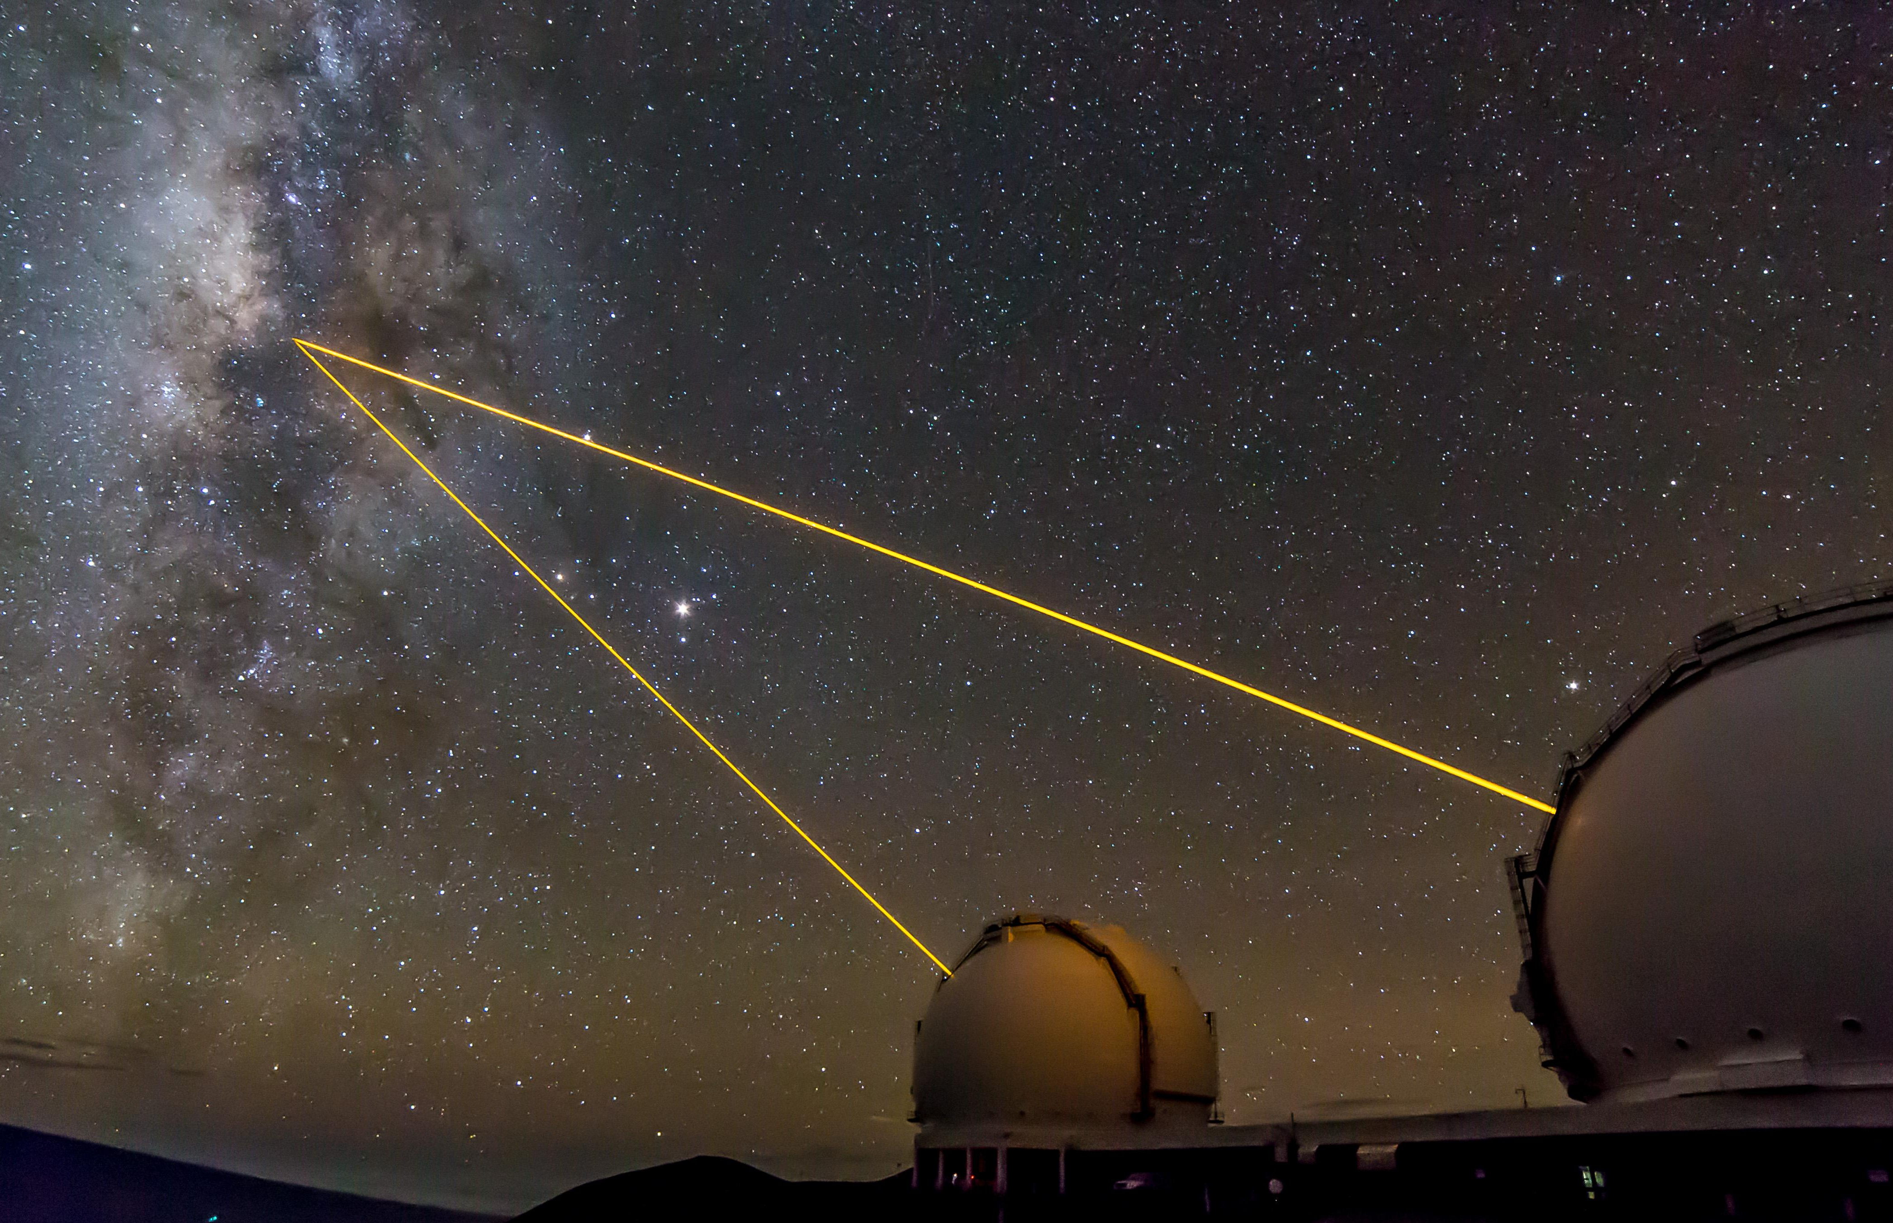
At the Galactic Center with Keck
0.5 light years
Keck NIRC2
Sgr A*:
SMBH → 4 10⁶ M⊙ within 0.1 pc
(Ghez+ 2003)
Central star cluster: S-stars
Hot early-type stars
(Ghez+1998, Paumard+2006)
©2016 Andrew Cooper
Andrew Cooper / WMKO
Notes:
SMBH at MilkyWay GC, of course everyone knows this by now
- Well Studied in IR using Keck LGSAO
- past focus has been on stars
- S cluster of hot young starts, lots of debate about
- Campaign this year to observe SO-2 closest approach , test of GR

Slide 3
At the Galactic Center with Keck
0.5 light years
Keck OSIRIS
Keck NIRC2
Images at multiple colors
=
a spectrum for each pixel
©2016 Andrew Cooper
Andrew Cooper / WMKO
Notes:
We’re mostly using OSIRIS measurements
- Integral Field Spectrometer
- Data include both high spatial resolution images
- and medium resolution spectroscopy
- data product is a cube
- image at every wavelength and spectrum at every pixel of the image

Slide 4
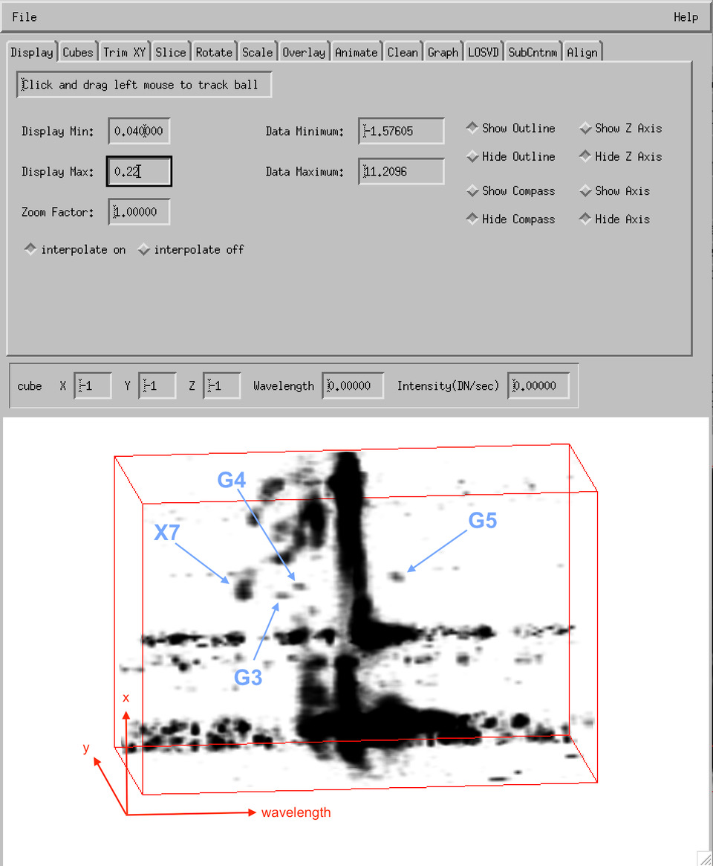
OsrsVol: a 3D view of data
Spectro-imaging 3D-visualization tool (Campbell+ 2012, ESO Messenger)
Spectro-imaging data Complex region → need tool to disentangle
Remove stellar continuum to see the gas
2013 OSIRIS
Notes:
Since the data are 3-D its natural to visualize in 3-D using “Volume Display"
- created a tool that makes it convenient and fun
- Use 3-D visualization tool, OsrsVol
If we look a specific emission feature from atomic Hydrogen, namely Bracket Gamma
- The tool helps us distinguish certain features
- that are isolated by spatial position and velocity
- For example this red circle shows blue doppler shifted

Slide 5
Detection of (more) G-objects
G3, G4 & G5
similar to G1 & G2
(Witzel+2014, 2017)
G-objects → dusty stellar objects:
Hydrogen line emission
Very red : much colder than any normal star (< 500–600 K)
Compact sources
Tight orbits around SMBH (orbits similar to S-stars)
2013 OSIRIS, Br𝛾
G3 → D2 in Eckart+2003
X7 → Mužić+2009
Notes:
Found 3 objects with characteristics similar to G1 and G2 (Witzel 2017, 2014)
- calling them G3,4, and 5
- G3 and X7 have been noted in previous papers , cite references
- highlight objects in 3-D image
- X7 subject of another study (not G-object)

Slide 6
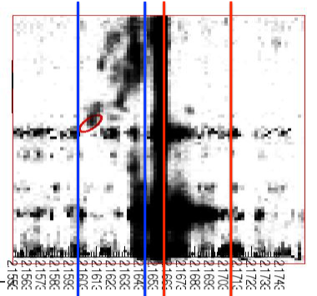
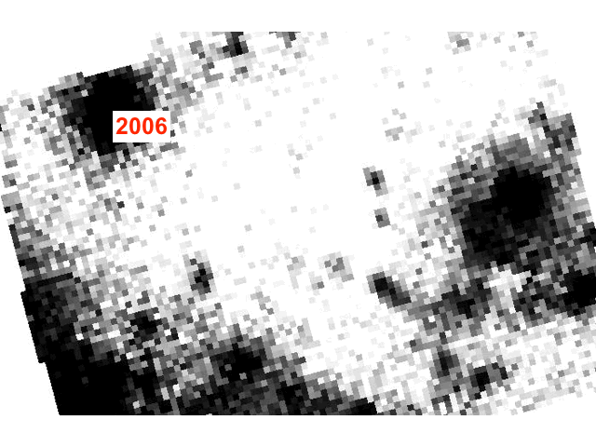
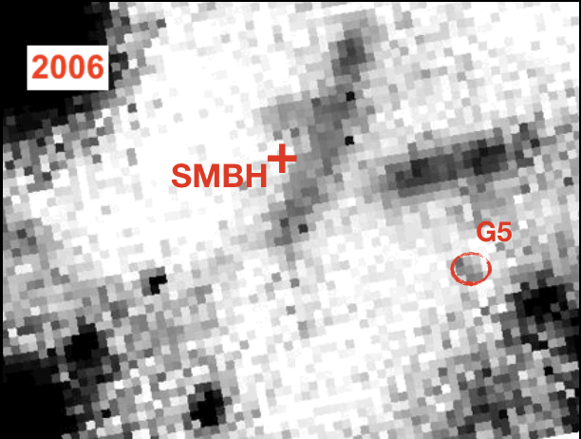
12 years of data: see objects move!
y
𝛌
Blueshifted features
Redshifted features
G4
+
+
SMBH
SMBH
G3
G5
X7
Notes:
Detect and measure proper motion over the 12 years
- We also can measure changes in velocity using the same data
- G3 and G5 in particular have significant changes in velocity over this time scale
- G1 and G2 higher velocities and are doppler shifted outside of shown slices
- These animations are split by doppler shift,
- Blue shifted features show the motion of G3 and G4
- Red shifted features show G5

Slide 7
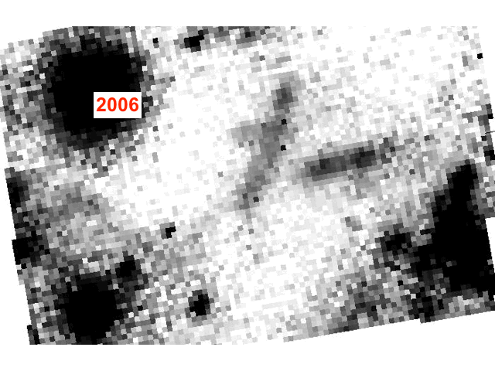
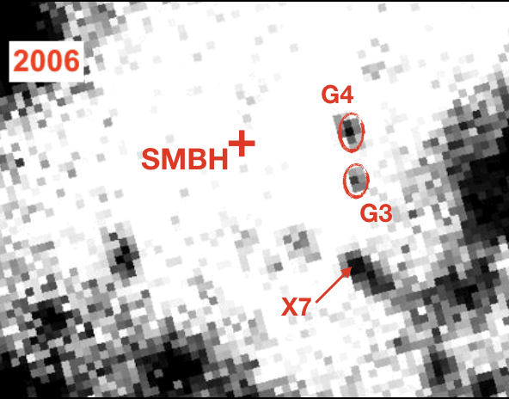
12 years of data: see objects move!
y
𝛌
Blueshifted features
Redshifted features
G4
+
+
SMBH
SMBH
G3
G5
X7
Notes:
Detect and measure proper motion over the 12 years
- We also can measure changes in velocity using the same data
- G3 and G5 in particular have significant changes in velocity over this time scale
- G1 and G2 higher velocities and are doppler shifted outside of shown slices
- These animations are split by doppler shift,
- Blue shifted features show the motion of G3 and G4
- Red shifted features show G5

Slide 8
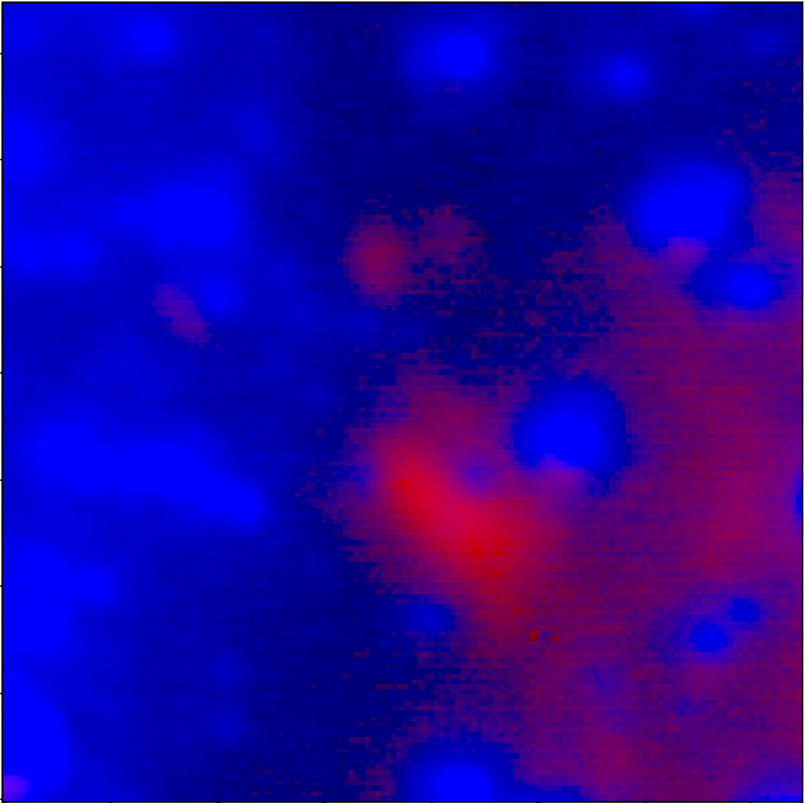
Thermal infrared detection
G3
(G2)
G4
+
SMBH
G5
G1
X7
2014 NIRC2 Kp & Lp
Notes:
One of the G characteristics is a very red color in K-L
- This K-L image shows good detection of G3 and G4
- G5 may be confused by the X7 feature in a pure image
- one reason why the IFU data are so powerful in identifying these objects

Slide 9
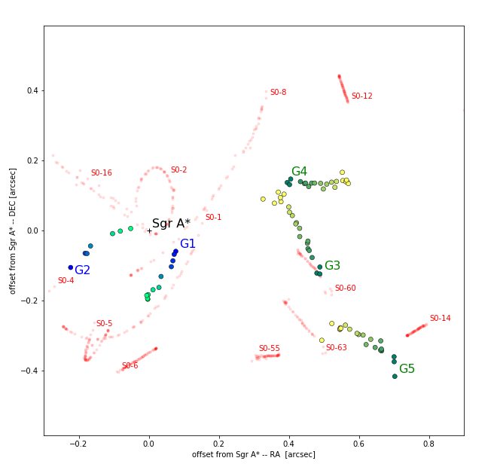
In orbit around SMBH
motion direction
orbit model
stars
G-objects (old, new)
2006
2017
2003
2014
G3
period ~ 200 yrs
almost circular orbit
G5
closest approach ~ in 15-30 yrs
very eccentric orbit
G4
headed out (to return in 400 years?)
orbit not well determined
Preliminary!
Notes:
Using our proper motion and velocity measurements, we’re able to fit orbits
- Green to yellow dots
- positional measurements
- show time progression
- These objects are distinct as compared to the S star orbits
- Discuss G3 orbit, circular,
- coming out of the page toward you
- G5 going towards the black hole,
- maybe close in about 20-30 years
- moving away from us into the page
- G4 orbit not well constrained
- may return in a century or so.
- more data will help constrain these orbits
- as well as further explore the G - characteristics

Slide 10
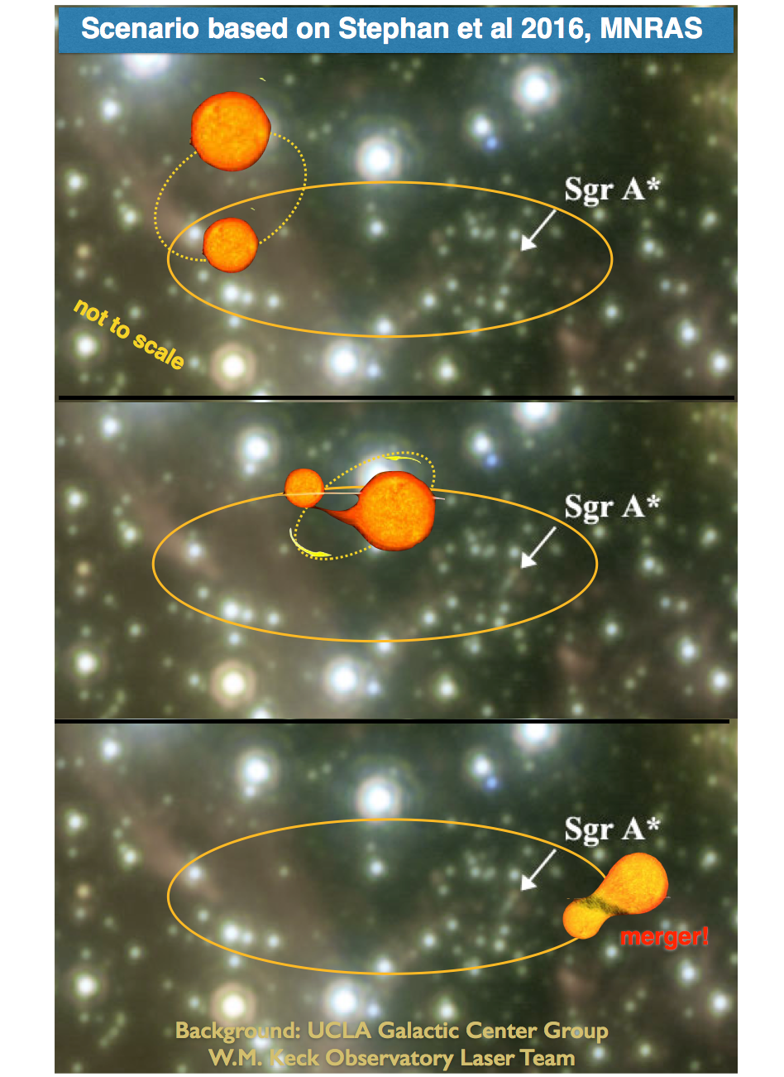
What are they?
influence of SMBH
G-objects = stellar mass surrounded by thick dust & gas
→ puffed up star
Binary mergers (Stephan+2016)
In vicinity of SMBH → higher tendency to merge
G-object being more common supports this hypothesis
G-objects progenitors of S-stars? (Stephan+2016)
S-stars: young, bright & very massive stars
G-objects orbits similar to S-stars
preferred explanations
orbits more elliptical
more massive stars
merge
Notes:
Mystery objects, What are they?
- Based on G1 and G2 surviving closest approach to Sgr A*
- They must be massive
- The extreme red color implies they’re blanketed by thick dust
- The hydrogen emission is evidence of excited gas , at least in the outer atmosphere
- Merger, currently preferred explanation, mergers (Stephan, 2016)
- Stephan 2016 compute that many of the binaries in the presence of the SMBH will be perturbed enough to merge
G object being common may support this hypothesis
perhaps an explanation for the S young star cluster
Once the thick and gas and dust are gone, reveal young looking hot star

Slide 11
Summary
12 years of Keck spectro-imaging data + osrsVol
New brighter G-objects
Origin & future?
Continue to closely follow them
Result of binary mergers?
Progenitors of S-stars?
randyc@keck.hawaii.edu; (808) 557-6548
ciurlo@astro.ucla.edu; (310) 873-7603
Notes:
To Summarize
- Looking at Br Gamma features over time near SgrA* has reveal more G like objects
- Having more of these ID’d, good for future study and solving the “mystery of the G objects"

Slide 12
Summary
12 years of Keck spectro-imaging data + osrsVol
New brighter G-objects
Origin & future?
Continue to closely follow them
Result of binary mergers?
Thank you!
Progenitors of S-stars?
randyc@keck.hawaii.edu; (808) 557-6548
ciurlo@astro.ucla.edu; (310) 873-7603
Notes:
To Summarize
- Looking at Br Gamma features over time near SgrA* has reveal more G like objects
- Having more of these ID’d, good for future study and solving the “mystery of the G objects"

Slide 13
Extra slides

Slide 14
What are they?
influence of SMBH
G-objects = stellar mass surrounded by thick dust & gas
→ puffed up star
Binary mergers (Stephan+2016)
In vicinity of SMBH → higher tendency to merge
G-object being more common supports this hypothesis
G-objects progenitors of S-stars? (Stephan+2016)
S-stars: young, bright & very massive stars
G-objects orbits similar to S-stars
preferred explanations
orbits more elliptical
more massive stars
can create stellar mass black holes
LIGO events:
black holes that are more massive and higher merger rates (same process but different binaries)
Notes:
- Mystery objects, What are they?
- Based on G1 and G2 surviving closest approach to Sgr A*
- They must be massive
- The extreme red color implies they’re blanketed by thick dust
- The hydrogen emission is evidence of excited gas , at least in the outer atmosphere
- Merger, currently preferred explanation, mergers (Stephan, 2016)
- Stephan 2016 compute that many of the binaries in the presence of the SMBH will be perturbed enough to merge
- G object being common may support this hypothesis
- perhaps an explanation for the S young star cluster
- Once the thick and gas and dust are gone, reveal young looking hot star

Slide 15
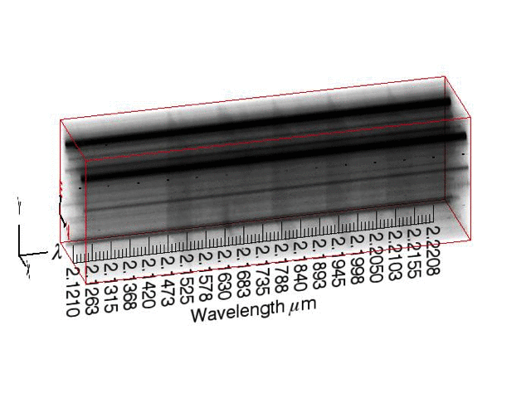
OsrsVol: a 3D view of data
Spectro-imaging 3D-visualization tool (Campbell+ 2012, ESO Messenger)
Spectro-imaging data Complex region → need tool to disentangle
Remove stellar continuum to see the gas
2013 OSIRIS
Notes:
- But the density of stars muddies what this study is trying to look at which is the gas
- subtract out the stars and highlight the emission gas emission features

Slide 16
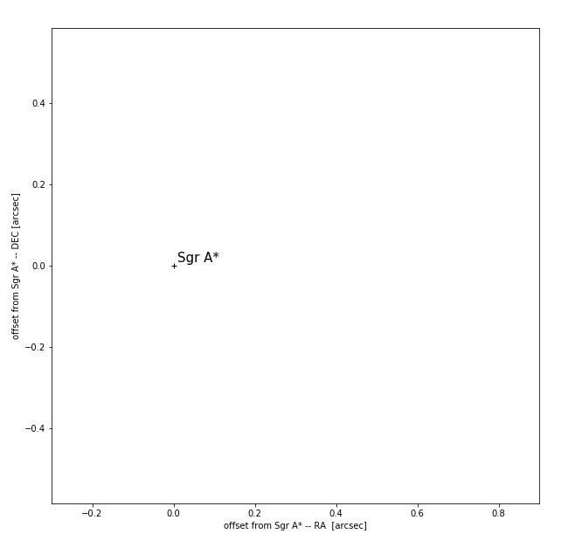
Notes:
→ other option for model showing

Slide 17
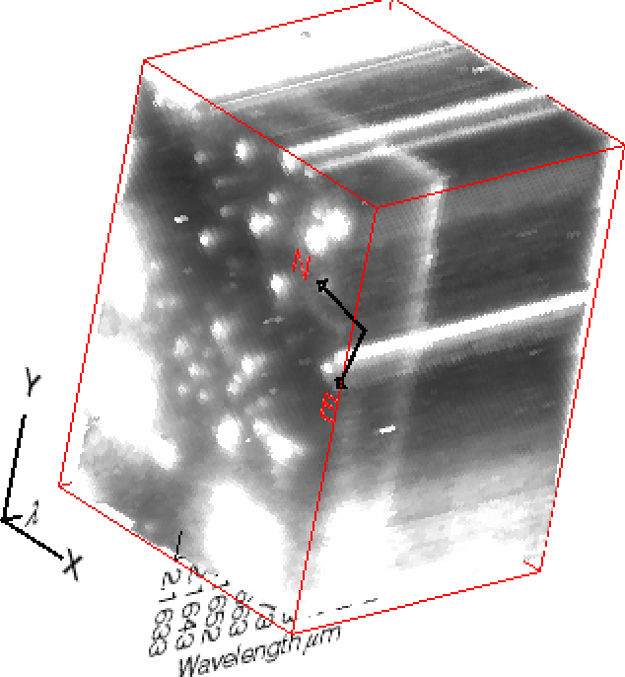
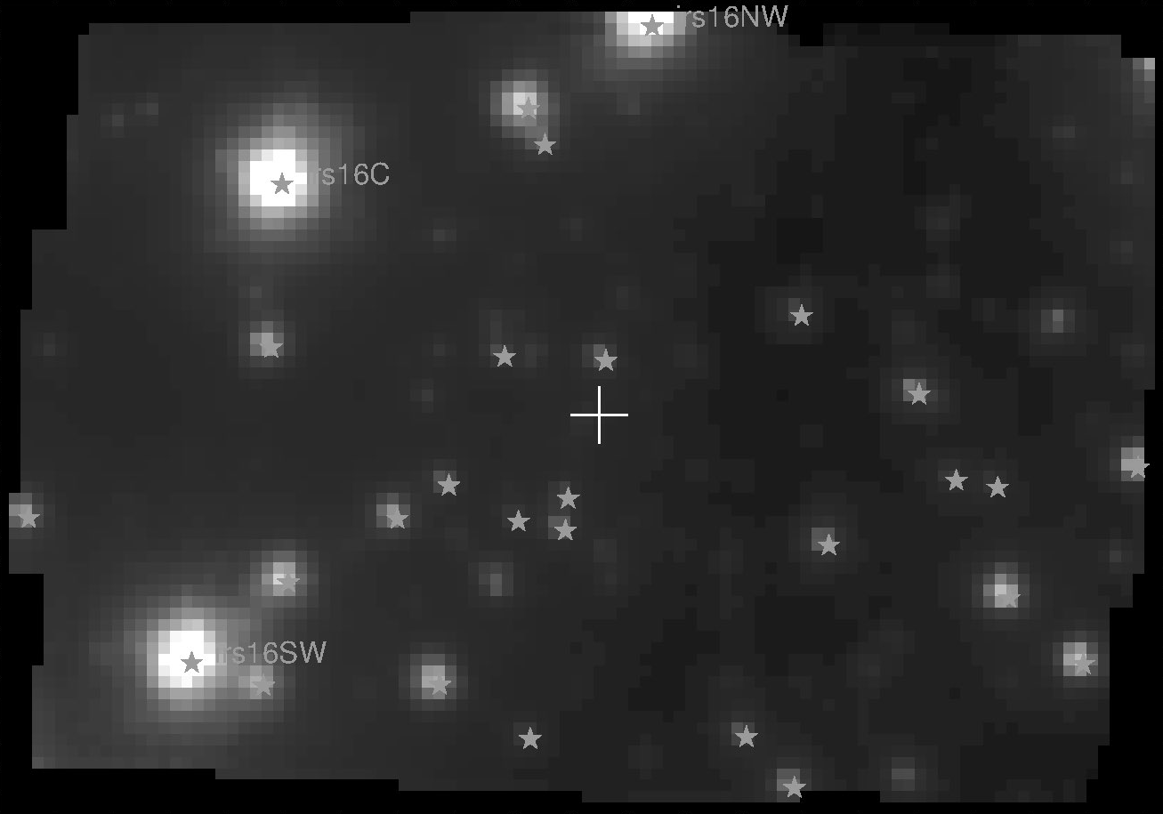
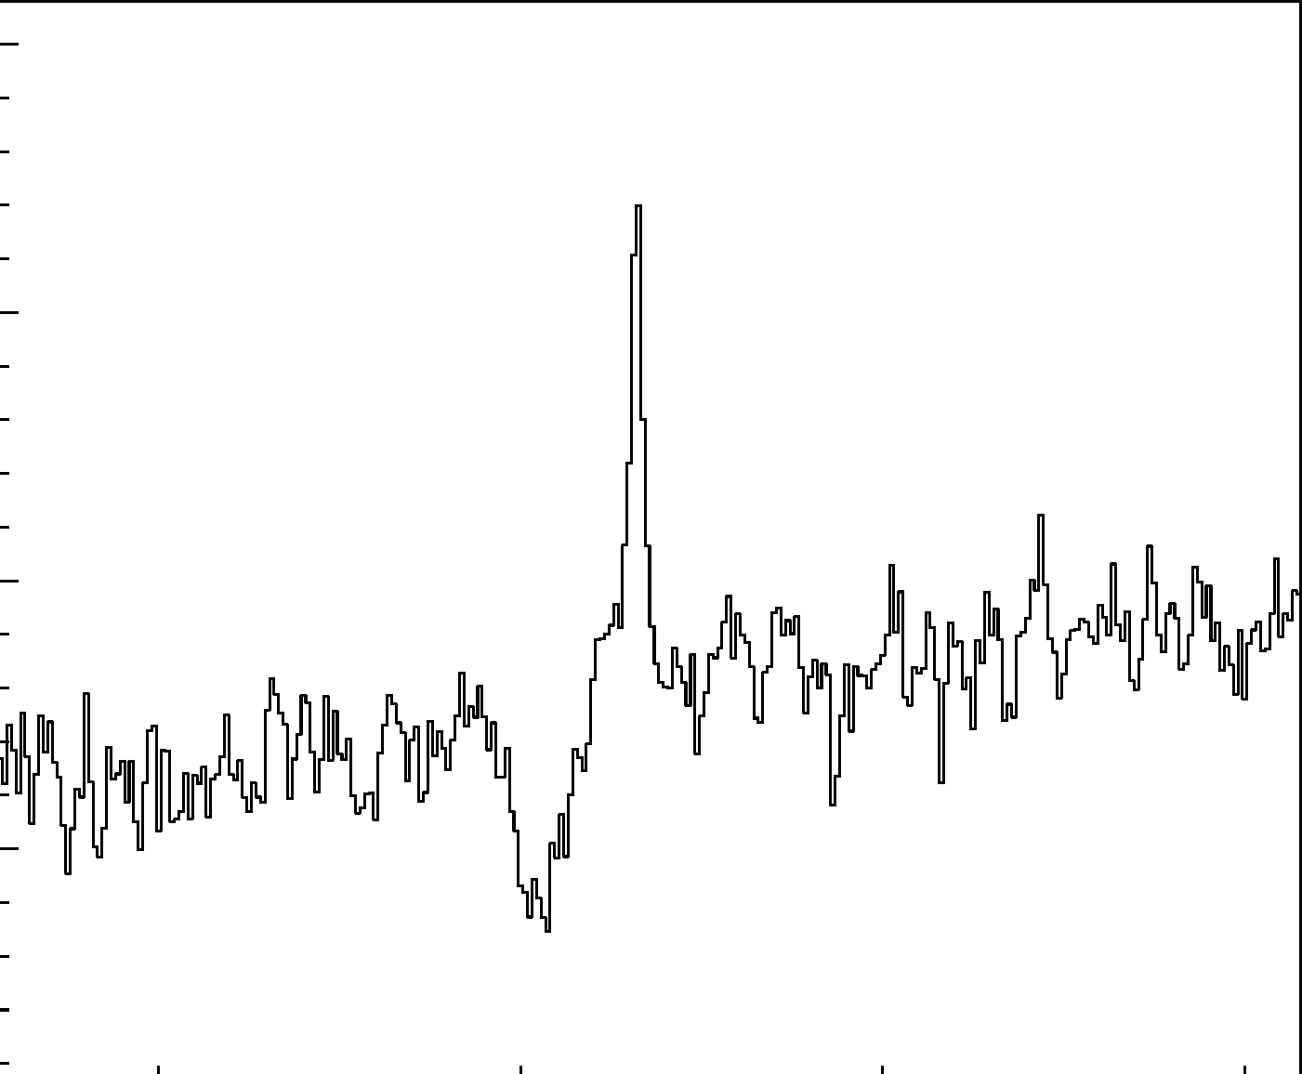
Spectro-imaging datacubes
image
spectrum
Images at multiple colors
=
a spectrum for each pixel
SMBH
Intensity
Wavelength

Slide 18
Read a spectrum
gas
spectrum
Intensity
star
Wavelength

Slide 19
Redshift/blueshift
spectrum
observer
Wavelength

Slide 20
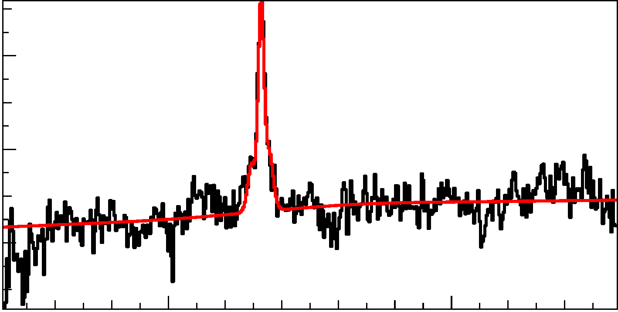
Model the gas emission
model
Example of data analysis:
For every pixel (=every spectrum) model gas emission
Model measures gas intensity
Create map of gas distribution
Intensity
Wavelength
Raw image that only show stars
Image showing gas emission
SMBH
SMBH

