Slide 1
Interstellar Dust Grain Alignment – Why Do We Detect Polarization?
B-G Andersson
SOFIA Science Center/USRA
bg@sofia.usra.edu
C: (410) 963-6052
Supported by NSF (Award: 1715867) and SOFIA Cy 4 & 5 grants

Slide 2
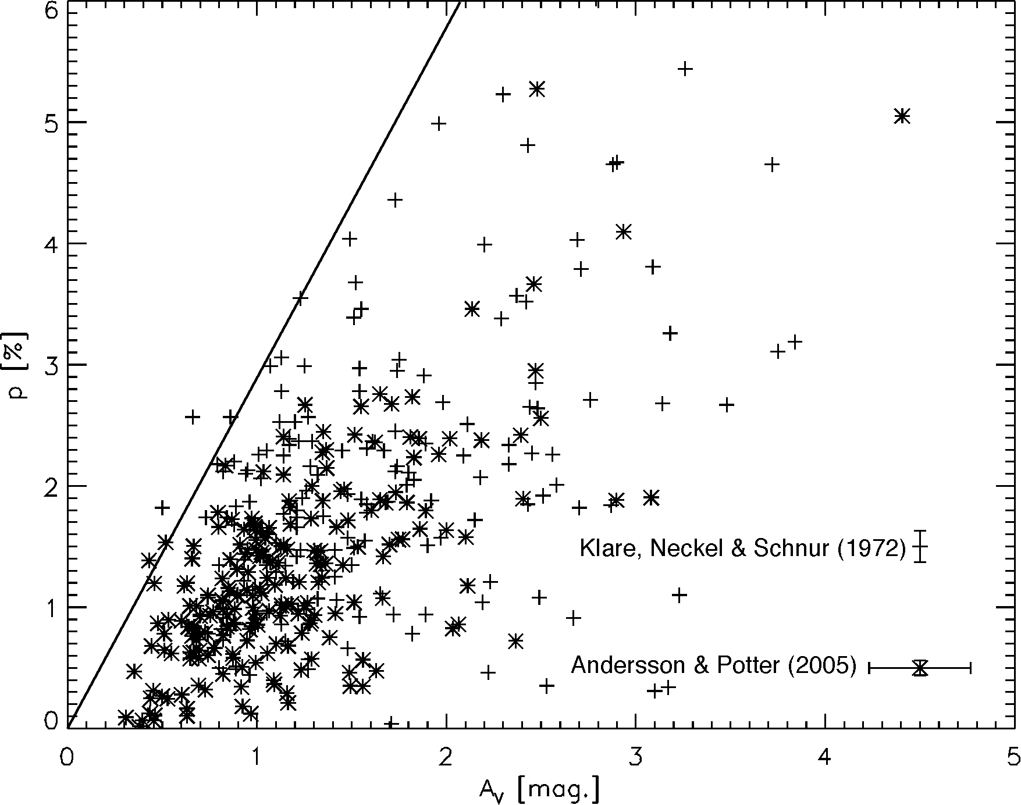
Aligned Dust Grain Cause Polarization…
Interstellar polarization was discovered already in 1949.
It is generally due to aligned, elongated dust grains
The polarization usually traces the dust and the magnetic field
Most astronomers assume that this is always true - But is it, really?
The micro-physics of the grain alignment has remained unclear, up until this decade.
To reliably use the polarization we must understand where it traces the magnetic field
Our group has been observationally probing grain alignment physics for the last decade

Slide 3
To Cause Polarization the Grains Must Line Up
A dust grain in interstellar space will initially rotate around a random axis (and wobble).
To cause polarization an individual grain first has to align its rotation with one of its “principal axes” (so it has a fixed projection)
Then, “all” the grains have to line up along a common direction
What causes this alignment?

Slide 4


Radiative Alignment Torque (“RAT”) Theory
“RAT” theory (developed since the mid-1990’s) predicts that grains are spun up by light (similar to a spinner being blown on)
For the interstellar “sand” this rotation causes an interaction with the magnetic field and aligns the grains with the field direction
  The other grain type – “soot” – should not “see” the magnetic field, but could be aligned along the direction of the radiation
An observationally well supported, quantitative theory of grain alignment, allows us to more reliably probe the magnetic fields
Provides new probes of the ISM
At this AAS we present two new test of RAT alignment
B

Slide 5
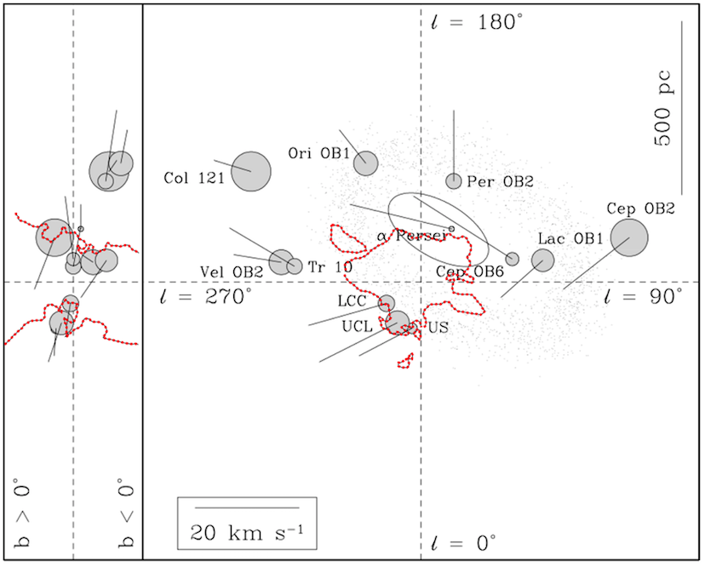
The Strength of the Radiation Affects the Alignment
Medan & Andersson (poster 247.13) has probed the grain alignment in the wall of the Local Bubble.
Using the polarization from 1066 field stars we showed that the grain alignment efficiency is driven by the brightness and distance to the hot stars in the near-by OB-associations
Top-down view (right) of the Galactic plane around the Sun. The Local Bubble is outlined in red. Gray circles show the locations of near-by OB associations
The grain alignment efficiency across the Local Bubble wall (averaged over Galactic latitude of b=30-42˚) is well matched by the radiation strength from the local OB-associations

Slide 6

Radiation Aligns Carbonaceous Grains (“soot”)
To align with the magnetic field, a grain must be “paramagnetic”
(They must have free, unpaired quantum spins in the solid)
Silicate grains (“sand”) are, but carbonaceous grains (“soot”) are not
  RAT therefore predicts that carbon grains do not align in the ISM
RAT does predicts that for strong radiation fields, the alignment direction (for any grain) becomes the direction of the radiation.
To test carbon grain alignment we observed IRC+10216 with SOFIA/HAWC+ (Andersson et al., Pres. 414.04)
The dust in the envelope of IRC+10216 is carbonaceous
The IRC+10216 envelope is radially polarized
The amount of polarization follows the dust temperature
These results supports RAT alignment of carbon grains

Slide 7
Summary:
We present two new tests of modern grain alignment theory
Our results – and the theory work, primarily by the U. Wisconsin group – are “finally” putting grain alignment on an solid footing.
This allows polarization measurements to be more reliably interpreted in terms of magnetic fields and provides new tools for understanding the interstellar medium.
Presentations:
Poster Presentation 247.13, (Medan & Andersson) on Wednesday
Oral Presentation 414.04, (Andersson et al.) on Friday, 10:30am
Further (background) information:
Andersson, Lazarian & Vaillancourt, ARA&A, 2015, 53, 501
http://astrob-g.net/grain-alignment

