Slide 1
Notes:
I'm reporting on work I did in collaboration with 6 undergraduates from the
College of Saint Benedict/Saint John’s University over a 10 year period.
In addition to data we collected ourselves, we also used data from the
American Association of Variable Star Observers.

Slide 2
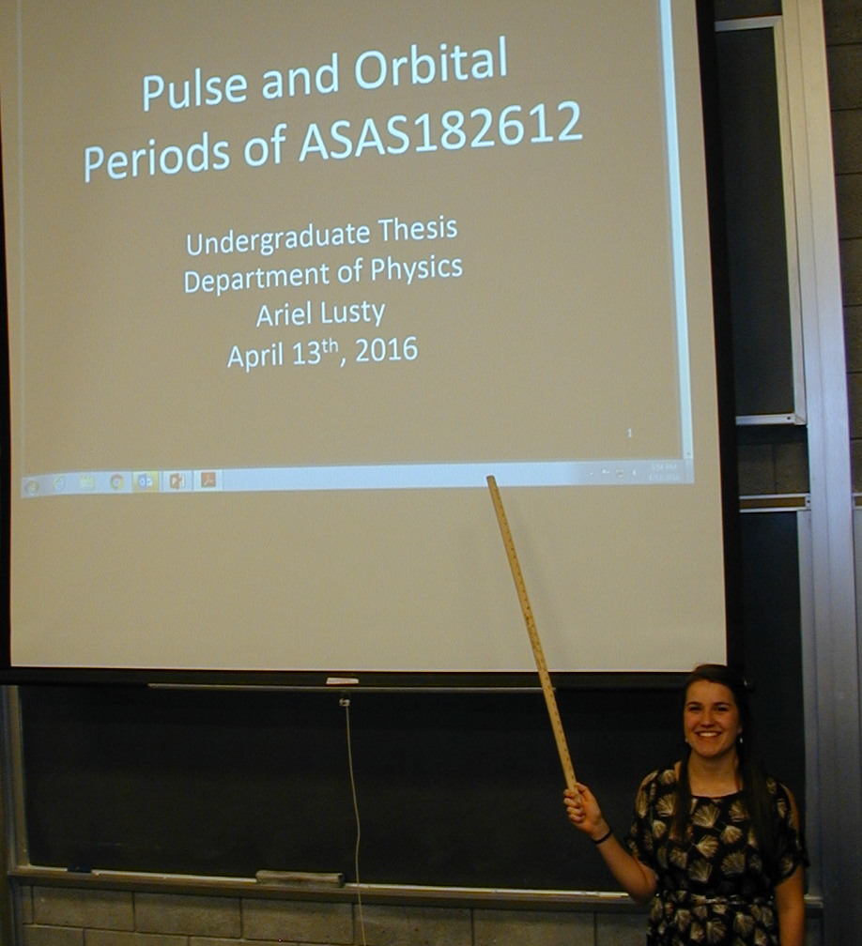
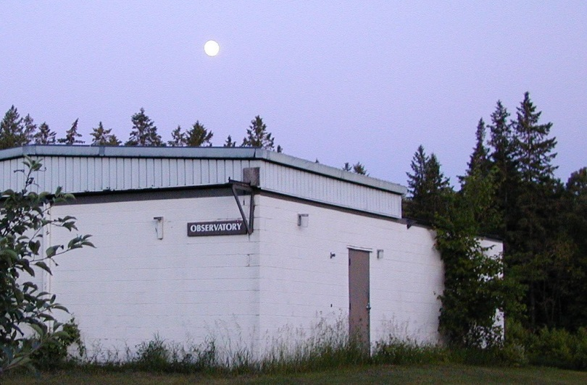
Notes:
The student work was for their undergraduate theses. When the weather was favorable, they could make a 2 block
walk to our observatory where using basically amateur-level equipment they could measure
stellar brightness, and at the end of term defend their thesis

Slide 3
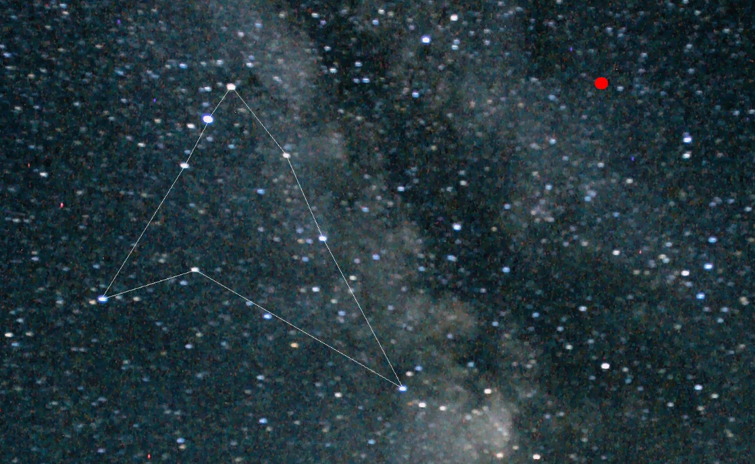
2005: reported variable by Pojmański et. al
2007: reported eclipsing by Antipin et. al
2007: AAVSO observing campaign
2013: orbit details by Sipahi et. al
Notes:
The object we study (shown in the red dot) is associated with the Milky Way, while not
actually in the disk. It can be described as being across the Milky Way from Altair.
However its about 1000 times further away than Altair. Other things being equal that would
make it a million times fainter than Altair, and thus too dim for our scope. However the
two stars in this object are both giant stars: 15 and 25 times the radius of the Sun, making them
only about 1/10,000 as bright as Altair; in range of our scope.
This object was discovered a bit more than a decade ago,
and exactly ten years ago AAVSO launched a planet-wide campaign to study it, and we have
been observing it since the start of that campaign.
Again, what we measure is only the total brightness of this object over time.

Slide 4
Notes:
We believe if we could resolve this object in detail we would see a pair of giant stars
orbiting about each other. The Cepheid variable is the larger star ballooning in and out.
The darker object is also a bright star, just slightly cooler than the Cepheid;
its shaded gray in contrast to the brighter Cepheid.
As you can see there are partial eclipses; the more prominent eclipse occurs
when the cool star blocks the light from the hotter star.
Now this is a bit of a surprise. Cepheids are rare;
binary stars aren't particularly rare, but being in the orbit plane so we can see
eclipses is rare. However, given a Galaxy of stars such objects are essentially statistically certain to exist. The surprise is that we
actually found this needle in a haystack.

Slide 5
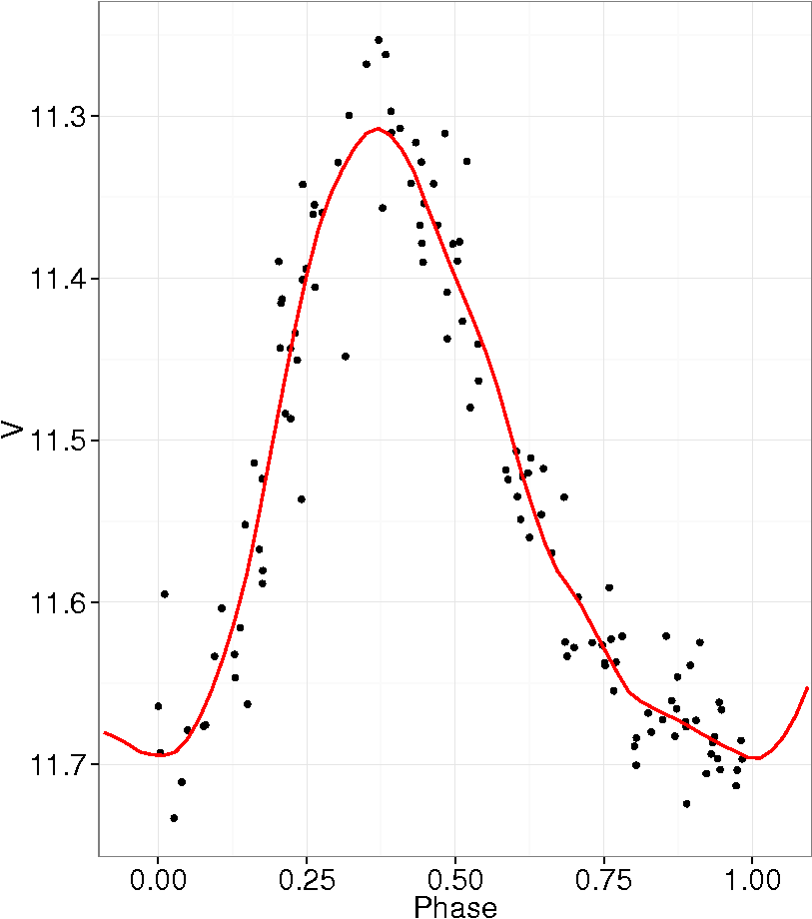
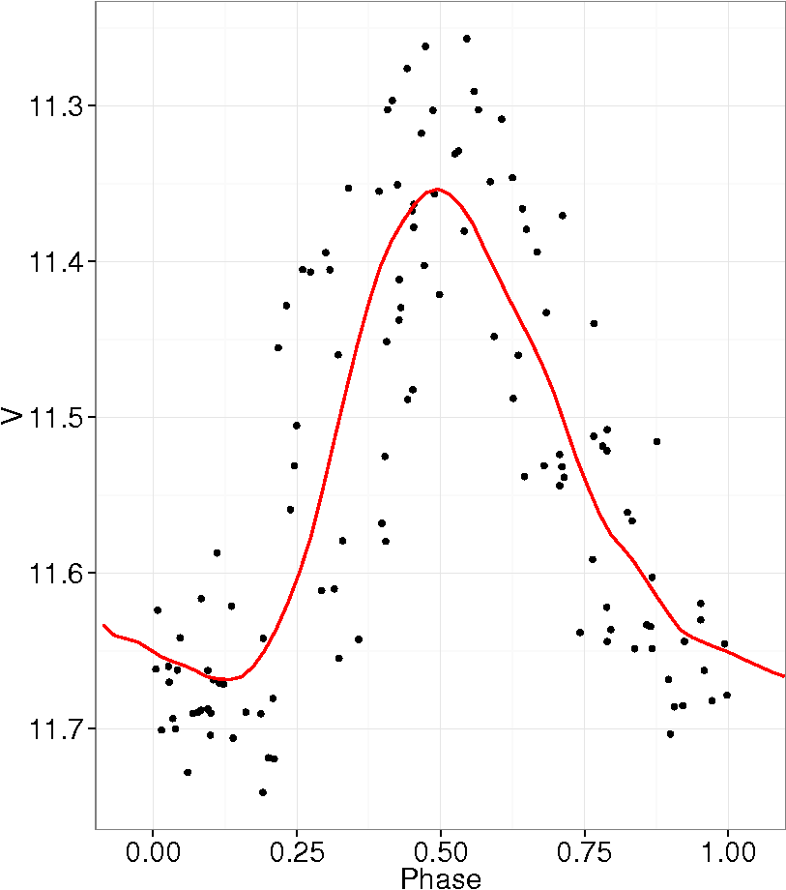
Continuous light curve as might be observed from a space telescope. At CSB/SJU observatory we might populate this span with 10-20 observations. We can model this data to determine the orbital contribution and pulse period.
Remove the orbital contribution.
The model provides pulse period. Break the data into individual cycles.
Avoid using data when in eclipse
Stack cycles
Notes:
This shows what we might theoretically measure: the combined brightness of the object as
a function of time. Here you can easily see each pulse along with the sinusoidal
background caused by the varying view angle on the gravitationally elongated
stars. The eclipses are a bit lost in all this variation.
However, perfectly clear nights are rare in MN so instead of having this smooth curve,
we'd have 10-20 actual observations, which makes discerning the
trend more difficult; we rely on computer modeling to pick out the orbital
contribution and the pulse period.
If we remove the orbital contribution
separate each cycle using the models pulse period
drop observations during eclipses
and stack the resulting cycles
we get something like this.
Now what was happening during our decade of observations was an unhappy surprise:
instead of the average behavior emerging, fits got sequentially worse
(this shows the last thesis result). This can happen if the modeling produces
an incorrect pulse period (so different phases are collected together)
or if the pulse period is changing.
Joe Hoppert was my first student to suggest looking at changing pulse periods.
Now stars changing much in a human lifetime would be a surprise.
One of the problems in with working with undergraduates is graduation happens before
"future work" occurs; so while we found evidence Joe was right we really didn't
have the smoking gun required for such a seeming unlikely possibility.
This year I'm on sabbatical, so I used my time this year to fully
curate all our and AAVSO data taken thru four different filters – essentially eight independent datasets --and do the "future work" suggest by Joe. What I found was:

Slide 6
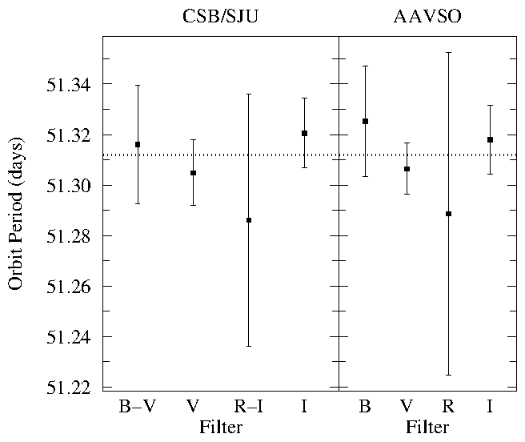
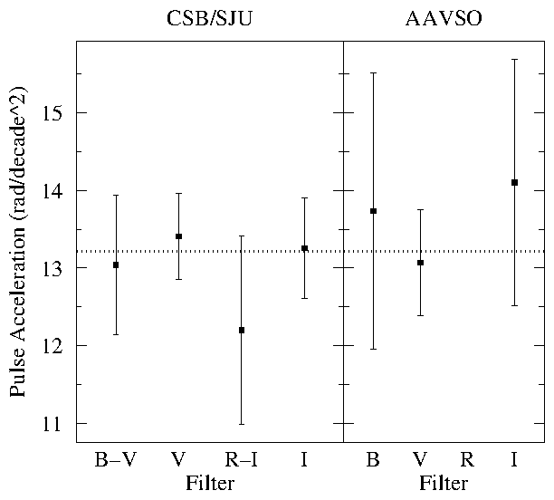
Across 4 filters and 2 datasets the models produce consistent results for
_{Orbit Period}
_{Pulse Period}
_{Pulse Acceleration}
Notes:
in all eight datasets a consistent orbital period
consistent pulse period
and SURPRISE a consistent, highly statistical significant, pulse acceleration

Slide 7
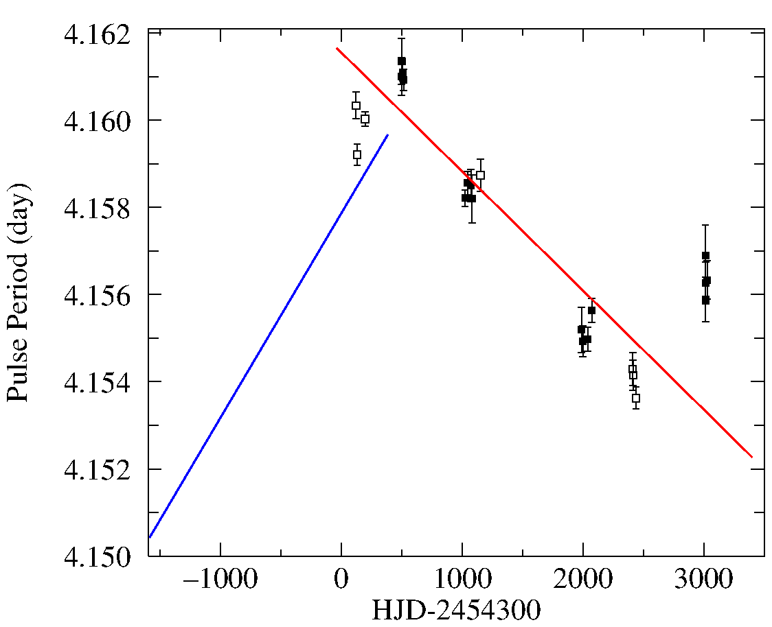
Our best fit Model Data points are no-acceleration models fit to 3 year data subsets Filled box= CSB/SJU Empty box = AAVSO
Sipahi (2013)
Pulse Period Oscillates
Erratic or Periodic?
tkirkman@csbsju.edu
Notes:
Another way of displaying the result is to show the changing pulse period
found by the modeling.
If I add the earlier work from the Turkish group we find an additional surprise:
pulse oscillation...the next question is whether this is erratic variation
or a periodically changing pulse period

