Slide 1
The Magnetic Origin of Black Hole Accretion Disk Winds Chris Shrader* (NASA Goddard Space Flight Center) Collaborators: D. Kazanas (GSFC), K. Fukumura (JMU), F. Tombesi (UMD), Ehud Behar (Technion)
This report is based on our recent article in Nature Astronomy, Fukumura et al 2017 (vol. 1,p62) and the accompanying Nature News article by J. Miller that appeared in the same volume (ARTICLE NUMBER: 0070).
Email: Chris.R.Shrader@nasa.gov
Cell: 1-240-486-1860

Slide 2
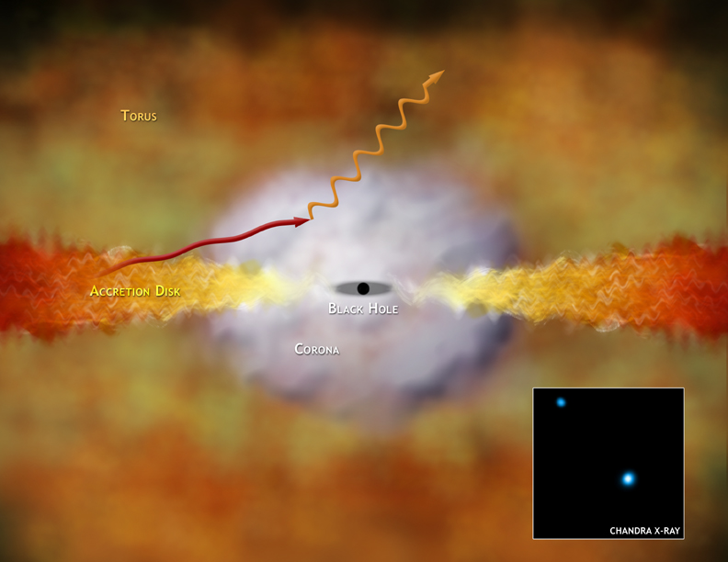
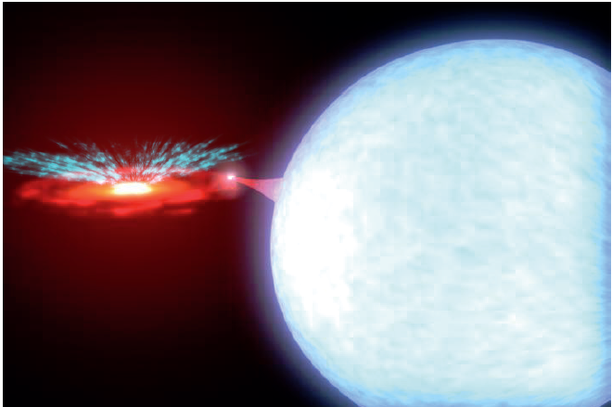
Signatures of Cosmic Black Holes
No light can escape from close to a black hole! We study them by virtue of the radiation from heated, in-falling material
They’re important! Energy released from accreting black holes is a major source of ionizing radiation in the universe
Also significant though is the matter expelled in the form of winds and jets, It can equal or exceed the in-falling mass
Winds may control the rate at which galaxies form stars
How exactly this expulsion occurs though remains illusive
The most plausible scenarios involve thermal, radiative or magnetic effects
How can we distinguish between these possibilities?

Slide 3
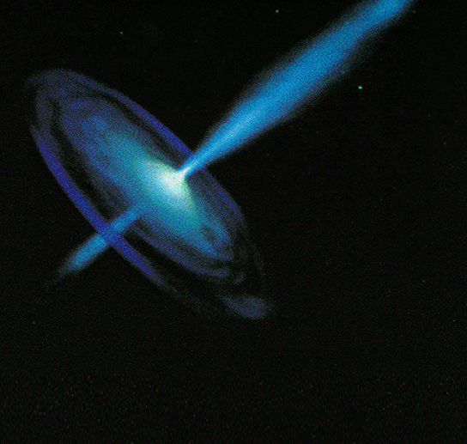
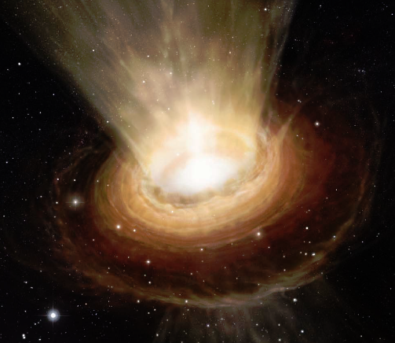
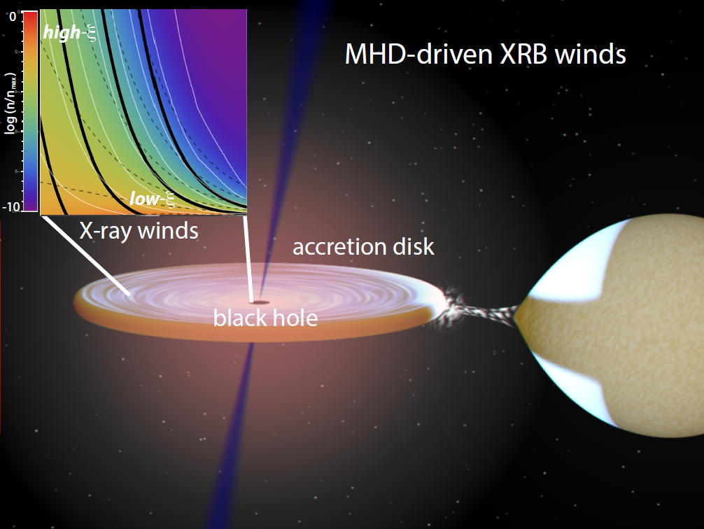
Magnetically Driven Winds
There is strong evidence for the presence of magnetic fields in accretion disks over a wide range of mass/luminosity scales
They may regulate the accretion flow
Collimated jets requiring structured fields are directly observed
We postulate that such magnetic fields threading the disks leads to wide-angle outflows, “winds”
Our Basic model:
Artist impression of jets, winds

Slide 4
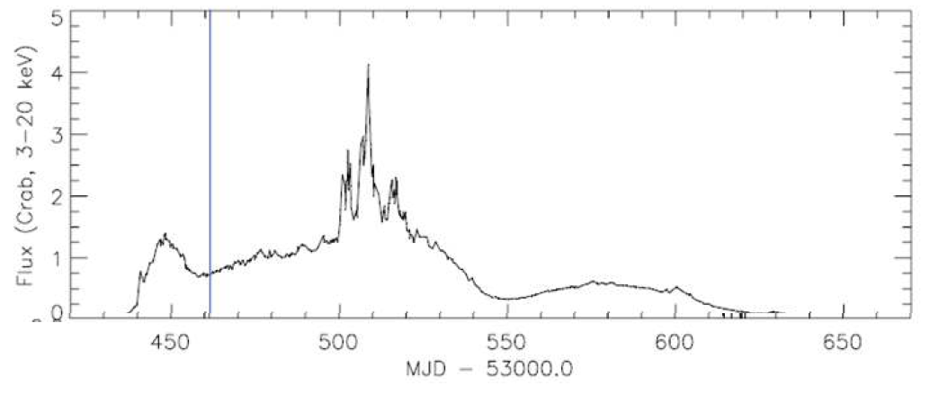
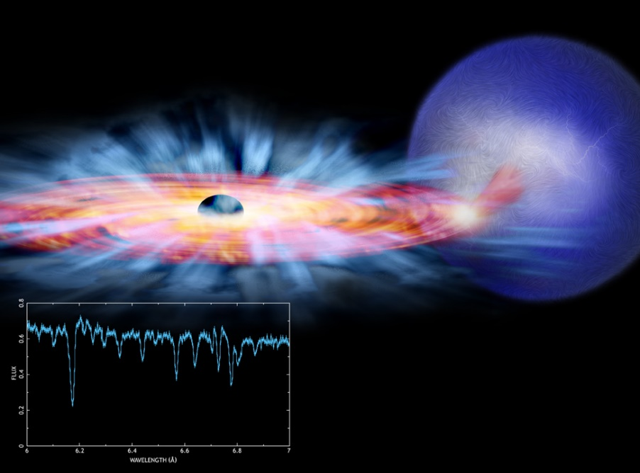
How do we test our idea? Need Bright Source & Large X-Ray Telescope
GRO J1655-40: Transient X-ray source, known to contain a black hole
Episodically becomes among the brightest sources in the X-ray sky
Observations were made with the Chandra X-ray observatory in 2005 historic outburst

Slide 5
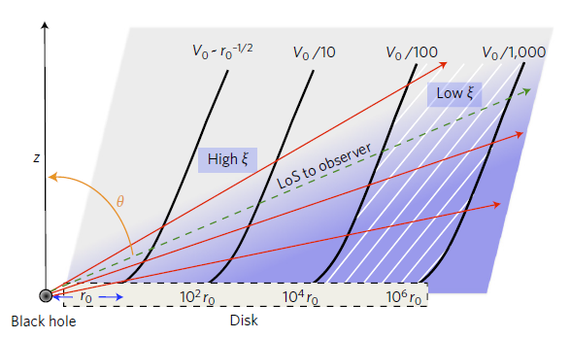
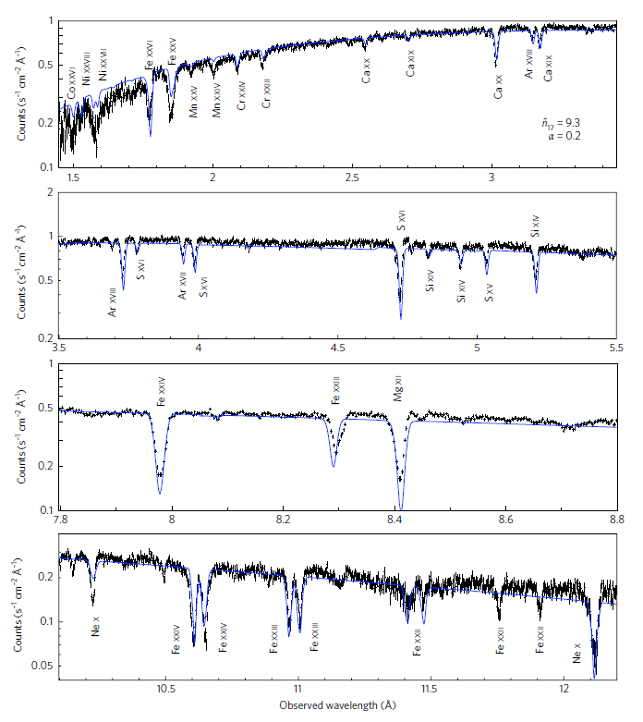
Absorption Features→ Outflowing Gas
Above: schematic of our model illustrating the mass density, velocity and ionization structure.
Right: The X-ray spectrum overlaid with our model. Not perfect, but surprisingly close representation of the widths and positions of the ~40 atomic absorption lines!

Slide 6
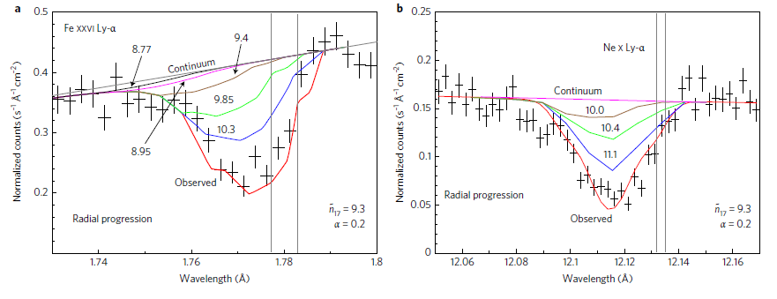
In more detail:
Lots of detail here, but the different colored curves represent different attempts of fit the data. By optimizing our model fits to the data we derive physical constraints.

Slide 7
What can we conclude?
Our model makes some specific predictions regarding the atomic absorption spectrum in the X-ray band
To a good approximation, we are able to reproduce observations made with the Chandra X-ray observatory, specifically the velocities and shapes of ~40 atomic absorption lines
We suggest that these results make a compelling argument in support of magnetically-driven outflows in black hole accretion disks

